Slide 1




Maurits W. Haverkort
Calculating photoemission, x-ray absorption, RIXS, and …
with Quanty
Institute for
Theoretical Physics

Slide 2
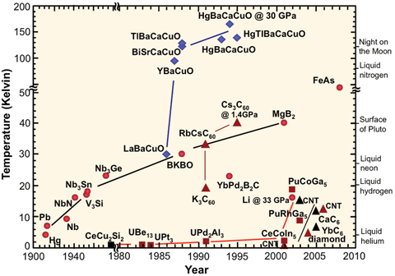
X-rays for the study of Quantum materials
Many non-trivial emergent phenomena in Quantum materials
For example high Tc superconductivity

Slide 3
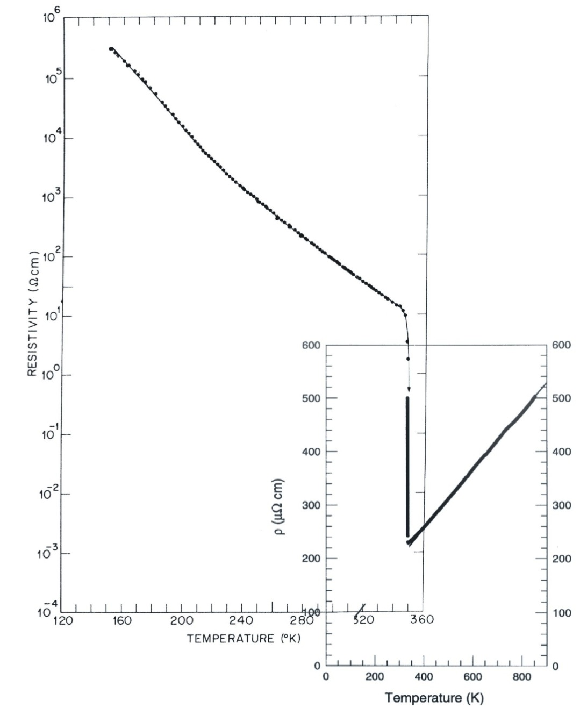
X-rays for the study of Quantum materials
Many non-trivial emergent phenomena in Quantum materials
Or metal insulator phase transitions
P. B. Allen et al.,
PRB 48, 4359 (1993)
M. Marezio et al.,
PRB 5, 2541 (1972)

Slide 4
Example metal insulator transition in VO₂
Phase transitions in simple materials
Low temperature: Insulator without excitations
P. B. Allen et al.,
PRB 48, 4359 (1993)
Intermediate temperature: Insulator with excitations
High temperature: Metal
M. Marezio et al.,
PRB 5, 2541 (1972)

Slide 5
Example metal insulator transition in VO₂
Optical gap in VO₂
P. B. Allen et al.,
PRB 48, 4359 (1993)
H.W. Verleur et al.,
Phys. Rev. 172, 788 (1968)
M. Marezio et al.,
PRB 5, 2541 (1972)

Slide 6
Example metal insulator transition in VO₂
Optical gap in VO₂
P. B. Allen et al.,
PRB 48, 4359 (1993)
Collective phenomena
H.W. Verleur et al.,
Phys. Rev. 172, 788 (1968)
M. Marezio et al.,
PRB 5, 2541 (1972)

Slide 7
Interactions between lattice, charge, orbital and spin
lattice
charge
orbital
spin

Slide 8
Challenges in describing correlated Quantum materials
Kinetic energy with mass correction term
Spin orbit interaction
Potential energy and Darwin term
Coulomb energy
For fixed nuclear positions that define the potential

Slide 9
Challenges in describing correlated Quantum materials
Kinetic energy with mass correction term
Spin orbit interaction
Potential energy and Darwin term
(Mean-field) Coulomb potential
For fixed nuclear positions that define the potential

Slide 10
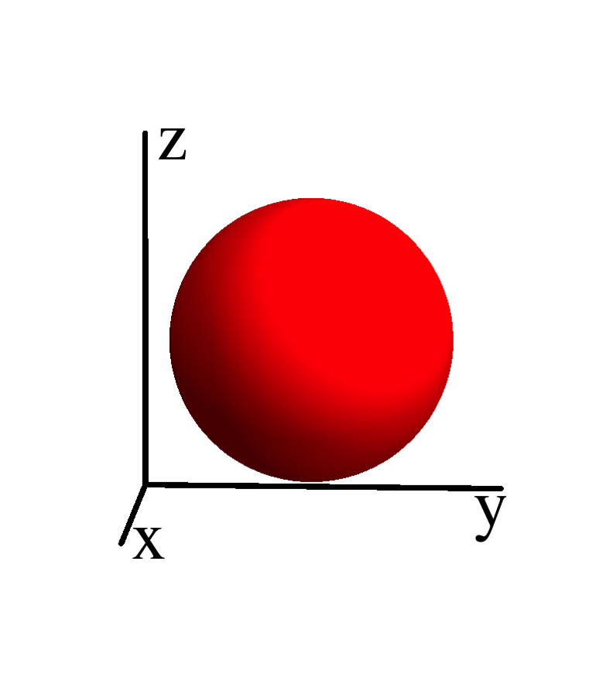
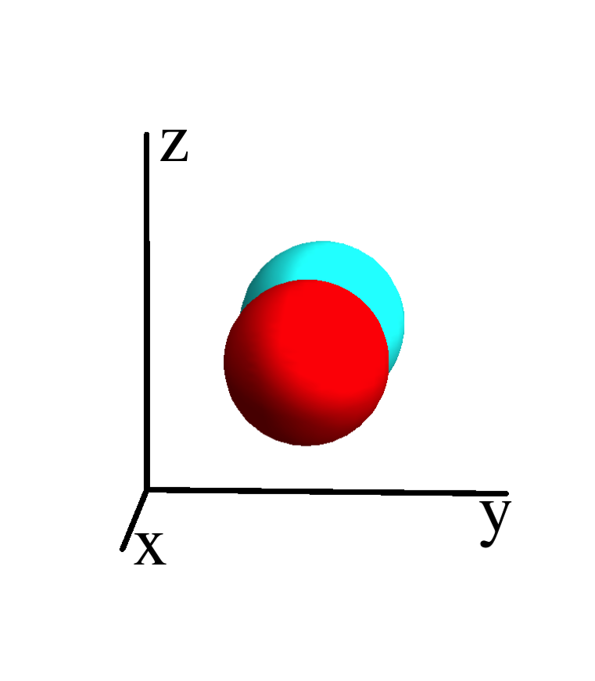
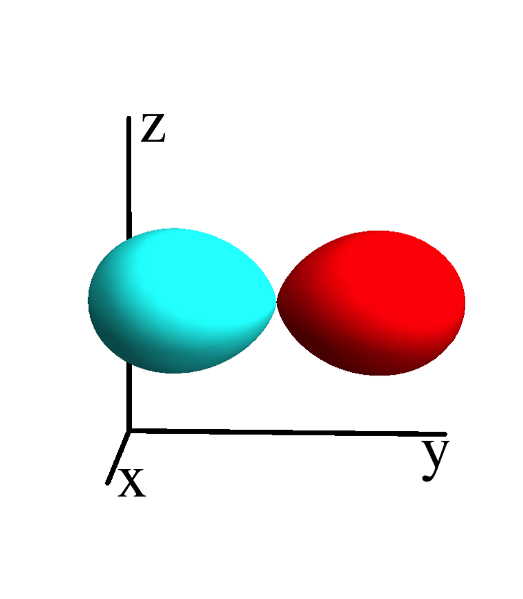
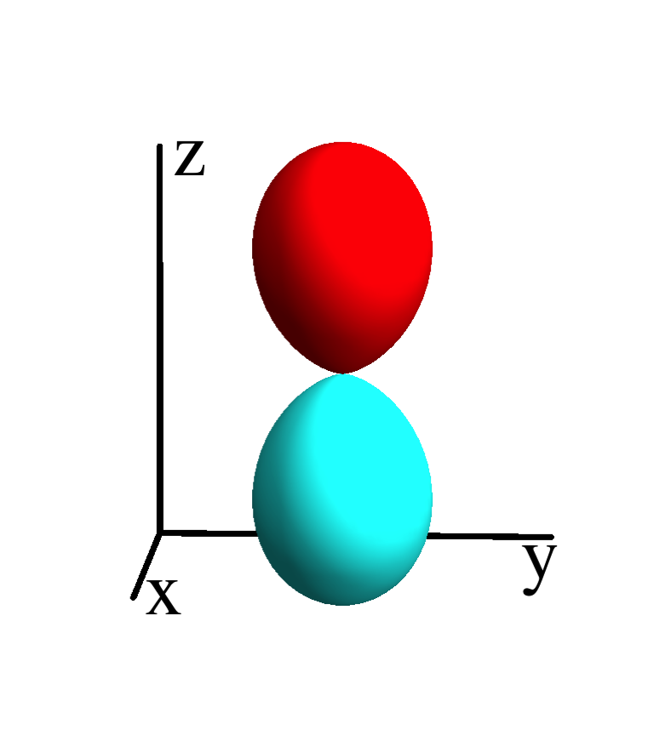
Mean-field calculations – matrix formalism
Define a basis of spin-orbitals
ε_{s}
Hamiltonian is represented by a matrix on this basis
ε_{p}
ε_{p}
ε_{p}

Slide 11
Quantum mechanics in matrix formalism – multi electron
_
Define a basis of many electron wave-functions (states)
0
ε_{s}
ε_{p}
ε_{p}
ε_{p}
Hamiltonian is a matrix on this basis
ε_{s}+ε_{p}+U_{sp}
ε_{s}+ε_{p}+U_{sp}
ε_{s}+ε_{p}+U_{sp}
2ε_{p}+U_{pp}
2ε_{p}+U_{pp}
2ε_{p}+U_{pp}
ε_{s}+2ε_{p}
+2U_{sp}+U_{pp}
ε_{s}+2ε_{p}
+2U_{sp}+U_{pp}
ε_{s}+2ε_{p}
+2U_{sp}+U_{pp}
…
3ε_{p}
+3U_{pp}

Slide 12

Exponential scaling of quantum mechanics
Example cluster of H atoms
# spin-
orbitals
# electrons
# atoms
# states
1 | 2 | 1 |  | ( ) | 2
2
1
Cluster of H atom
only include the 1s orbital

Slide 13
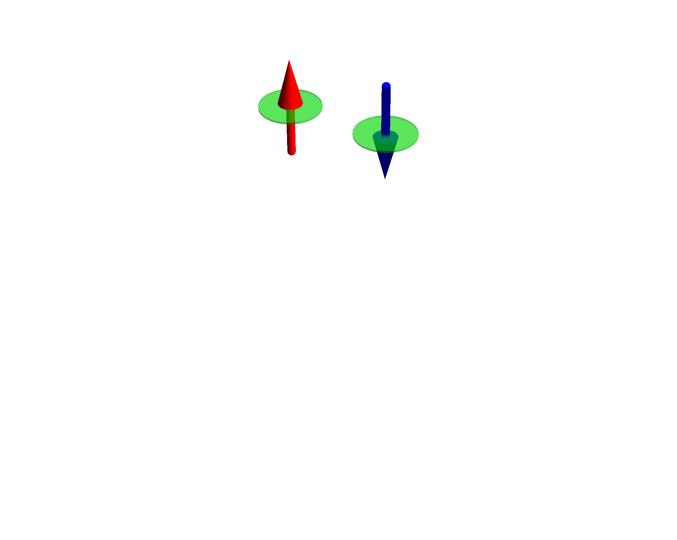
Exponential scaling of quantum mechanics
Example cluster of H atoms
# spin-
orbitals
# electrons
# atoms
# states
1 | 2 | 1 |  | ( ) | 2
2 | 4 | 2 |  | ( ) | 6
2
1
4
2
Cluster of H atom
only include the 1s orbital

Slide 14
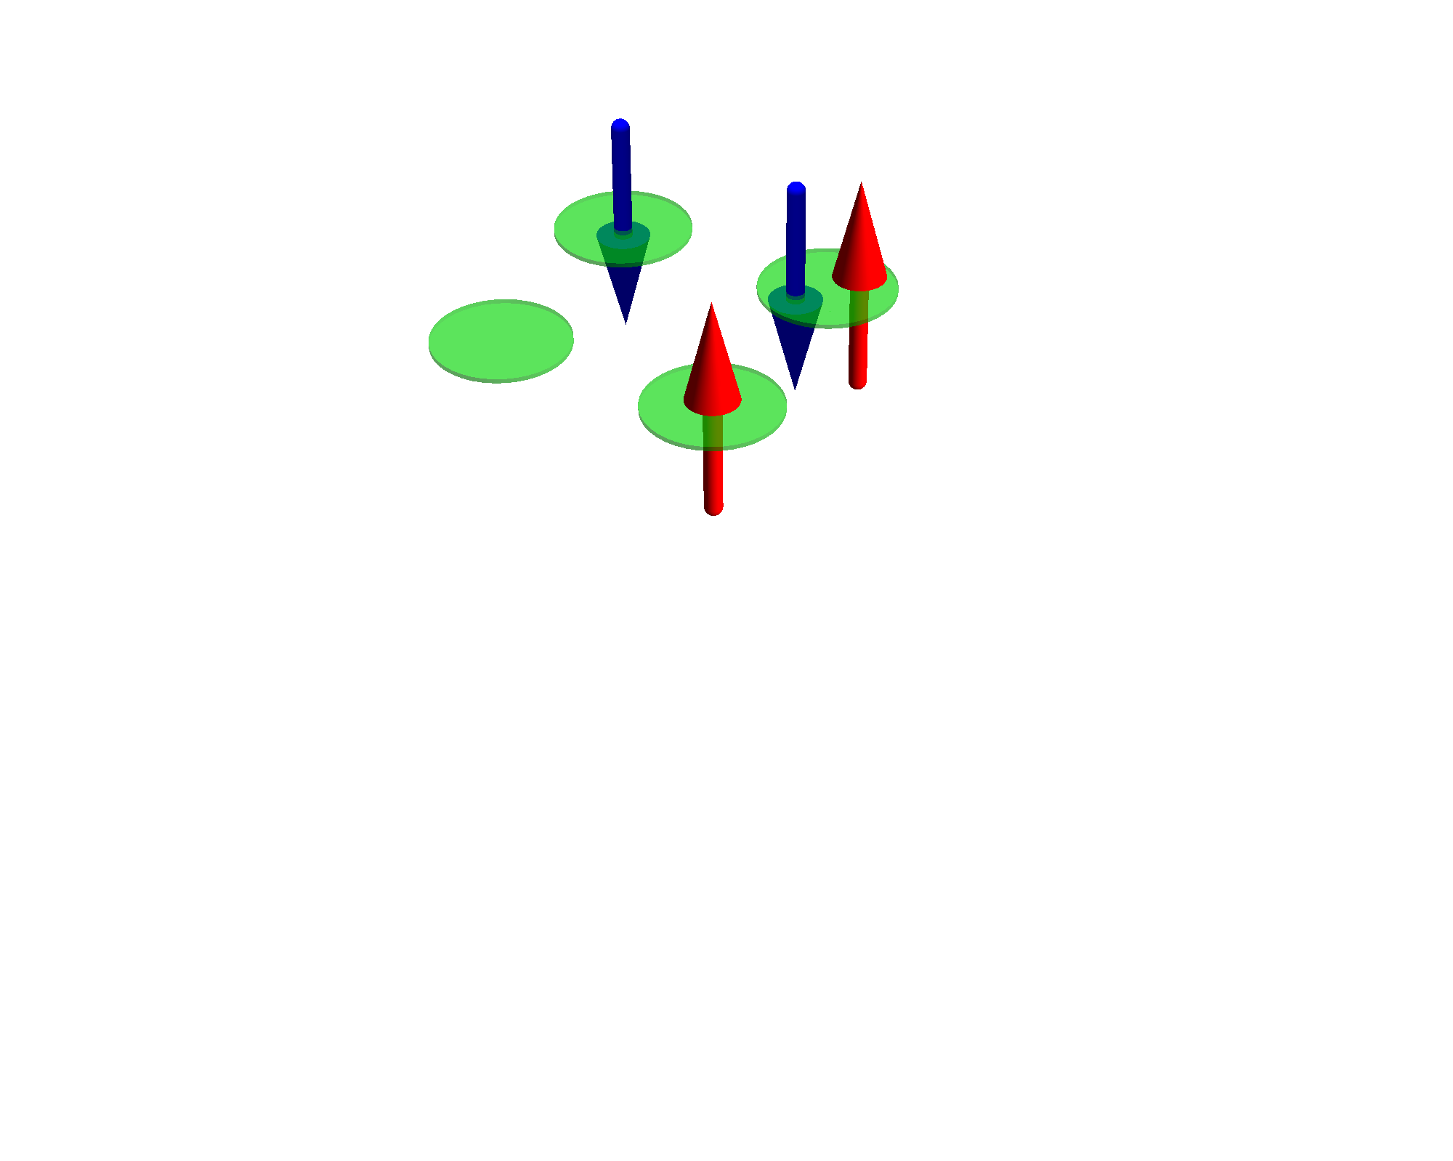
Exponential scaling of quantum mechanics
Example cluster of H atoms
# spin-
orbitals
# electrons
# atoms
# states
1 | 2 | 1 |  | ( ) | 2
2 | 4 | 2 |  | ( ) | 6
4 | 8 | 4 |  | ( ) | 70
2
1
4
2
8
4
Cluster of H atom
only include the 1s orbital

Slide 15
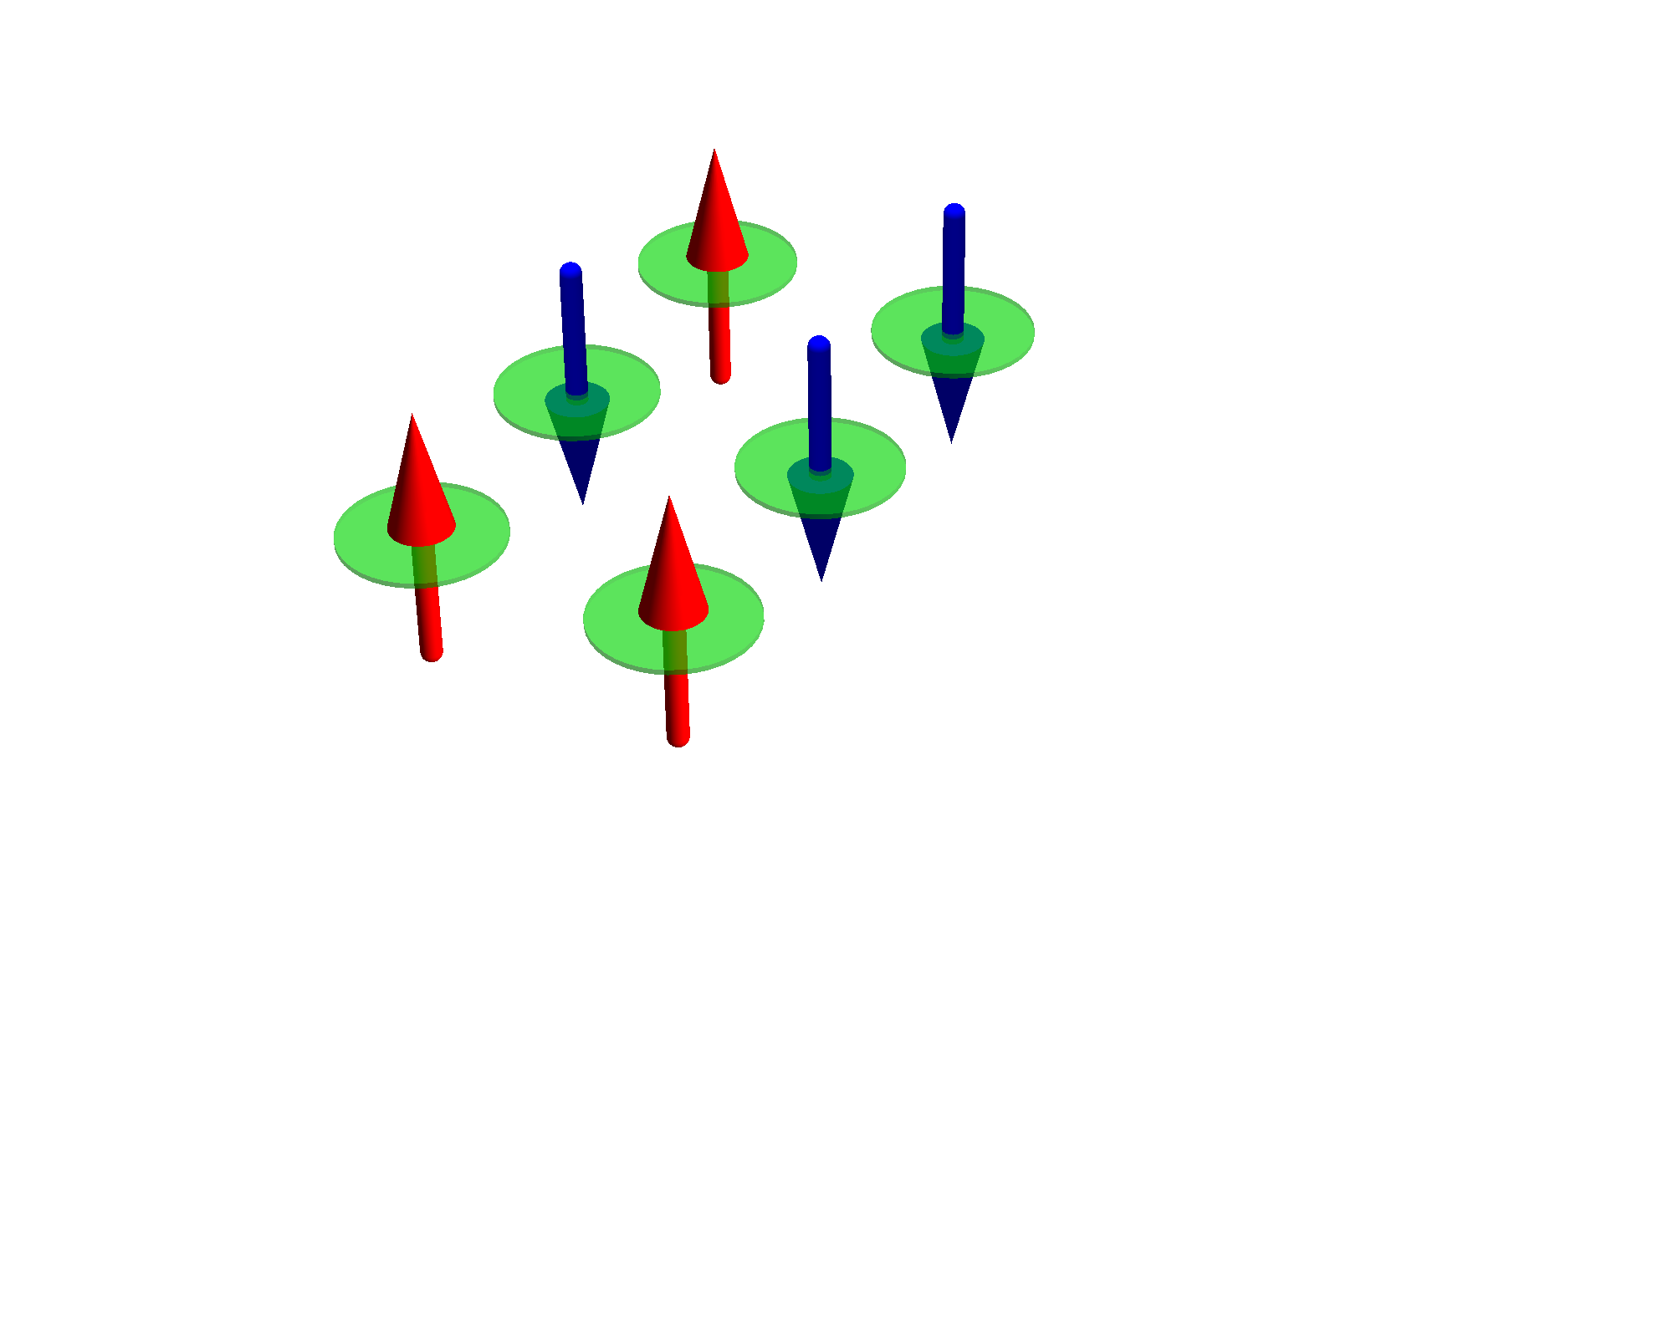
Exponential scaling of quantum mechanics
Example cluster of H atoms
# spin-
orbitals
# electrons
# atoms
# states
1 | 2 | 1 |  | ( ) | 2
2 | 4 | 2 |  | ( ) | 6
4 | 8 | 4 |  | ( ) | 70
6 | 12 | 6 |  | ( ) | 924
2
1
4
2
8
4
12
6
Cluster of H atom
only include the 1s orbital

Slide 16
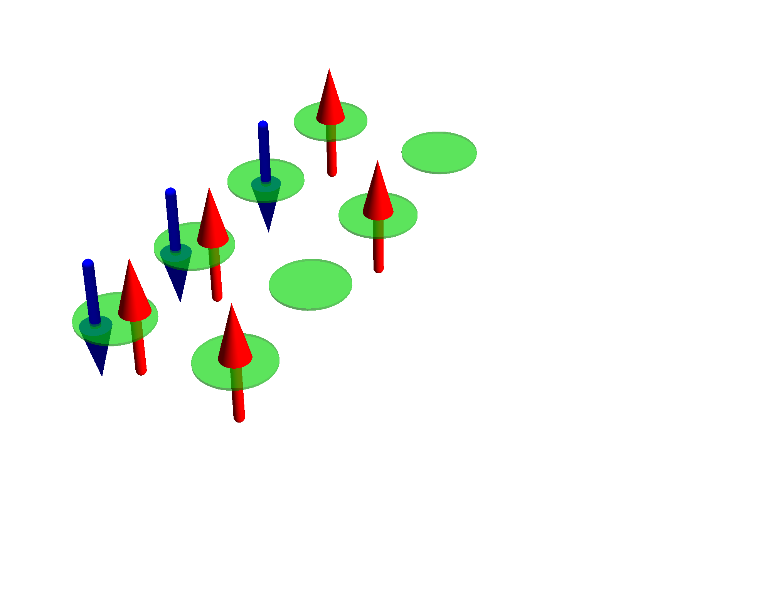
Exponential scaling of quantum mechanics
Example cluster of H atoms
# spin-
orbitals
# electrons
# atoms
# states
1 | 2 | 1 |  | ( ) | 2
2 | 4 | 2 |  | ( ) | 6
4 | 8 | 4 |  | ( ) | 70
6 | 12 | 6 |  | ( ) | 924
8 | 16 | 8 |  | ( ) | 12 870
2
1
4
2
8
4
12
6
16
8
Cluster of H atom
only include the 1s orbital

Slide 17
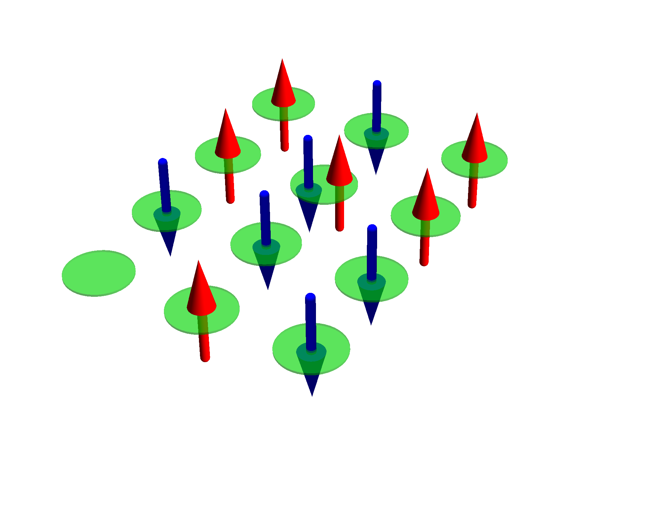
Exponential scaling of quantum mechanics
Example cluster of H atoms
# spin-
orbitals
# electrons
# atoms
# states
1 | 2 | 1 |  | ( ) | 2
2 | 4 | 2 |  | ( ) | 6
4 | 8 | 4 |  | ( ) | 70
6 | 12 | 6 |  | ( ) | 924
8 | 16 | 8 |  | ( ) | 12 870
10 | 20 | 10 |  | ( ) | 184 756
2
1
4
2
8
4
12
6
16
8
20
10
Cluster of H atom
only include the 1s orbital

Slide 18
Exponential scaling of quantum mechanics
Example cluster of H atoms
# spin-
orbitals
# electrons
# atoms
# states
1 | 2 | 1 |  | ( ) | 2
2 | 4 | 2 |  | ( ) | 6
4 | 8 | 4 |  | ( ) | 70
6 | 12 | 6 |  | ( ) | 924
8 | 16 | 8 |  | ( ) | 12 870
10 | 20 | 10 |  | ( ) | 184 756
12 | 24 | 12 |  | ( ) | 2 704 156
2
1
4
2
8
4
12
6
16
8
20
10
Cluster of H atom
only include the 1s orbital
24
12

Slide 19
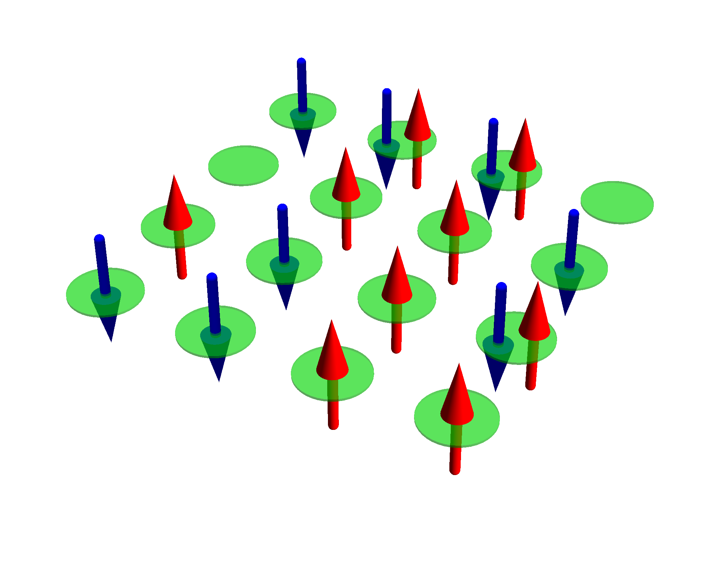
Exponential scaling of quantum mechanics
Example cluster of H atoms
# spin-
orbitals
# electrons
# atoms
# states
1 | 2 | 1 |  | ( ) | 2
2 | 4 | 2 |  | ( ) | 6
4 | 8 | 4 |  | ( ) | 70
6 | 12 | 6 |  | ( ) | 924
8 | 16 | 8 |  | ( ) | 12 870
10 | 20 | 10 |  | ( ) | 184 756
12 | 24 | 12 |  | ( ) | 2 704 156
14 | 28 | 14 |  | ( ) | 40 116 600
2
1
4
2
8
4
12
6
16
8
20
10
Cluster of H atom
only include the 1s orbital
24
12
28
14

Slide 20
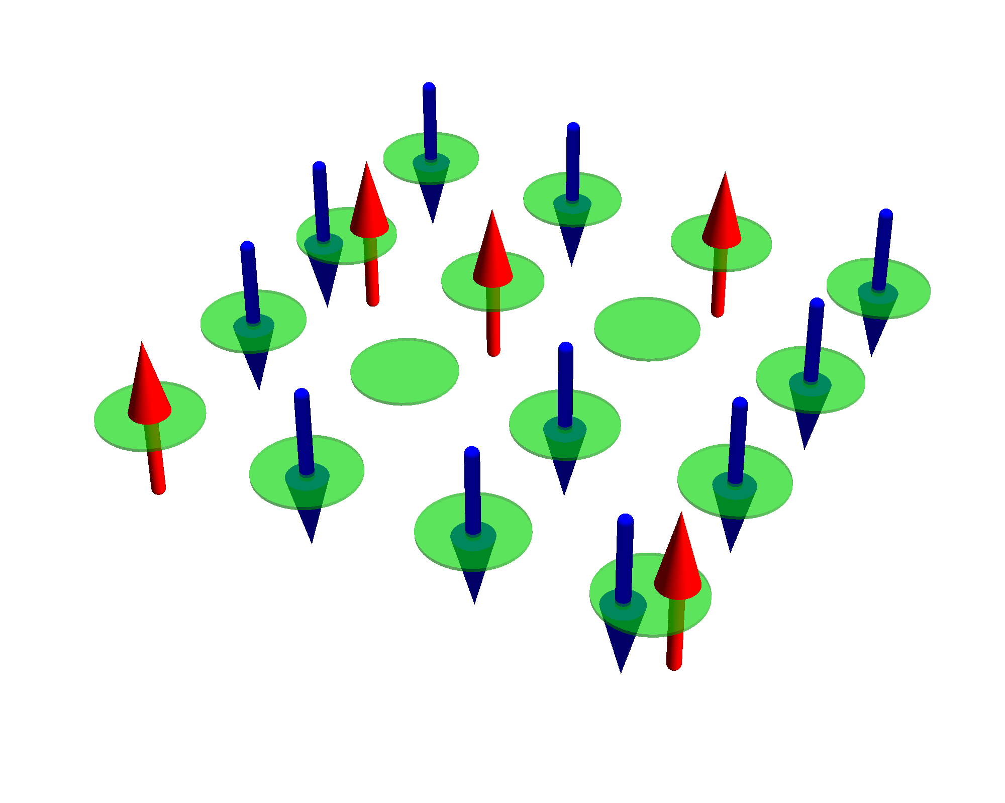
Exponential scaling of quantum mechanics
Example cluster of H atoms
# spin-
orbitals
# electrons
# atoms
# states
1 | 2 | 1 |  | ( ) | 2
2 | 4 | 2 |  | ( ) | 6
4 | 8 | 4 |  | ( ) | 70
6 | 12 | 6 |  | ( ) | 924
8 | 16 | 8 |  | ( ) | 12 870
10 | 20 | 10 |  | ( ) | 184 756
12 | 24 | 12 |  | ( ) | 2 704 156
14 | 28 | 14 |  | ( ) | 40 116 600
16 | 32 | 16 |  | ( ) | 601 080 390
2
1
4
2
8
4
12
6
16
8
20
10
Cluster of H atom
only include the 1s orbital
24
12
28
14
32
16

Slide 21
Exponential scaling of quantum mechanics
Example cluster of H atoms
# spin-
orbitals
# electrons
# atoms
# states
1 | 2 | 1 |  | ( ) | 2
2 | 4 | 2 |  | ( ) | 6
4 | 8 | 4 |  | ( ) | 70
6 | 12 | 6 |  | ( ) | 924
8 | 16 | 8 |  | ( ) | 12 870
10 | 20 | 10 |  | ( ) | 184 756
12 | 24 | 12 |  | ( ) | 2 704 156
14 | 28 | 14 |  | ( ) | 40 116 600
16 | 32 | 16 |  | ( ) | 601 080 390
18 | 36 | 18 |  | ( ) | 9 075 135 300
2
1
4
2
8
4
12
6
16
8
20
10
Cluster of H atom
only include the 1s orbital
24
12
28
14
32
16
36
18

Slide 22
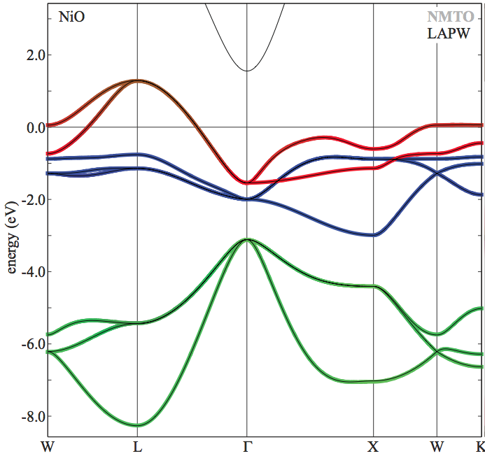
Exponential scaling of quantum mechanics
Example NiO
# spin-
orbitals
# electrons
# unit cells
# states
1 | 16 | 14 |  | ( ) | 120
16
14
NiO
Ni 3d and O 2p per unit cell
On LDA level NiO is metallic (in reality a good insulator)

Slide 23
Exponential scaling of quantum mechanics
Example NiO
# spin-
orbitals
# electrons
# unit cells
# states
1 | 16 | 14 |  | ( ) | 120
2 | 32 | 28 |  | ( ) | 35 960
16
14
32
28
NiO
Ni 3d and O 2p per unit cell
On LDA level NiO is metallic (in reality a good insulator)

Slide 24
Exponential scaling of quantum mechanics
Example NiO
# spin-
orbitals
# electrons
# unit cells
# states
1 | 16 | 14 |  | ( ) | 120
2 | 32 | 28 |  | ( ) | 35 960
3 | 48 | 42 |  | ( ) | 12 271 512
16
14
32
28
48
42
NiO
Ni 3d and O 2p per unit cell
On LDA level NiO is metallic (in reality a good insulator)

Slide 25
Exponential scaling of quantum mechanics
Example NiO
# spin-
orbitals
# electrons
# unit cells
# states
1 | 16 | 14 |  | ( ) | 120
2 | 32 | 28 |  | ( ) | 35 960
3 | 48 | 42 |  | ( ) | 12 271 512
4 | 64 | 56 |  | ( ) | 4 426 165 368
16
14
32
28
48
42
64
56
NiO
Ni 3d and O 2p per unit cell
On LDA level NiO is metallic (in reality a good insulator)

Slide 26
Exponential scaling of quantum mechanics
Example NiO
# spin-
orbitals
# electrons
# unit cells
# states
1 | 16 | 14 |  | ( ) | 120
2 | 32 | 28 |  | ( ) | 35 960
3 | 48 | 42 |  | ( ) | 12 271 512
4 | 64 | 56 |  | ( ) | 4 426 165 368
5 | 80 | 70 |  | ( ) | 1 646 492 110 120
16
14
32
28
48
42
64
56
80
70
NiO
Ni 3d and O 2p per unit cell
On LDA level NiO is metallic (in reality a good insulator)

Slide 27
Exponential scaling of quantum mechanics
Example NiO
# spin-
orbitals
# electrons
# unit cells
# states
1 | 16 | 14 |  | ( ) | 120
2 | 32 | 28 |  | ( ) | 35 960
3 | 48 | 42 |  | ( ) | 12 271 512
4 | 64 | 56 |  | ( ) | 4 426 165 368
5 | 80 | 70 |  | ( ) | 1 646 492 110 120
6 | 96 | 84 |  | ( ) | 624 668 654 531 480
16
14
32
28
48
42
64
56
80
70
96
84
NiO
Ni 3d and O 2p per unit cell
On LDA level NiO is metallic (in reality a good insulator)

Slide 28
Exponential scaling of quantum mechanics
Example NiO
# spin-
orbitals
# electrons
# unit cells
# states
1 | 16 | 14 |  | ( ) | 120
2 | 32 | 28 |  | ( ) | 35 960
3 | 48 | 42 |  | ( ) | 12 271 512
4 | 64 | 56 |  | ( ) | 4 426 165 368
5 | 80 | 70 |  | ( ) | 1 646 492 110 120
6 | 96 | 84 |  | ( ) | 624 668 654 531 480
7 | 112 | 98 |  | ( ) | 240 260 199 935 164 200
16
14
32
28
48
42
64
56
80
70
96
84
NiO
Ni 3d and O 2p per unit cell
On LDA level NiO is metallic (in reality a good insulator)
112
98

Slide 29
Exponential scaling of quantum mechanics
Example NiO
# spin-
orbitals
# electrons
# unit cells
# states
1 | 16 | 14 |  | ( ) | 120
2 | 32 | 28 |  | ( ) | 35 960
3 | 48 | 42 |  | ( ) | 12 271 512
4 | 64 | 56 |  | ( ) | 4 426 165 368
5 | 80 | 70 |  | ( ) | 1 646 492 110 120
6 | 96 | 84 |  | ( ) | 624 668 654 531 480
7 | 112 | 98 |  | ( ) | 240 260 199 935 164 200
…
16
14
32
28
48
42
64
56
80
70
96
84
NiO
Ni 3d and O 2p per unit cell
On LDA level NiO is metallic (in reality a good insulator)
112
98

Slide 30
Many advanced methods available
Hartree-Fock approximation
Density functional theory
Dynamical mean-field theory
DΓA
Configuration interaction
Coupled Cluster
Restrictive Active Space
Quantum Montecarlo
Tensor network states
Cluster expansion
Renormalization group theory
Some work for some properties of some materials, none work for all

Slide 31
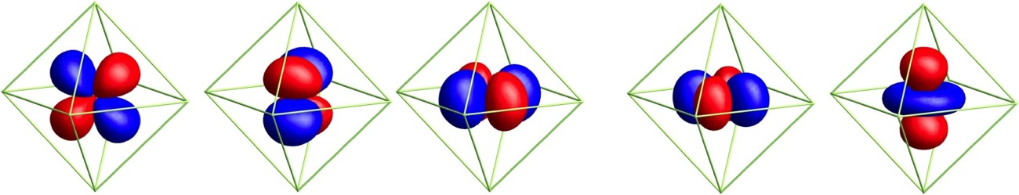
Need advanced tools to measure
Spin arrangements (element resolved of TM multilayers)
Valence and local symmetry of TM compounds
Orbital occupation (the d (f)-shell is 5 (7) fold degenerate)
Use spectroscopies
d_{yz}
d_{xz}
d_{xy}
d_{x}2_{-y}2
d_{3z}2_{-r}2
And excitations (spin-waves – magnons – orbital excitations)
How the low energy Hamiltonian emerges from the full Hamiltonian

Slide 32
Spectroscopy as a tool to test and learn
PES
Optics

Slide 33
X-ray spectroscopy as a tool to test and learn
PES
XAS
RXD
RIXS
nIXS

Slide 34
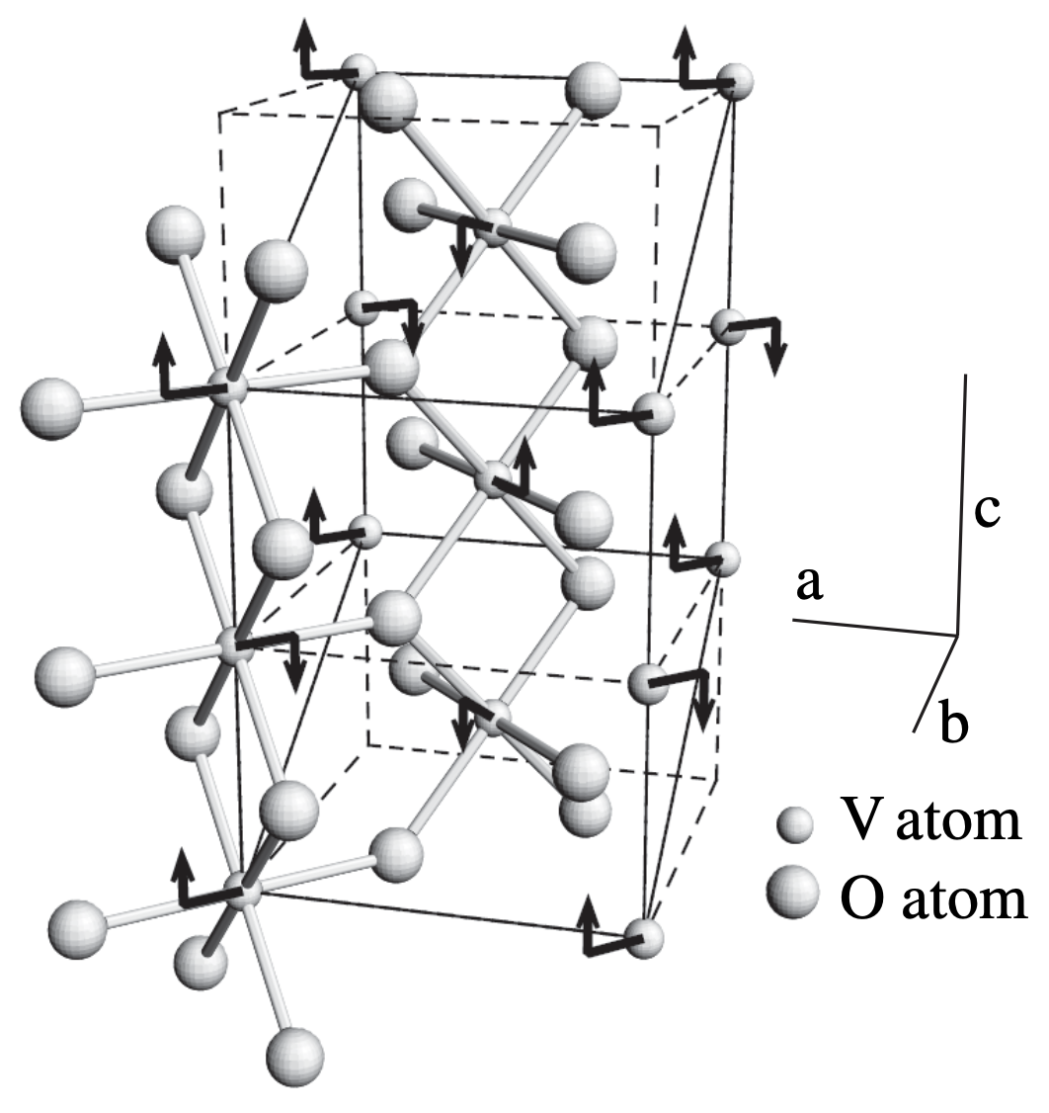
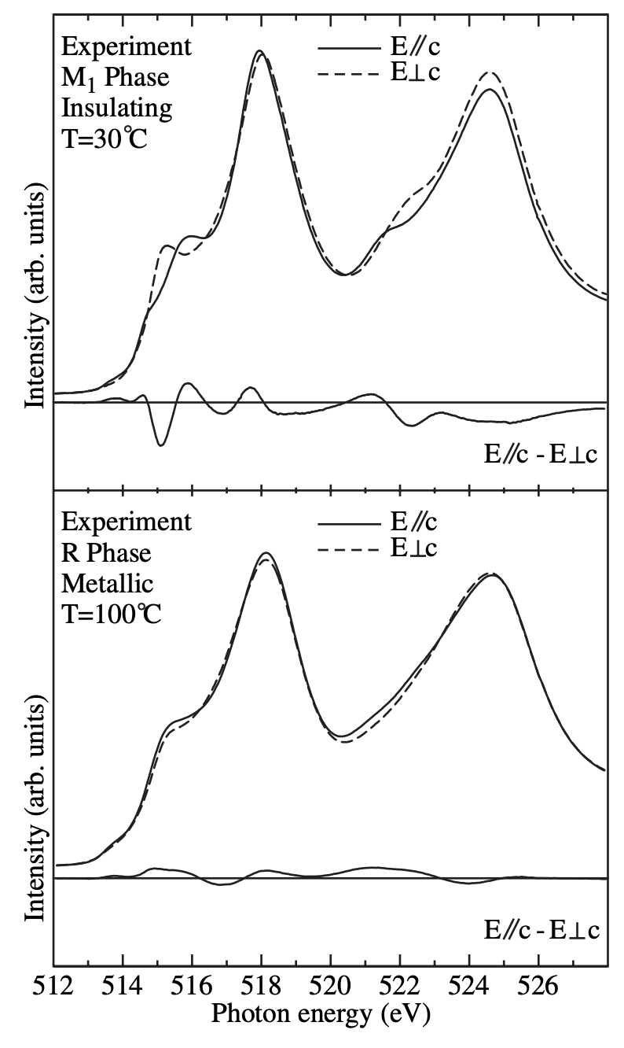
Example XAS on VO₂
Need theory to extract information from the spectra
P. B. Allen et al.,
PRB 48, 4359 (1993)
M. Marezio et al.,
PRB 5, 2541 (1972)
PRL 95, 196404 (2005)

Slide 35
Need theory to relate the material properties to the spectra
Different models
Levels of theory
Crystal-field
Ligand-field
Anderson Impurity (DMFT)
DFT
Spin-wave theory
…
Different spectroscopies
PES ESR
IPES NMR
cPES STM
Optics Magnetization
XAS Specific heat
RXD …
RIXS
nIXS
XES Please list your
FY publications at
EC www.quanty.org
Merged in a script language
Not structure in result out.
You need to do some programming / modeling

Slide 36
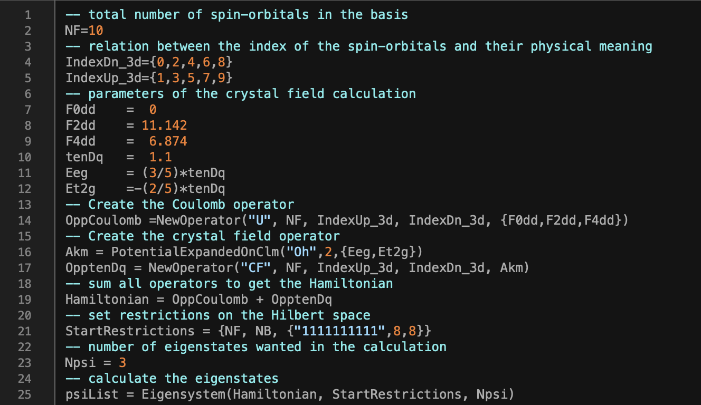
Quanty script for a crystal field calculation on Ni in NiO

Slide 37
Some theoretical background
Second quantization
Response theory
Green’s functions
Model optimization
See also lecture notes on Youtube
https://www.youtube.com/@MauritsHaverkort

Slide 38
Some theoretical background
Second quantization
Response theory
Green’s functions
Model optimization
See also lecture notes on Youtube
https://www.youtube.com/@MauritsHaverkort

Slide 39
Introducing language – Second quantization
Many particle wave function
with
Youtube

Slide 40
Introducing language – Second quantization
For H atom
Many particle wave function
  One particle orbital
  With quantum number
Youtube

Slide 41
Introducing language – Second quantization
For He atom
Many particle wave function
Assume orbitals have similar structure as H orbitals and take as an ansatz the state:
  One particle orbital
  With quantum number
with
And optimize to find lowest energy
Youtube

Slide 42
Introducing language – Second quantization
One problem: 4 solutions
Many particle wave function
  One particle orbital
  With quantum number
  Pauli: postulate: no math reason, but new physics:
Two electrons can not be in the same spin-orbital
They are all orthogonal to each other
Youtube

Slide 43
Introducing language – Second quantization
One problem: 4 solutions
Many particle wave function
  One particle orbital
  With quantum number
  Pauli: postulate: no math reason, but new physics:
Two electrons can not be in the same spin-orbital
  Oh Oh still two states left …. Eh ….
  Must hold for any basis, see what happens when rotating the spin quantization axis
They are all orthogonal to each other
Youtube

Slide 44
Introducing language – Second quantization
Youtube

Slide 45
Introducing language – Second quantization
Youtube

Slide 46
Introducing language – Second quantization
He ansatz wavefunction
Many particle wave function
  One particle orbital
  With quantum number
  Pauli: postulate: no math reason, but new physics:
Two electrons can not be in the same spin-orbital for any basis (anti-symmetrize)
Youtube

Slide 47
Introducing language – Second quantization
He ansatz wavefunction
Many particle wave function
  One particle orbital
  With quantum number
  Pauli: postulate: no math reason, but new physics:
Two electrons can not be in the same spin-orbital for any basis (anti-symmetrize)
Youtube

Slide 48
Introducing language – Second quantization
He ansatz wavefunction
Many particle wave function
  One particle orbital
  With quantum number
  Single Slater determinant
Youtube

Slide 49
Introducing language – Second quantization
Li ansatz wavefunction
Youtube

Slide 50
Introducing language – Second quantization
Ne ansatz wave function
  Not practical, need a different notation
Youtube

Slide 51
Introducing language – Second quantization
Youtube

Slide 52
Introducing language – Second quantization
Youtube

Slide 53
Introducing language – Second quantization
Youtube

Slide 54
Introducing language – Second quantization
Paul: postulate: no math reason, but new physics:
Two electrons can not be in the same spin-orbital for any basis (anti-symmetrize)
Youtube

Slide 55
Introducing language – Second quantization
  One particle orbital
  With quantum number
  Single Slater determinant
Many particle wave function
Youtube

Slide 56
Operators in second quantization
How to calculate:
or:
Distinguish two cases

Slide 57
Operators in second quantization
One particle operators
Two particle operators

Slide 58
Operators in second quantization
One particle operators
Proof: homework
with,
Two particle operators
with,

Slide 59
Some theoretical background
Second quantization
Response theory
Green’s functions
Model optimization
See also lecture notes on Youtube
https://www.youtube.com/@MauritsHaverkort

Slide 60

Response theory – photon absorption
Due to the external electromagnetic field the electron moves in space
A change in position yields the induced dipole moment (p)
Absorption is movement against a force
The velocity of the electron proportional to the induced current (j)
The change in current over time yields the acceleration of the electrons
Accelerated electrons radiate photons - diffraction
Youtube

Slide 61
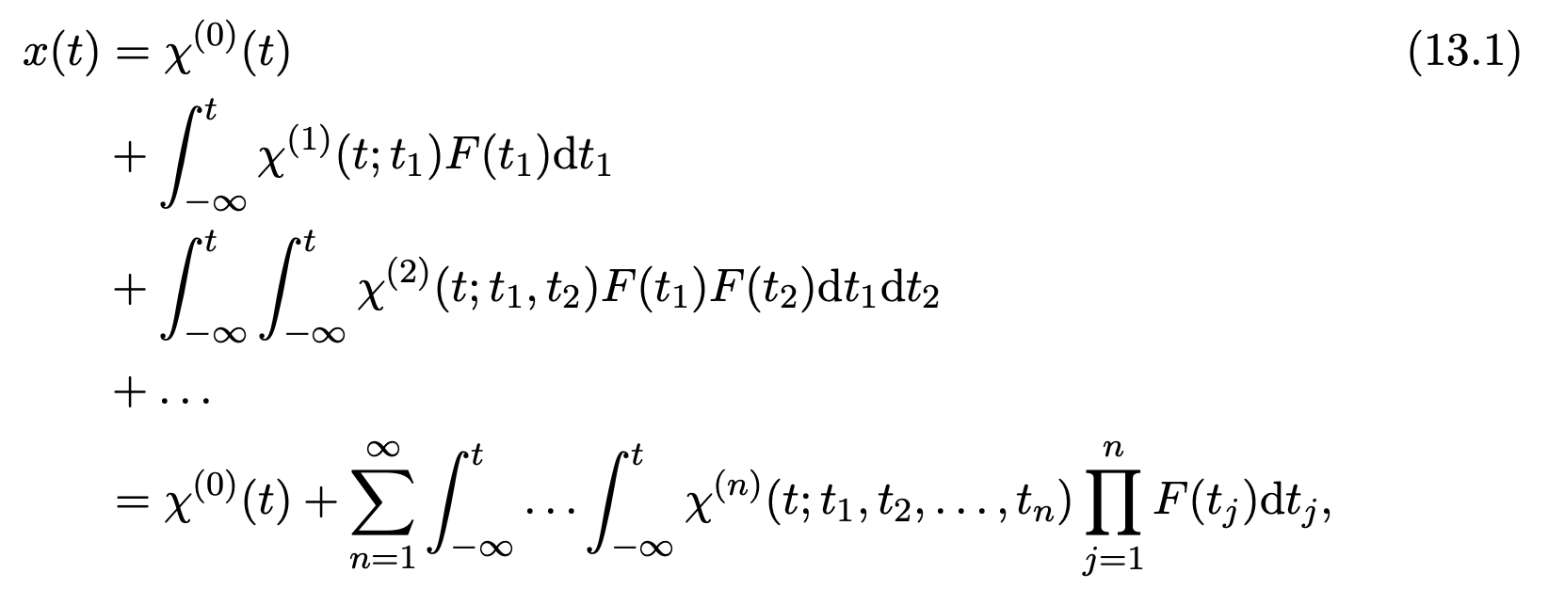
Measurements: Response theory
How does the system react when you act on it
Volterra series expansion
Fourier transform
Energy conservation
It does not matter if we do our experiment today or tomorrow
Youtube

Slide 62
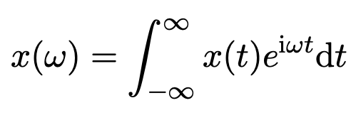
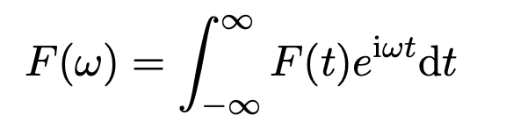
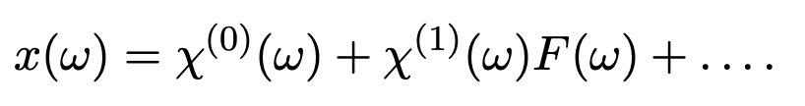
Measurements: Response theory
How does the system react when you act on it
Volterra series expansion
Fourier transform
Youtube

Slide 63
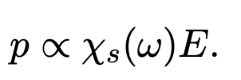

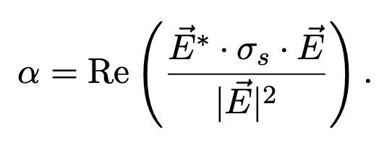

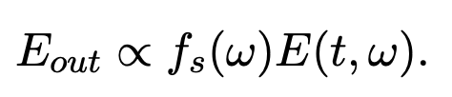
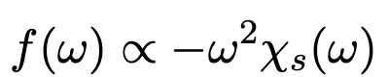
Measurements: Response theory
How does the system react when you act on it
Volterra series expansion
Relation between susceptibility and experimental observables
Polarizability
Absorption
Diffraction
Youtube

Slide 64

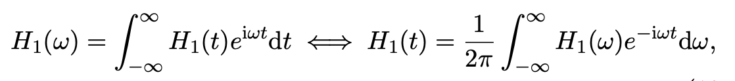

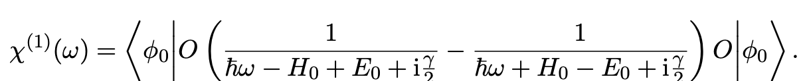
How to calculate the susceptibility – Kubo
System given by Hamiltonian H and time dependent perturbation H₁
With Fourier transforms
Measure operator O
Youtube

Slide 65
Relation to Fermis golden rule
Youtube

Slide 66
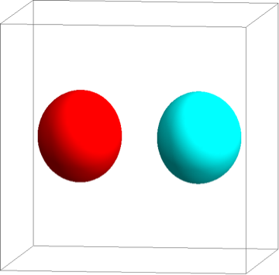
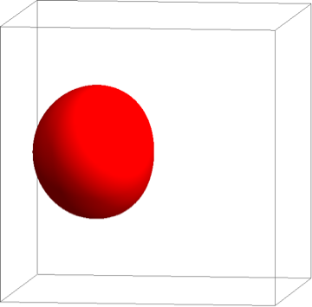
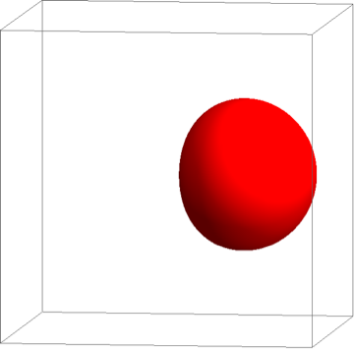
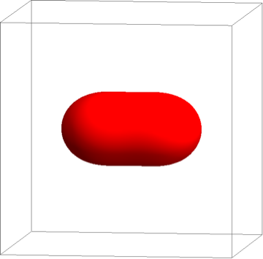
Example on an H₂ molecule
1s
1s

Slide 67
Example on an H₂ molecule
1s
1s

Slide 68
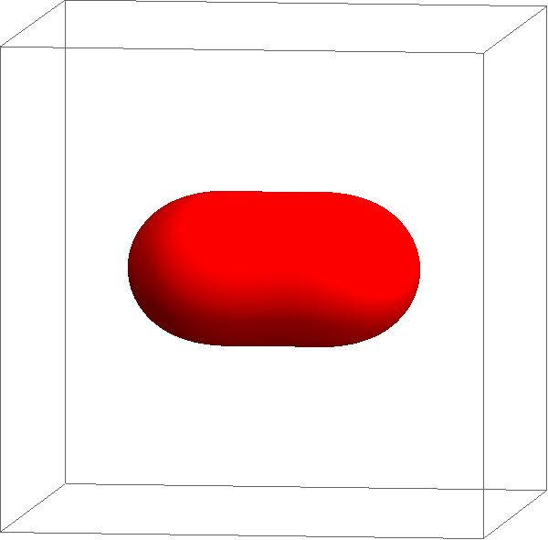
Example on an H₂ molecule
1s
1s

Slide 69

Example on an H₂ molecule
Intensity
Excitation energy

Slide 70

Example on an H₂ molecule – with correlations

Slide 71
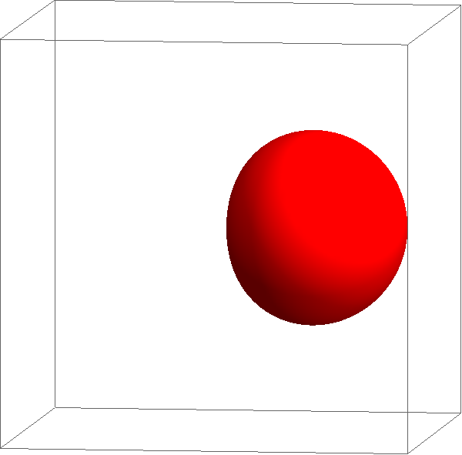
Example on an H₂ molecule – with correlations

Slide 72
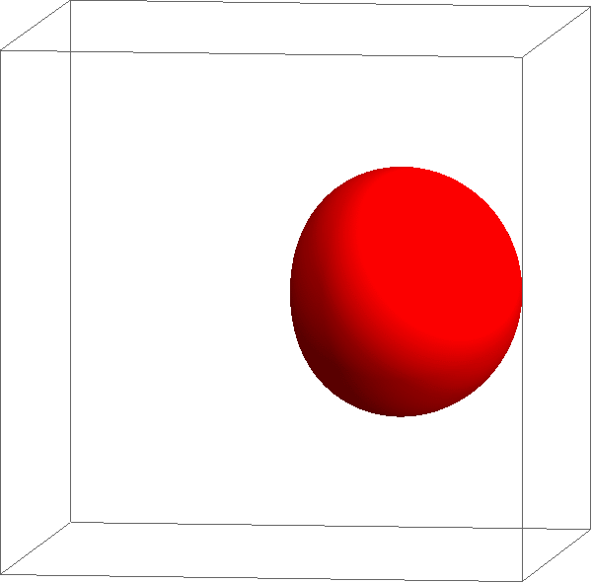
Example on an H₂ molecule – with correlations

Slide 73
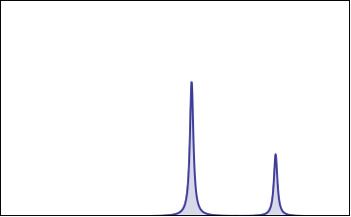
Example on an H₂ molecule – with correlations
Intensity
Excitation energy

Slide 74
Example on an H₂ molecule – with correlations
1s
1s
Intensity
Excitation energy

Slide 75
Challenges in calculation
Calculate the many-body ground-state
Calculate the effect of the operator O on the ground-state
Calculate the time evolution of state

Slide 76
The transition operator – photon matter interactions
Calculate the effect of the operator O on the ground-state
Photons, neutrons, electrons, … only interact with one electron simultaneously.

Slide 77
The transition operator – photon matter interactions
Calculate the effect of the operator O on the ground-state
Photons, neutrons, electrons, … only interact with one electron simultaneously.
Youtube

Slide 78
Challenges in calculation
Calculate the many-body ground-state
Calculate the effect of the operator O on the ground-state
Calculate the time evolution of state

Slide 79
Three classes of excitations
Band excitations
Resonances
Excitons

Slide 80
X-ray absorption spectroscopy – excitons
W=1
U=20
Q=0
Core – valence interaction
Intensity
2p
Energy (eV)

Slide 81
X-ray absorption spectroscopy – excitons
W=1
U=20
Q=0.25
Intensity
2p
Energy (eV)

Slide 82
X-ray absorption spectroscopy – excitons
W=1
U=20
Q=0.5
Intensity
2p
Energy (eV)

Slide 83
X-ray absorption spectroscopy – excitons
W=1
U=20
Q=1.0
Intensity
2p
Energy (eV)

Slide 84
X-ray absorption spectroscopy – excitons
W=1
U=20
Q=1.25
Intensity
2p
Energy (eV)

Slide 85
X-ray absorption spectroscopy – excitons
W=1
U=20
Q=1.5
Intensity
2p
Energy (eV)

Slide 86
X-ray absorption spectroscopy – excitons
W=1
U=20
Q=1.75
Intensity
2p
Energy (eV)

Slide 87
X-ray absorption spectroscopy – excitons
W=1
U=20
Q=2.0
Exciton
Intensity
Continuum edge jump
2p
Energy (eV)

Slide 88
Three classes of excitations
Band excitations
Resonances
Excitons

Slide 89
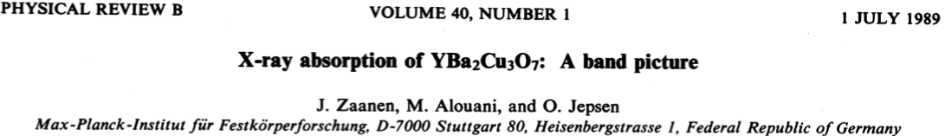
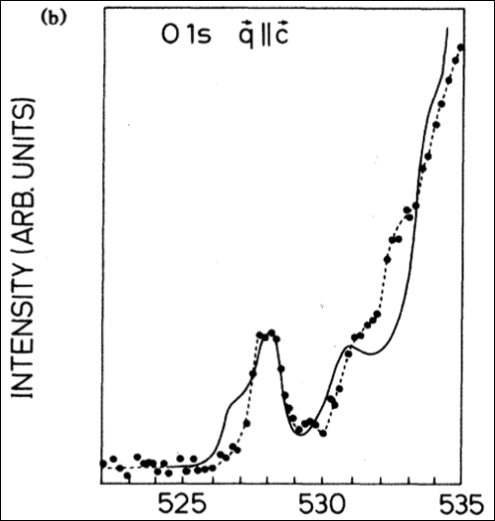
X-ray absorption spectroscopy – a band picture
1s

Slide 90
Three classes of excitations
Band excitations
Resonances
Excitons

Slide 91
X-ray absorption spectroscopy – excitons
2p

Slide 92



X-ray absorption spectroscopy – excitons
2p

Slide 93
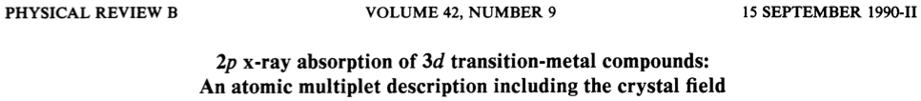
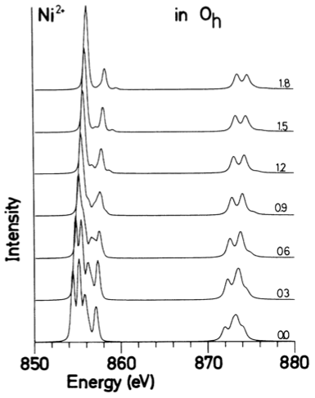
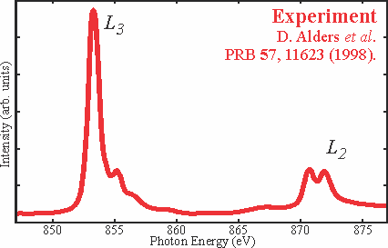
Local many body calculations based on parameters

Slide 94
Local many body calculations based on parameters
Parameters
Size of the Coulomb interaction
Size of the crystal-field

Slide 95
How to calculate these parameters
Theory
Experiment
Start from LDA potential
Create Wannier functions
On this basis and potential build local Hamiltonian including all local many body interactions
Solve by exact diagonalization
Phys. Rev. B 85, 165113 (2012)
2p
M.W. Haverkort, M. Zwierzycki, O.K. Andersen, PRB 85, 165113 (2012).

Slide 96
What do you need to consider when calculating excitons
Example of d-d excitations in NiO

Slide 97

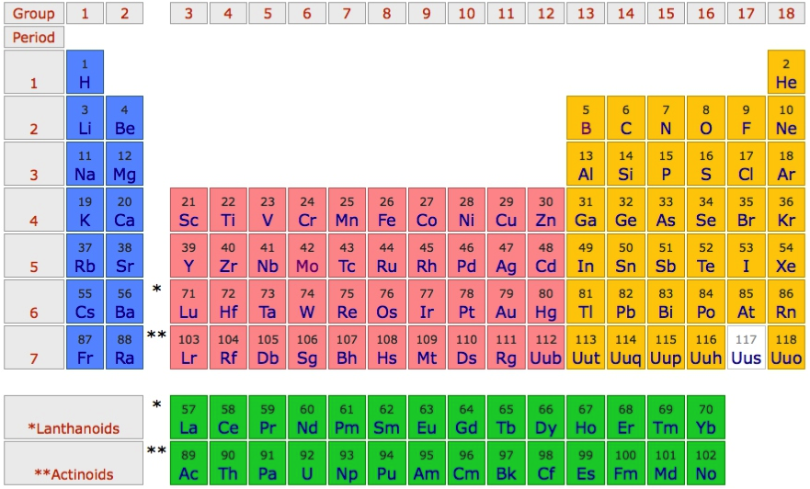
Example of localized states in NiO - excitons
O²⁻ - 2p⁶
Ni²⁺ - 4s⁰ 3d⁸

Slide 98
Partly filled degenerate d-shell – in LDA NiO is a metal

Slide 99
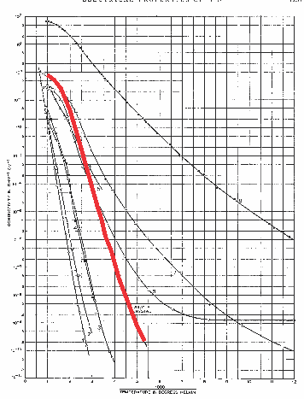
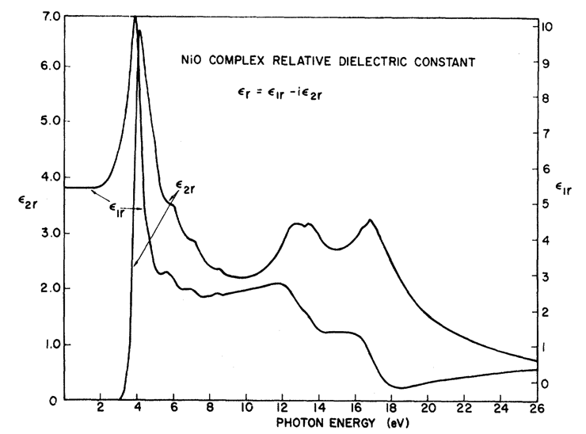
In LDA NiO is a metal: Experimentally it is a good insulator
F. J. Morin, Phys. Rev. 93, 1199 (1954)
Local d-d excitations inside the optical gap. Week in optics as NiO has inversion symmetry, i.e. they are dipole forbidden
R. Newman and R. M. Chrenko,
Phys. Rev 114 1507 (1959)
Room temperature
ρ~10⁵ Ω cm
Conductivity (Ω⁻¹ cm⁻¹)
Optical-gap
3.5 – 4.0 eV
Temperature⁻¹

Slide 100
d-d excitations inside gap (inelastic x-ray scattering)
Beyond – dipole
1 eV loss of
10 000 eV photons
Theory M. W. Haverkort et al. PRL 99, 257401 (2007)

Slide 101
Orbital energy level diagram
e_{g}
t_{2g}

Slide 102
First peak, excitation from t_{2g} to e_{g}
First peak, understandable on the level of LDA+U
M. W. Haverkort et al. PRB 85, 165113 (2012)

Slide 103
Third peak – Coulomb repulsion
Coulomb repulsion is smaller when electrons are farther apart
d_{z2}
d_{x2-y2}
d_{xy}

Slide 104
Third peak – Coulomb repulsion
Coulomb repulsion is smaller when electrons are farther apart
d_{z2}
d_{x2-y2}
d_{xy}
d_{xy}

Slide 105
Third peak – Coulomb repulsion
Third peak understandable on the level of time dependent LDA+U
M. W. Haverkort et al. PRB 85, 165113 (2012)

Slide 106
Second peak, double excitation from t_{2g} to e_{g}
DMFT with ED solver
Mix of DMRG and Quantum Chemistry
M. W. Haverkort et al. PRB 85, 165113 (2012)

Slide 107
Second peak, double excitation from t_{2g} to e_{g}
Warning!!! A single photon can only excite a single electron. The reason you see these strong double excitations is a true quantum many-body effect!
- Need to solve locally the full many-body problem
M. W. Haverkort et al. PRB 85, 165113 (2012)

Slide 108
Three classes of excitations
Band excitations
Resonances
Excitons

Slide 109
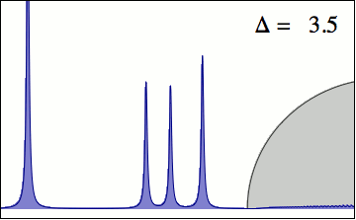
Interaction between localized and delocalized states
Elastic line
Local excitons
(d-d excitations)
Itinerant excitations
(charge-transfer)
M. W. Haverkort et al. EPL 108, 57004 (2014)

Slide 110

Interaction between localized and delocalized states
Elastic line
Local excitons
(d-d excitations)
Itinerant excitations
(charge-transfer)
M. W. Haverkort et al. EPL 108, 57004 (2014)

Slide 111
Interaction between localized and delocalized states (MnO)
LDA+Ligand – Field
LDA+DMFT

Slide 112
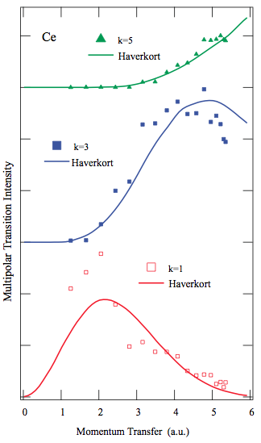
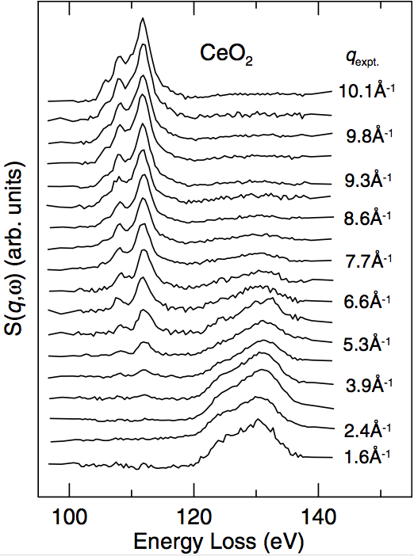
Multipole expansion – |q| dependence
Why are the multipole excitations at lower energy so much sharper and thus clearer to see?
Phys. Rev. Lett. 99, 257401 (2007)
J. A. Bradley et al.,
Phys. Rev. B 84, 205105 (2011).
R. A. Gordon, et al.
Euro. Phys. Lett. 81, 26004 (2008)

Slide 113
Some theoretical background
Second quantization
Response theory
Green’s functions
Model optimization
See also lecture notes on Youtube
https://www.youtube.com/@MauritsHaverkort

Slide 114
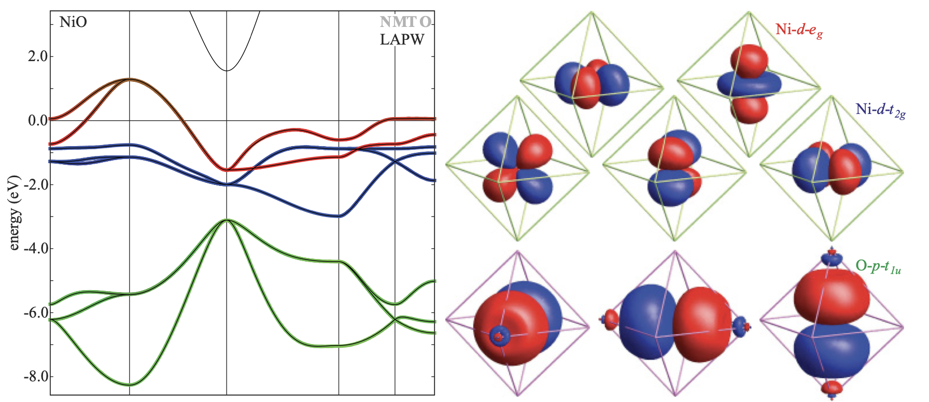
NiO – Density functional theory

Slide 115
NiO – Crystal field theory
Approximate a solid by a single atom + external effective potential

Slide 116
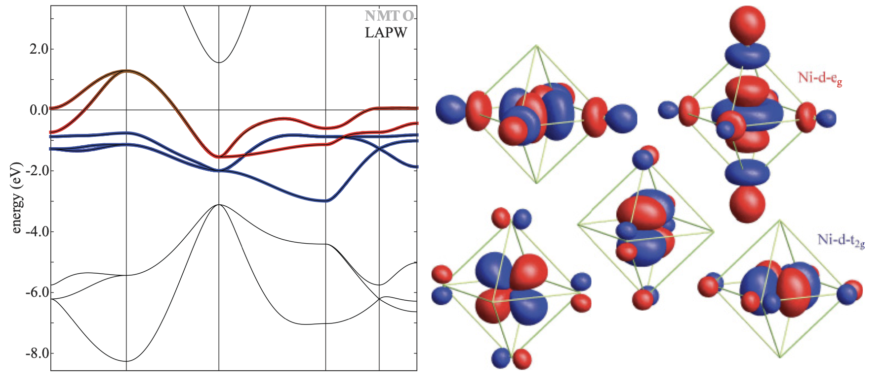
NiO – Crystal field theory
Approximate a solid by a single atom + external effective potential

Slide 117
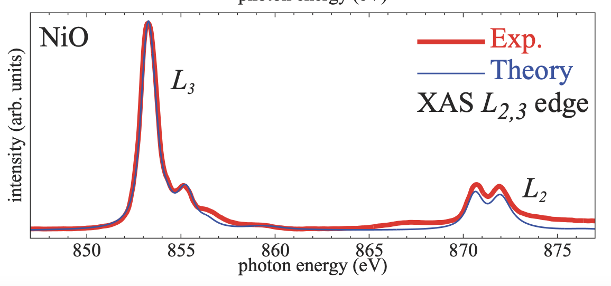
NiO – Crystal field theory
Approximate a solid by a single atom + external effective potential

Slide 118
NiO – Ligand field theory
Approximate a solid by a single atom +
ligand atoms (linear combinations of O atoms)

Slide 119
NiO – Ligand field theory
Approximate a solid by a single atom +
ligand atoms (linear combinations of O atoms)

Slide 120

NiO – Ligand field theory
Approximate a solid by a single atom +
ligand atoms (linear combinations of O atoms)

Slide 121

NiO – Ligand field theory
Approximate a solid by a single atom +
ligand atoms (linear combinations of O atoms)

Slide 122
NiO – Ligand field theory
Approximate a solid by a single atom +
ligand atoms (linear combinations of O atoms)

Slide 123

NiO – Ligand field theory
Approximate a solid by a single atom +
ligand atoms (linear combinations of O atoms)

Slide 124

Obtain a crystal-field from a ligand field Hamiltonian
Orbital dependent “dilution” of Coulomb interaction

Slide 125

Anderson impurity model
Different geometries to represent the bath

Slide 126
Anderson impurity model
Use Schur’s formula for matrix inversion
A
B
Youtube

Slide 127
Example – Auger-Meitner lifetime of core holes
Atomic Hamiltonian only including bound states
Coulomb operator
Atomic Hamiltonian with one free electron

Slide 128
Auger-Meitner lifetime in Ho – Dy nuclear transition

Slide 129
Example – Fluorescence lifetime of core holes
Atomic Hamiltonian without photons
Electron photon interaction
Atomic Hamiltonian with one photon

Slide 130

Fluorescence lifetime in Mn – Fe nuclear transition

Slide 131

Fluorescence lifetime in Mn – Fe nuclear transition

Slide 132

Fluorescence lifetime in Mn – Fe nuclear transition

Slide 133

Mixing of states with different photon number

Slide 134

Resonances in RIXS – Ce f-f transitions

Slide 135
Dynamical mean-field theory
What are the parameters of the Bath in an Anderson impurity model
Youtube

Slide 136
DMFT – short introduction
Two atoms interacting with each other
A
B
Define a non-interacting reference system such that it has the same Green’s function as G(BB,ω)
Youtube

Slide 137
DMFT – short introduction

Slide 138
Some theoretical background

Slide 139
XAS and the conductivity tensor (σ) – an example for s to p
Real
Imaginary
Absorption –Im[σ]
(in Landau Lifschitz absorption is Re[σ])
ω₀

Slide 140
But the conductivity tensor (σ) is a TENSOR

Slide 141
But the conductivity tensor (σ) is a TENSOR
Absorption
–Im[ε.σ.ε]

Slide 142
But the conductivity tensor (σ) is a TENSOR
Spectrum measured with
x-polarized light

Slide 143
But the conductivity tensor (σ) is a TENSOR
Spectrum measured with
y-polarized light

Slide 144
But the conductivity tensor (σ) is a TENSOR
Spectrum measured with
z-polarized light

Slide 145
But the conductivity tensor (σ) is a TENSOR
Spectrum measured with
(y+z)-polarized light
Absorption
–Im[ε.σ.ε]

Slide 146
But the conductivity tensor (σ) is a TENSOR
Spectrum measured with
(y+z)-polarized light

Slide 147
The conductivity tensor (σ) in cubic symmetry

Slide 148
The conductivity tensor (σ) in tetragonal symmetry

Slide 149
The conductivity tensor (σ) in orthorhombic symmetry

Slide 150
The conductivity tensor (σ) in monoclinic symmetry

Slide 151
The conductivity tensor (σ) in triclinic symmetry

Slide 152
The conductivity tensor (σ) in magnetic materials

Slide 153
The conductivity tensor (σ) in magnetic materials

Slide 154
Sum rules for circular dichroism: orbital and spin momentum

Slide 155
Thole et al.’s sum-rules in tensor form. s to p excitations

Slide 156
And now momentum, i.e. spatial resolved, from XAS to RXD
X-ray Absorption Spectroscopy (XAS) at the TM 2p to 3d edge
Resonant X-ray Diffraction (RXD)
Hannon, Trammel, Bloom, Gibbs
Phys. Rev. Lett. 61, 1245 (1988)
Phys. Rev. B 43, 5663 (1991)
Cara, Thole
Rev. Mod. Phys. 66, 1509 (1994)
2p

Slide 157

An example magnetic Bragg reflection of Ho metal film
2p

Slide 158

An example magnetic Bragg reflection of Ho metal film

Slide 159

Absorption and diffraction – two sides of the same coin
Polarizability: displacement of the electron
Conductivity: movement of the electron
Scattering length: acceleration of the electron

Slide 160
Absorption and diffraction – two sides of the same coin
Crystalline solid
Each site gets polarized by the photon field and the local charge density starts to oscillate.
Absorption
Scattering
σ_{i}
σ_{i}
σ_{i}
σ_{i}

Slide 161
Relation between resonant x-ray diffraction and absorption
2p
2p

Slide 162
Absorption and diffraction – two sides of the same coin
Crystalline sollid
Each site gets polarized by the photon field and the local charge density starts to oscillate.
Absorption
Scattering
σ_{i}
σ_{i}
σ_{i}
σ_{i}
Diffraction at given momentum determined by the sum of local scattering with correct phase:

Slide 163
An example magnetic Bragg reflection of Ho metal film

Slide 164
Fundamental spectra from the literature

Slide 165
Fundamental spectra from the literature

Slide 166
Fundamental spectra from the literature

Slide 167
Fundamental spectra from the literature

Slide 168
An example magnetic Bragg reflection of Ho metal film

Slide 169
Can we use sum-rules to get quantitative information

Slide 170
Can we use sum-rules to get quantitative information

Slide 171
Can we use sum-rules to get quantitative information

Slide 172
Can we use sum-rules to get quantitative information

Slide 173
Can we use sum-rules to get quantitative information

Slide 174
Can we use sum-rules to get quantitative information

Slide 175
Solve Maxwell's equations (with side conditions)

Slide 176
And now excitations , from RXD to RIXS
X-ray Absorption
Spectroscopy
Resonant X-ray
Diffraction
Resonant Inelastic
X-ray scattering
2p
2p
2p

Slide 177




Dispersing magnons

Slide 178

Dispersing magnons – Neutron scattering
Interaction of Neutrons with matter is well understood (magnetic dipole),
single magnon intensity
q-dispersion
M. T. Hutchings and E. J. Samuelsen,
Phys. Rev. B 6, 3447 (1972)

Slide 179

Recent development – measure spin dynamics with x-rays
Resonant Inelastic
X-ray Scattering
RIXS
It now becomes feasible to measure the dynamics of low energy excitations in:
thin films
surfaces
Interfaces
nano-crystals
molecules
Picture by G. Ghiringhelli and L. Braicovich

Slide 180


RIXS – very high quality data on small samples
L. Braicovich, et al. LaSrCuO₄, PRL 104, 077002 (2010)

Slide 181

RIXS – very high quality data on small samples
orbitons
spinons
Schlappa, et al. Sr₂CuO₃, Nature 485 82 (2012)

Slide 182
What is Resonant Inelastic X-ray Scattering (RIXS)
Intermediate state with core hole and one extra valence electron
Outgoing light of
~ 0.5 to 10 keV
minus
10 meV to 10 eV
Incoming light of
~ 0.5 to 10 keV

Slide 183

RIXS – what does one measure
Intermediate state
Initial state
Final state

Slide 184

RIXS – what does one measure
Interaction of Neutrons with matter is easy (magnetic dipole),
but for resonant inelastic x-ray scattering nothing is obvious.
A lot is known though…

Slide 185
RIXS – what does one measure
Interaction of Neutrons with matter is easy (magnetic dipole),
but for resonant inelastic x-ray scattering nothing is obvious.
A lot is known though…

Slide 186
RIXS – what is the cross section
Interaction of Neutrons with matter is easy (magnetic dipole),
but for resonant inelastic x-ray scattering nothing is obvious.
A lot is known though…

Slide 187
RIXS – what does one measure
Interaction of Neutrons with matter is easy (magnetic dipole),
but for resonant inelastic x-ray scattering nothing is obvious.
A lot is known though…

Slide 188
RIXS – what does one measure
Interaction of Neutrons with matter is easy (magnetic dipole),
but for resonant inelastic x-ray scattering nothing is obvious.
A lot is known though…

Slide 189
RIXS – what does one measure
Interaction of Neutrons with matter is easy (magnetic dipole),
but for resonant inelastic x-ray scattering nothing is obvious.
A lot is known though…

Slide 190
RIXS – what does one measure
Interaction of Neutrons with matter is easy (magnetic dipole),
but for resonant inelastic x-ray scattering nothing is obvious.
A lot is known though…

Slide 191
RIXS – what does one measure
Interaction of Neutrons with matter is easy (magnetic dipole),
but for resonant inelastic x-ray scattering nothing is obvious.
A lot is known though…

Slide 192
RIXS – what does one measure
Interaction of Neutrons with matter is easy (magnetic dipole),
but for resonant inelastic x-ray scattering nothing is obvious.
A lot is known though…

Slide 193
XAS – XRD – RIXS – a time dependent picture

Slide 194

XAS – XRD – RIXS – a time dependent picture in NiO
e_{g}
t_{2g}

Slide 195






NiO – Ni 2p to Ni 3d excitation
Ni-3d and O-2p on level of DMFT. (locally all interactions included)
e_{g}
After excitation Auger decay is possible, and included:
Ni-3d, Ni-3p, or Ni-3s scatters into the Ni-2p core hole and a Ni-3d, Ni-3p or Ni-3s orbital is emitted into εs,p,d,f,g or h orbital
t_{2g}
Ni-3d and Ni-2p Coulomb interactions are local and included

Slide 196

NiO – Ni 2p to Ni 3d excitation
X-ray absorption of NiO (L₂₃ edge) is well described.
How does the wave-function (charge density) evolve as a function of time when the sample is hit by an x-ray pulse?

Slide 197
NiO – Ni 2p to Ni 3d excitation
We include a light field of 1 kV per Angstrom (possible at SLAC) at an energy of 852 eV.
e_{g}
t_{2g}
Pulse duration is 100 atto seconds
Upto χ₇ (4-th-order) response functions are included

Slide 198

NiO 2p to 3d excitation in the time domain
Energy of pulse 852 eV
FWHM 100 as
41 eV
1 kV Å⁻¹
holes in Ni 3d-shell
holes in Ni 2p-shell
350 attosecond

Slide 199

Magnetic excitations in NiO
Abhishek Nag, …, Ke-Jin Zhou, NiO, PRL 124, 067202 (2020)

Slide 200

Single and double magnon excitations in NiO
Abhishek Nag, …, Ke-Jin Zhou, NiO, PRL 124, 067202 (2020)

Slide 201
RIXS – what does one measure
Interaction of Neutrons with matter is easy (magnetic dipole),
but for resonant inelastic x-ray scattering nothing is obvious.
A lot is known though…

Slide 202
RIXS – what does one measure
Interaction of Neutrons with matter is easy (magnetic dipole),
but for resonant inelastic x-ray scattering nothing is obvious.
A lot is known though…
BOOM

Slide 203


RIXS – what does one measure
Interaction of Neutrons with matter is easy (magnetic dipole),
but for resonant inelastic x-ray scattering nothing is obvious.
A lot is known though…

Slide 204
Challenge – No small parameter – perturbation theory fails
Different interactions are of similar scale
Perturbation theory leads to divergent series
i.e. summing part of the series gives a different result from the full solution!

Slide 205
RIXS – what does one measure
Intermediate state
Initial state
Final state

Slide 206

Relations between absorption, elastic- and inelastic scattering
The elastic scattering tensor is related to the absorption by the optical theorem (Conservation of energy)
Elastic scattering is a limiting case of inelastic scattering:
If one restricts the inelastic scattering operator R to the ground-state one describes the elastic scattering
For the description of magnetic excitations:
Expand the scattering operator on spin operators
M.W. Haverkort PRL 105, 167404 (2010)

Slide 207
Understand RIXS by numerical solving a model
The equation to solve
with,
and

Slide 208


Single Ni atom in crystal-field theory

Slide 209


Hubbard model on finite (12) size cluster

Slide 210
Understand RIXS as effective operator
Replace the exact RIXS operator by a low energy effective operator
Write the exact RIXS operator as a series
Possible operators in the series could be
Task: find all operators
and all coefficients

Slide 211
Challenge – No small parameter – perturbation theory fails
Different interactions are of similar scale
Perturbation theory leads to divergent series
i.e. summing part of the series gives a different result from the full solution!

Slide 212
Divergent series – example from functions
The following function is smooth, continues and infinite differentiable on the real axis
We can write the function as an expansion on powers of x:

Slide 213
Divergent series – example from functions
The following function is smooth, continues and infinite differentiable on the real axis
We can write the function as an expansion on powers of x:
Truncate at i=2

Slide 214
Divergent series – example from functions
The following function is smooth, continues and infinite differentiable on the real axis
We can write the function as an expansion on powers of x:
Truncate at i=4

Slide 215
Divergent series – example from functions
The following function is smooth, continues and infinite differentiable on the real axis
We can write the function as an expansion on powers of x:
Truncate at i=10

Slide 216
Divergent series – example from functions
The following function is smooth, continues and infinite differentiable on the real axis
We can write the function as an expansion on powers of x:
Truncate at i=20

Slide 217
Divergent series – example from functions
The following function is smooth, continues and infinite differentiable on the real axis
We can write the function as an expansion on powers of x:
Truncate at i=50

Slide 218

General problem in many particle physics

Slide 219

General problem in many particle physics
Need for a non-divergent (non perturbative) series expansion

Slide 220
Fourier v.s. Taylor – example from functions
The following function is smooth, continues and infinite differentiable on the real axis
We can write the function as a sum of orthonormal functions:

Slide 221
Fourier v.s. Taylor – example from functions
The following function is smooth, continues and infinite differentiable on the real axis
We can write the function as a sum of orthonormal functions:
Truncate at n=1

Slide 222
Fourier v.s. Taylor – example from functions
The following function is smooth, continues and infinite differentiable on the real axis
We can write the function as a sum of orthonormal functions:
Truncate at n=2

Slide 223
Fourier v.s. Taylor – example from functions
The following function is smooth, continues and infinite differentiable on the real axis
We can write the function as a sum of orthonormal functions:
Truncate at n=3

Slide 224
Fourier v.s. Taylor – example from functions
The following function is smooth, continues and infinite differentiable on the real axis
We can write the function as a sum of orthonormal functions:
Truncate at n=4

Slide 225
Fourier v.s. Taylor – example from functions
The following function is smooth, continues and infinite differentiable on the real axis
We can write the function as a sum of orthonormal functions:
Truncate at n=5

Slide 226
An alternative expansion for operators
Projection expansions for functions
with
if
Projection expansions for operators
with
if

Slide 227
An alternative expansion for operators
Trivial example
with
and
an orthonormal complete set
we have
The trivial example needs exponentially many weird operators
Alternative:
O^{m,n} an operator that transforms exponentially many states that share property n into states that share property m

Slide 228
Expansion of the RIXS operator
Create a local (j) expansion
Lattice model

Slide 229
Expansion of the RIXS operator
Create a local (j) expansion
Lattice model
Site j
Level L=0 only include operators acting on site j

Slide 230
Expansion of the RIXS operator
Create a local (j) expansion
Lattice model
j
Level L=1 include operators acting on site j and n.n.

Slide 231
Expansion of the RIXS operator
Create a local (j) expansion
Lattice model
j
Level L=2 include operators acting on site j, n.n. and n.n.n.

Slide 232
Expansion of the RIXS operator
Create a local (j) expansion
Lattice model
j
Level L=3 include operators acting on site j, n.n., n.n.n. and n.n.n.n.
etc.

Slide 233
Expansion of the RIXS operator
Convergence of this series is guaranteed by linear algebra!
define

Slide 234
Expansion of the RIXS operator
Convergence of this series is guaranteed by linear algebra!
As RIXS intensity is bounded:
Sufficient condition to guarantee absolute convergence of series

Slide 235
Example for doped Hubbard model
with
As a first step we need to create all possible O_{m,n}
For L=0 we only look at local operators
The local Fock space is given by 4 states
Operators on that basis as
4 by 4 matrices

Slide 236
Example for doped Hubbard model
For L=1 we look at two sites
The Fock space is given by 16 states
Resulting in 16²=256 operators

Slide 237
Example for doped Hubbard model
We can get back to more familiar representations by linear combing these operators (unitary transformation)
For L=0 (only keeping the particle number conserving operators)

Slide 238

Example for doped Hubbard model
We can get back to more familiar representations by linear combing these operators (unitary transformation)
For L=1 (only keeping the particle number conserving operators)

Slide 239


RIXS – effective operator – spin excitations
Effective operator for spin excitations only

Slide 240
RIXS – effective operator – spin excitations
Need to calculate x-ray absorption spectra
… and spin susceptibilities

Slide 241
RIXS – effective operator – spin excitations
Theory
Experiment
Need to calculate x-ray absorption spectra
σ⁽⁰⁾=

Slide 242
Predicted RIXS spectra with cross polarized light
spin susceptibility, same as neutron scattering

Slide 243
General polarization: RIXS is a mixture of 1 and 2 spin flips

Slide 244
Spin excitations in 1-dimension

Slide 245

Spin excitations in 1-dimension
S. Glawion, …, R. Claessen, TiOCl, PRL 107, 107402 (2011)

Slide 246

Spin excitations in 1 dimension – Sr₂CuO₃

Slide 247
Dispersing orbitals
orbitons
spinons

Slide 248



Dispersing orbitals

Slide 249

Dispersing orbitals

Slide 250
Additional information
Code to calculate core level spectroscopy
www.quanty.org
YouTube lectures on solid state physics
https://www.youtube.com/c/MauritsHaverkort

Slide 251

Graphical interface to Quanty

