Slide 1
DFT to multiplet ligand field theory
Maurits W. Haverkort
Institute for theoretical physics – Heidelberg University
M.W.Haverkort@thphys.uni-heidelberg.de

Slide 2
The aim
In order to understand materials and their properties theoretically we need to make a model that contains enough information to describe the system and a model that is simple enough such that we can solve it
Mean-field theory (Hartree-fock or DFT within the LDA / Kohn-Sham formalism) is such a model that works for itinerant systems. (Materials and or experiment type)
Crystal-field theory and Ligand field theory are such models that work for localized experiments and materials.
Can we reduce the number of parameters in crystal-field theory?
Can we find models for correlated metals?

Slide 3
Four examples
MgO
Band-structure and Wannier orbitals
NiO
Band-structure and Wannier orbitals and a local ligand field model
Alkali metals
Can one make a tight binding model?

Slide 5
MgO – rocksalt structure
O
Mg

Slide 6
MgO – band-structure
Mg-3s character
O-2p character

Slide 7
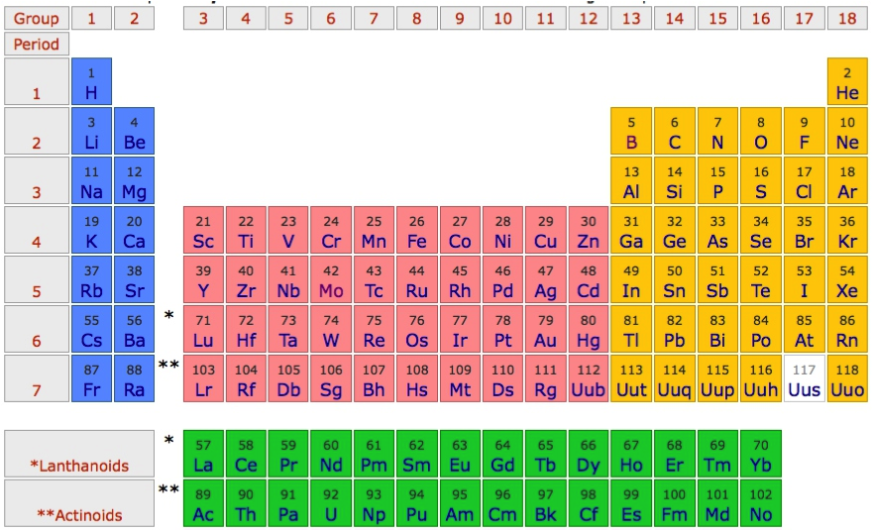
MgO – band-structure

Slide 8
MgO – band-structure
1s²2s²2p⁴
1s²2s²2p⁶3s²

Slide 9
MgO – band-structure
1s²2s²2p⁶
1s²2s²2p⁶3s⁰

Slide 10
MgO – band-structure
Mg-3s character
O-2p character

Slide 11
MgO – band-structure – minimal basis O-p and Mg-s

Slide 12
MgO – atomic orbitals
Mg-3s

Slide 13
MgO – atomic orbitals
O-2p

Slide 14
MgO – atomic orbitals
Mg-3s
O-2p

Slide 15
MgO – wannier orbitals
Mg-3s
atomic
Mg-3s
Wannier

Slide 16
MgO – wannier orbitals
O-2p
atomic
O-2p
Wannier

Slide 17
MgO – wannier orbitals

Slide 18
MgO – wannier orbitals
Mg-3s
Wannier
O-2p
Wannier
Mg-3s
atomic
O-2p
atomic

Slide 19
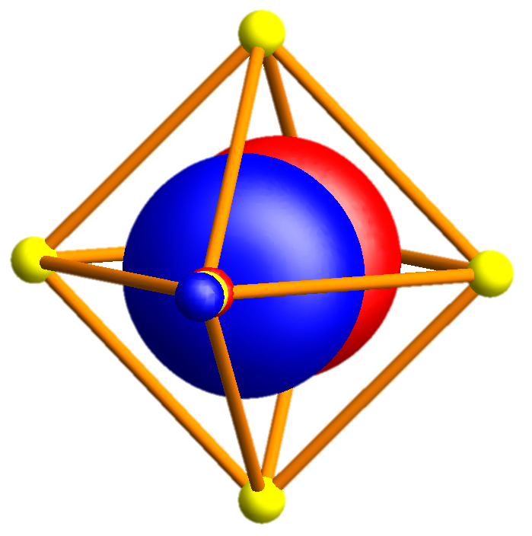
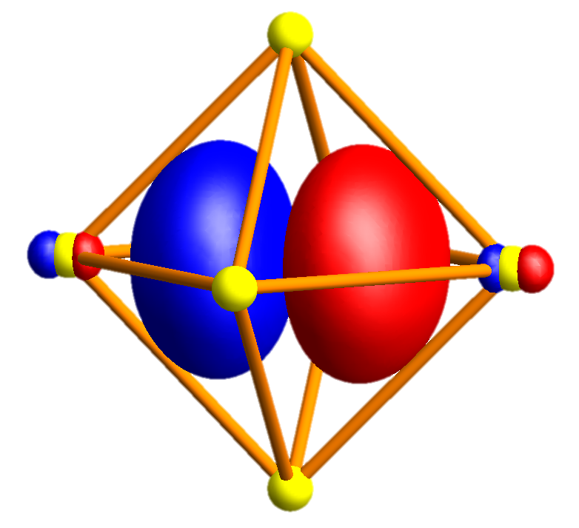
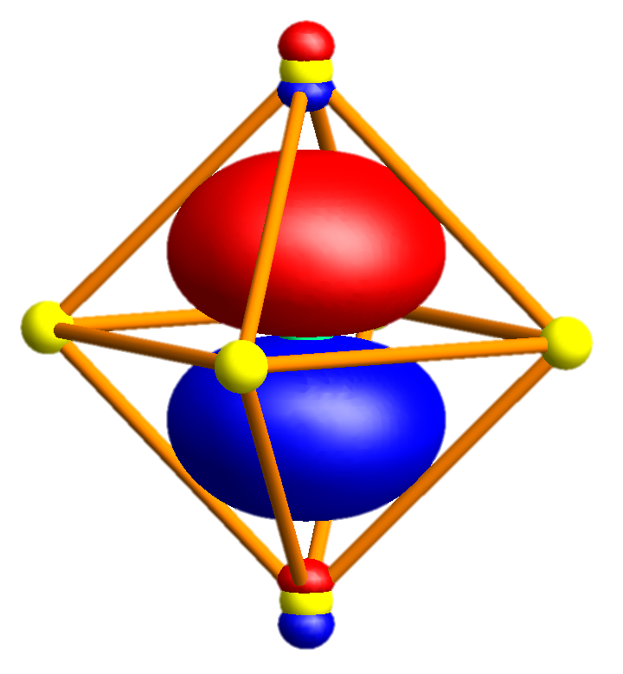
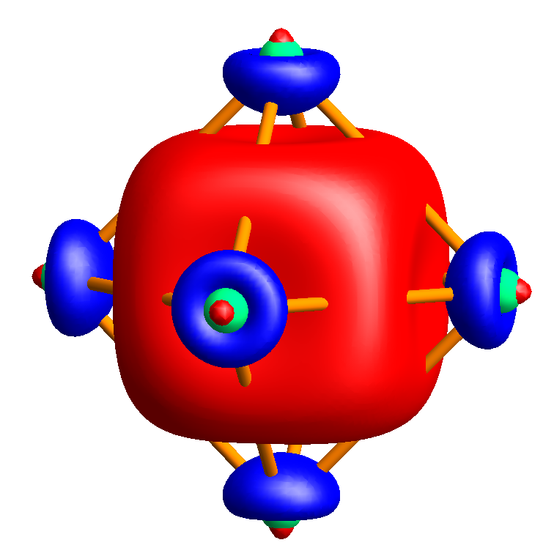
MgO – wannier orbitals

Slide 20
MgO – band-structure
Mg-3s character
O-2p character

Slide 21
MgO – band-structure – minimal basis O-p and Mg-s

Slide 22
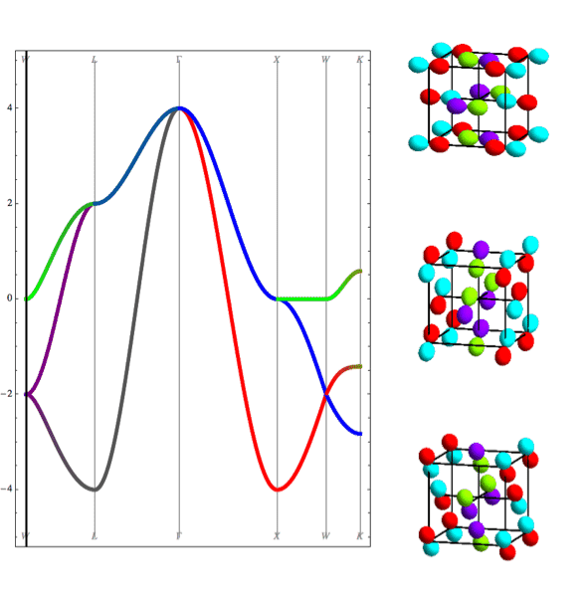
MgO – band-structure
Nearest neighbor tight binding
Full DFT calculation
L
Γ
X
W

Slide 23
MgO – band-structure – minimal basis O-p and Mg-s
Mg 3s
O 2p
O 2s
Mg 2p

Slide 24
MgO – band-structure – minimal basis O-p and Mg-s
Mg 3s
O 2p
O 2s
Mg 2p

Slide 25
MgO – band-structure – minimal basis O-p and Mg-s
Mg 3s
Mg 3s
O 2p
O 2p
O 2s
Mg 2p

Slide 26
MgO – band-structure – minimal basis O-p and Mg-s
Mg 3s
Mg 3s
O 2p
O 2p
O 2s
Mg 2p

Slide 27
NiO – rocksalt structure
O
Ni

Slide 28
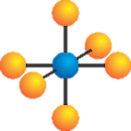
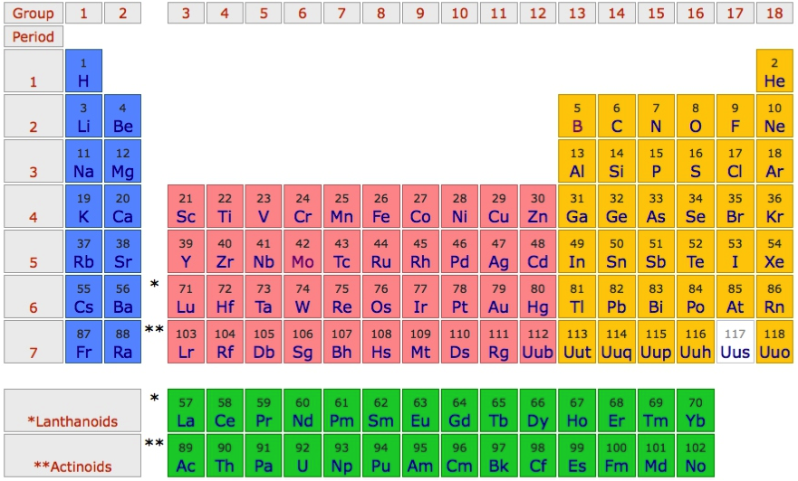
Use NiO as an example material
O²⁻ - 2p⁶
Ni²⁺ - 4s⁰ 3d⁸

Slide 29
“Downfold” the DFT results to obtain basis of choice

Slide 30
Pick a basis of “TM-d” and “O-p” Wannier orbitals
e_{g} σ bond
t_{2g} π bond

Slide 31
The TM-d Wannier orbitals are very close to atomic orbitals

Slide 32
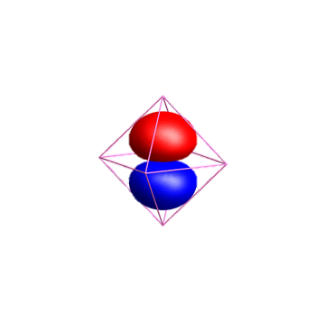
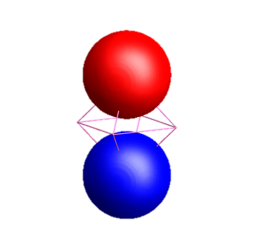
The O-p Wannier orbitals have tails!!!
O-2p
Ni-4s

Slide 33
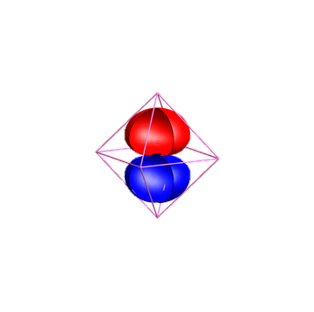
The O-p Wannier orbitals have tails!!!
O-2p
Ni-4s

Slide 34
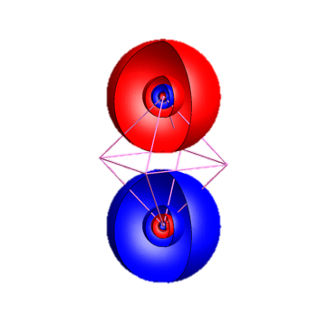
The O-p Wannier orbitals have tails!!!
O-2p
Ni-4s

Slide 35
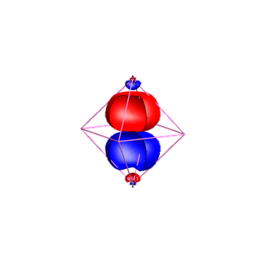
The O-p Wannier orbitals have tails!!!
Ni-4s
O-2p

Slide 36
Pick a basis of “TM-d” and “O-p” Wannier orbitals

Slide 37
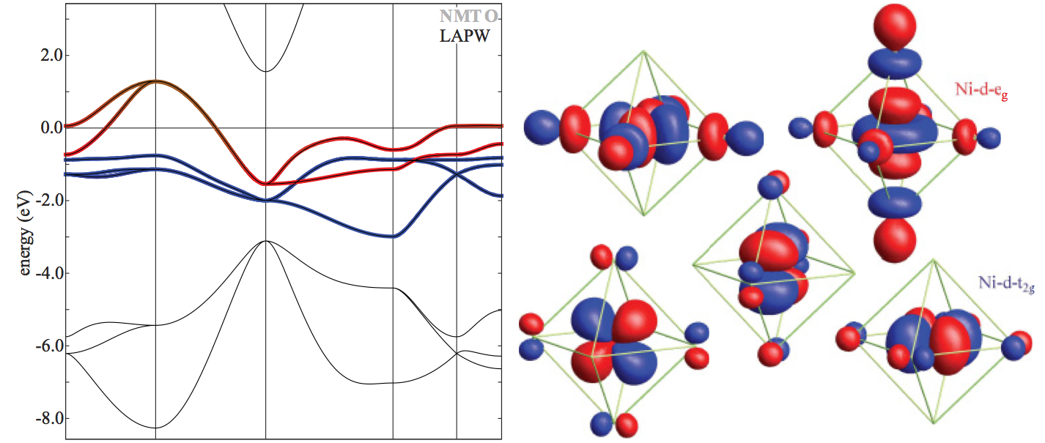
Pick a basis of “TM-d” Wannier orbitals

Slide 38
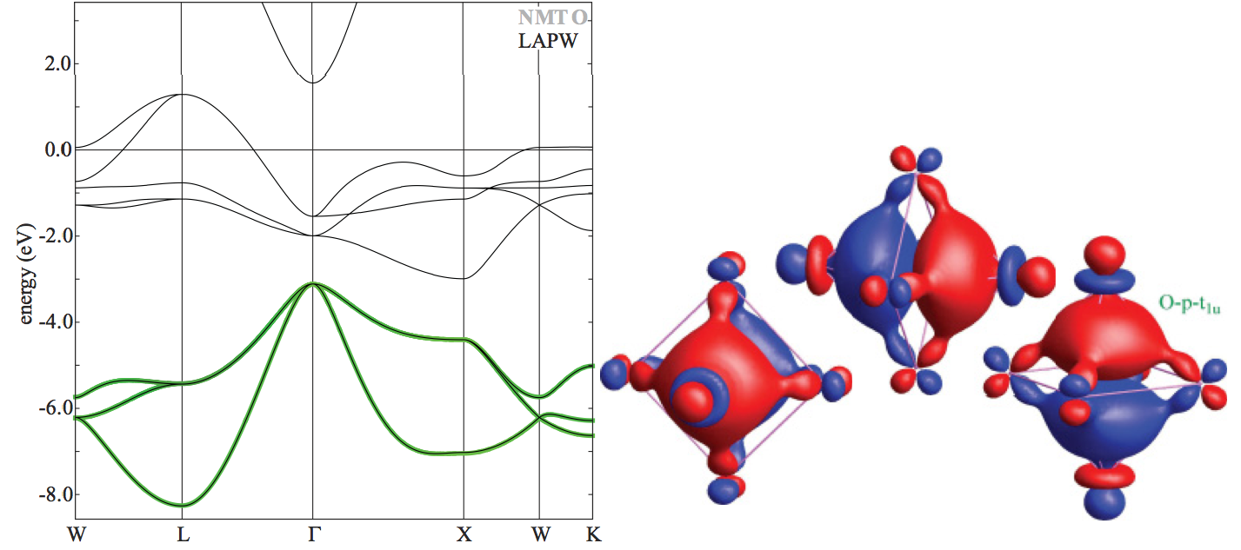
Pick a basis of “O-p” Wannier orbitals

Slide 39
NiO in a LDA band-structure picture

Slide 40
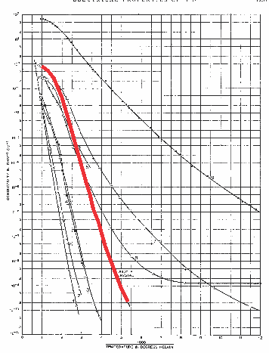
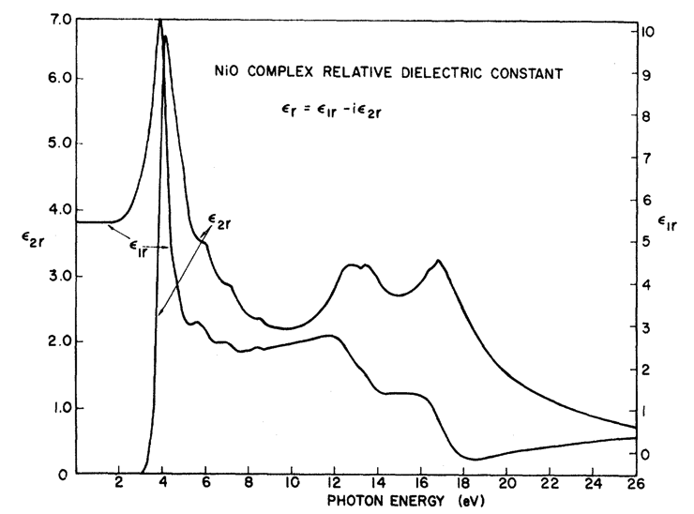
In LDA NiO is a metal: Experimentally it is a good insulator
F. J. Morin, Phys. Rev. 93, 1199 (1954)
R. Newman and R. M. Chrenko,
Phys. Rev 114 1507 (1959)
Room temperature
ρ~10⁵ Ο cm
Optical-gap
3.5 – 4.0 eV

Slide 41
“Downfold” the DFT results to obtain basis of choice

Slide 42
Orbital energy level diagram obtained from LDA

Slide 43
Orbital energy level diagram obtained from LDA

Slide 44
Orbital energy level diagram obtained from LDA

Slide 45
Orbital energy level diagram obtained from LDA

Slide 46
Orbital energy level diagram obtained from LDA

Slide 47
Create ligand orbitals from O-2p Wannier orbitals

Slide 48
Create ligand orbitals from O-2p Wannier orbitals

Slide 49
Create ligand orbitals from O-2p Wannier orbitals

Slide 50
Create ligand orbitals from O-2p Wannier orbitals

Slide 51
Create ligand orbitals from O-2p Wannier orbitals

Slide 52
Create ligand orbitals from O-2p Wannier orbitals

Slide 53
Create ligand orbitals from O-2p Wannier orbitals

Slide 54
Create ligand orbitals from O-2p Wannier orbitals

Slide 55
Create ligand orbitals from O-2p Wannier orbitals

Slide 56
Create ligand orbitals from O-2p Wannier orbitals

Slide 57
Create ligand orbitals from O-2p Wannier orbitals

Slide 58
Create ligand orbitals from O-2p Wannier orbitals

Slide 59
Create ligand orbitals from O-2p Wannier orbitals

Slide 60
Create ligand orbitals from O-2p Wannier orbitals

Slide 61
Orbital energy level diagram obtained from LDA

