Slide 1


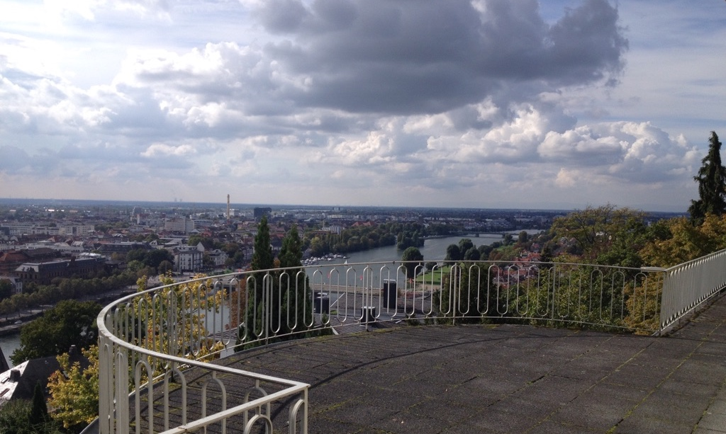
Why Spectroscopy on Quantum
materials and the philosophy of Quanty
Institute for
Theoretical Physics

Slide 2
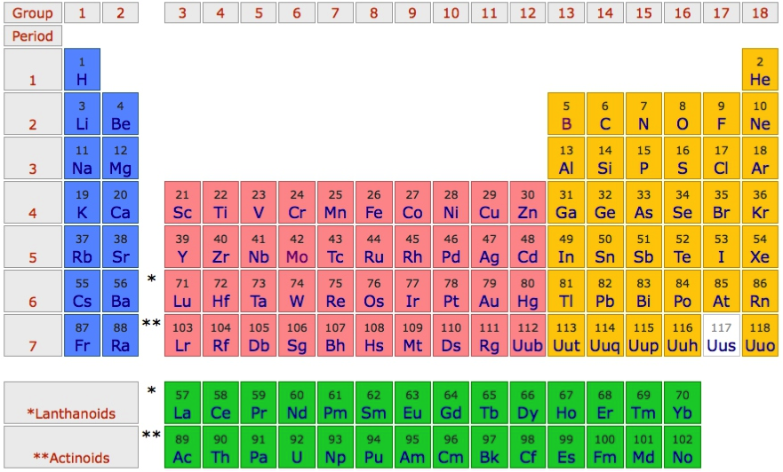
Challenges in solid state physics / chemistry
Important for technology
Important in biochemistry (active centers of enzymes)
Often open shell systems, involved to understand

Slide 3
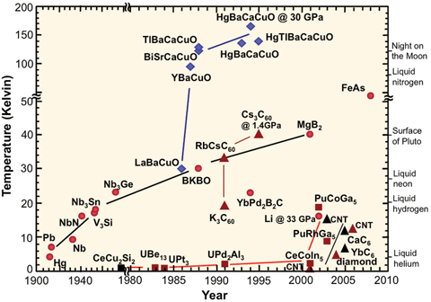
Transition metal compounds; a large variety of properties
High-Tc superconductivity

Slide 4
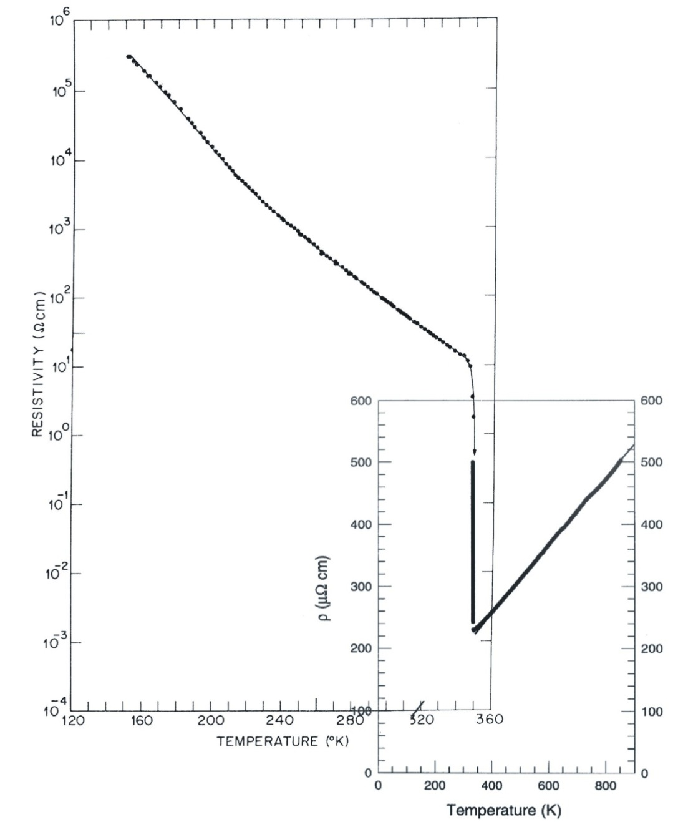
Transition metal compounds; a large variety of properties
Metal insulator transitions
VO₂
Resistivity (Ωcm)
P. B. Allen et al.,
PRB 48, 4359 (1993)
M. Marezio et al.,
PRB 5, 2541 (1972)

Slide 5
Transition metal compounds; a large variety of properties
Active centers in enzymes
Fe in Heme
Mn role in photosynthesis

Slide 6
Interaction between the charge, lattice, orbital and spin
Charge
Lattice
Spin
Orbital

Slide 7
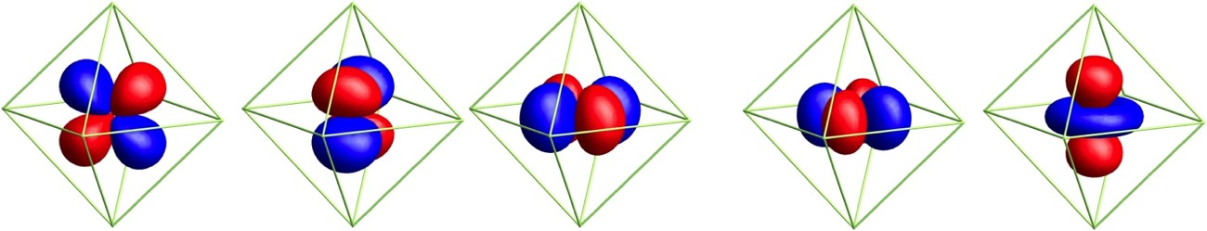
Need tools to measure
Spin arrangements (element resolved of TM multilayers)
Valence and local symmetry of TM compounds
Orbital occupation (the d (f)-shell is 5 (7) fold degenerate)
Spectroscopy
_{(x-ray spectroscopy)}
d_{yz}
d_{xz}
d_{xy}
d_{x}2_{-y}2
d_{3z}2_{-r}2
And excitations (spin-waves – magnons – orbital excitations)
How the low energy Hamiltonian emerges from the full Hamiltonian

Slide 8
Spectroscopy as a tool to test and learn
PES
Optics

Slide 9
X-ray spectroscopy as a tool to test and learn
PES
XAS
RXD
RIXS
nIXS

Slide 10
Need theory to relate the material properties to the spectra
Different models
Levels of theory
Crystal-field
Ligand-field
Anderson Impurity (DMFT)
DFT
Spin-wave theory
Different spectroscopies
PES ESR
IPES NMR
cPES STM
Optics Magnetization
XAS Specific heat
RXD Mass spectroscopy
RIXS
nIXS
XES Please list your
FY publications at
EC www.quanty.org
Merged in a script language
Not structure in result out.
You need to do some programming / modeling

