Slide 1
Core level spectroscopy of transition metal and rare earth compounds
Transition metal and rare earth compounds show a wealth of different properties. They are used as materials for energy storage (battery compounds), dyes in solar cells, elements in the read head of hard disks, high temperature superconductors, or the active centers in many of the known enzymes. The large variety of tunable properties of these materials is related to the large number of low energy degrees of freedom of the transition metal or rare earth ion. Correlations between the electrons in a solid lead to a detailed interplay between the local spin, charge, orbital and lattice degrees of freedom. The result is extremely rich physics of these open shell systems. At the same time the interplay between several low energy degrees of freedom make these materials involved to understand. Although enormous theoretical progress has been made during the last years in the understanding of correlated materials one often needs experimental input to understand particular phenomenon.
Core level spectroscopy in many cases turns out to be a very efficient method to study the many body properties of these systems. Core level photoelectron spectroscopy allows one to determine how the low energy Hamiltonian arises from the high-energy scale interactions. It thus provides information on the low energy model parameters of the system. X-ray absorption spectroscopy contains information on the local electronic structure. It provides information on the symmetry of the wave function, such as the local spin-state or orbital occupation. Resonant x-ray diffraction is related to x-ray absorption, in addition to x-ray absorption it allows one to study the special dependence of local electronic order in the system. Resonant inelastic x-ray scattering allows one to study the dynamics of low energy excitations. Non-resonant inelastic x-ray scattering of core level excitations is a technique rather comparable to x-ray absorption spectroscopy with the difference that it allows for non-dipole transitions, useful in the study of involved orbital or multipole ordering.
For the understanding of these spectra, in this class of materials, it is important to realize that one needs to treat the interactions between the electrons beyond mean field approximations. It is not sufficient to assume independent electrons interacting with an average potential, but one has to consider the interaction between each pair of electrons explicitly. In the spectra, this leads to excitons and multiplets that dominate the spectral line-shape.
In this talk I will discuss these various forms of core level spectroscopy, which material properties one can obtain with these techniques and how to theoretically understand these spectra. During the tutorial, I will introduce Quanty, (www.quanty.org) a versatile many body quantum script language that allows one to relatively easily write small programs that can calculate core level spectra of a variety of materials using different levels of approximation or models.

Slide 2
Core level spectroscopy
of transition metal and rare earth compounds
http://www.thphys.uni-heidelberg.de/~haverkort/talks/
Maurits W. Haverkort
Institute for theoretical physics, Heidelberg University, Heidelberg, Germany
M.W.Haverkort@thphys.uni-heidelberg.de

Slide 3
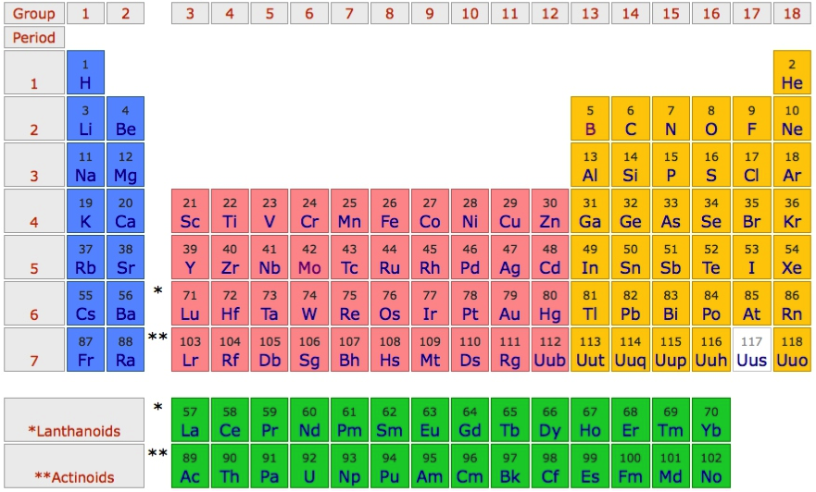
Challenges in solid state physics / chemistry
Important for technology
Important in biochemistry (active centers of enzymes)
Often open shell systems, involved to understand

Slide 4
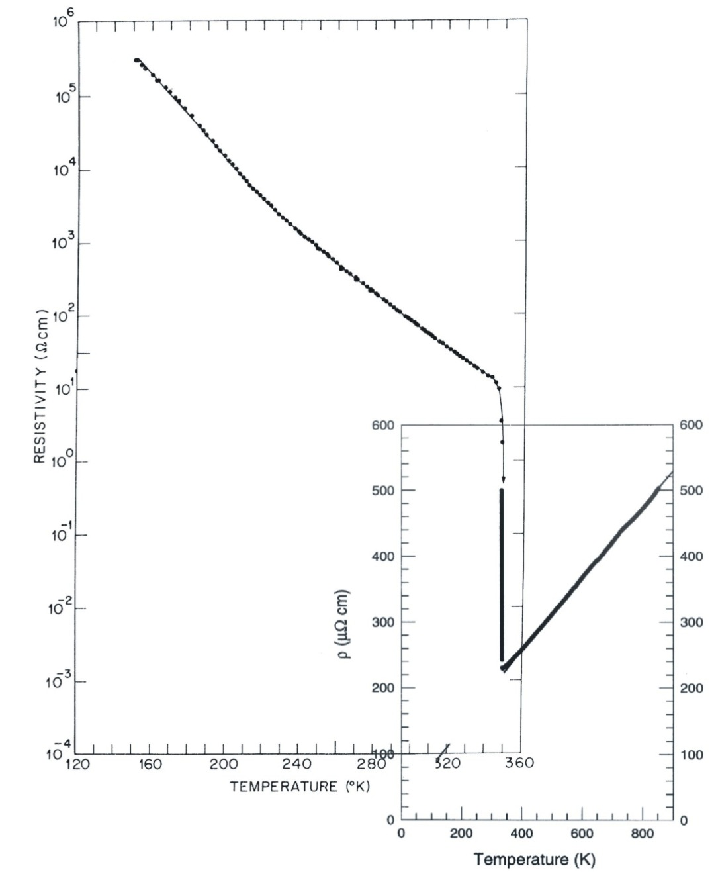
Transition metal compounds; a large variety of properties
Metal insulator transitions
VO₂
Resistivity (Ωcm)
P. B. Allen et al.,
PRB 48, 4359 (1993)
M. Marezio et al.,
PRB 5, 2541 (1972)

Slide 5
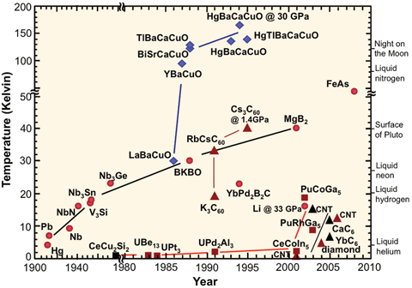
Transition metal compounds; a large variety of properties
High-Tc superconductivity

Slide 6
Transition metal compounds; a large variety of properties
Active centers in enzymes
Fe in Heme
Mn role in photosynthesis

Slide 7
Interaction between the charge, lattice, orbital and spin
Charge
Lattice
Spin
Orbital

Slide 8
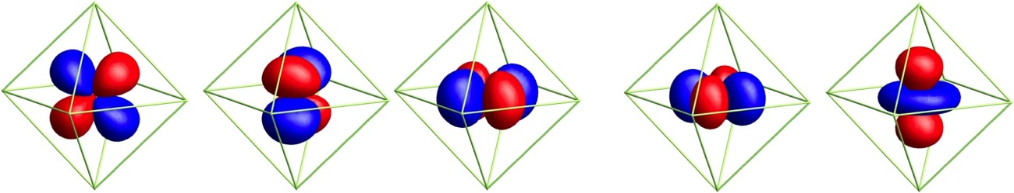
Need tools to measure
Spin arrangements (element resolved of TM multilayers)
Valence and local symmetry of TM compounds
Orbital occupation (the d-shell is 5 fold degenerate)
Spectroscopy
_{(x-ray spectroscopy)}
d_{yz}
d_{xz}
d_{xy}
d_{x}2_{-y}2
d_{3z}2_{-r}2
And excitations (spin-waves – magnons – orbital excitations)
How the low energy Hamiltonian emerges from the full Hamiltonian

Slide 9
Spectroscopy as a tool to test and learn
PES
Optics

Slide 10
X-ray spectroscopy as a tool to test and learn
PES
XAS
RXD
RIXS
nIXS

Slide 11
Second talk
RXD
RIXS
nIXS

Slide 12
First talk
PES
XAS
Slide 92
Slide 14

Slide 13
Start with X-ray Absorption Spectroscopy
2p

Slide 14
X-ray Absorption Spectroscopy – some observations
Data L. H. Tjeng et al.

Slide 15
X-ray Absorption Spectroscopy – some observations
2p
Data L. H. Tjeng et al.

Slide 16
X-ray Absorption Spectroscopy – some observations
Valence dependence – ground state symmetry determines the line shape
Data L. H. Tjeng et al.

Slide 17
X-ray Absorption Spectroscopy – some observations
Polarized XAS
Sensitive to
Orbital occupation
Natural linear dichroism
2p
C. T. Chen et al PRL 68, 2543 (1992)

Slide 18
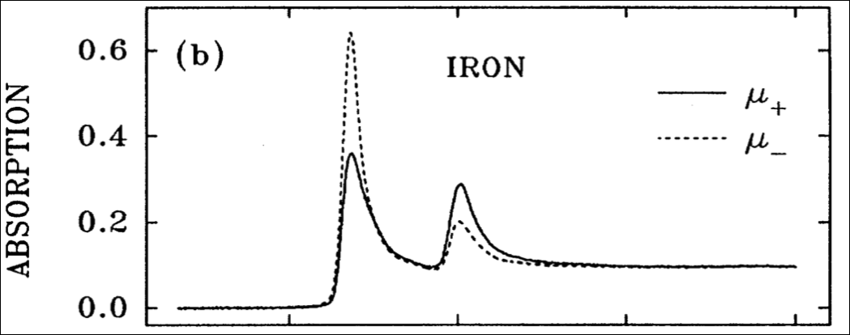
X-ray absorption spectroscopy – Spin sensitive
Polarized XAS
Sensitive to
Magnetic moments
Magnetic circular dichroism
2p
700
720
740
760
Photon energy (eV)
J. Stöhr, J. Elec. Spec. Rel. Phonom. 75, 253 (1995).

Slide 19
X-ray Absorption Spectroscopy – some observations
Polarized XAS
Sensitive to
Magnetic moments
Magnetic linear dichroism
2p
P. Kuiper et al., PRL 70, 1549 (1993)

Slide 20
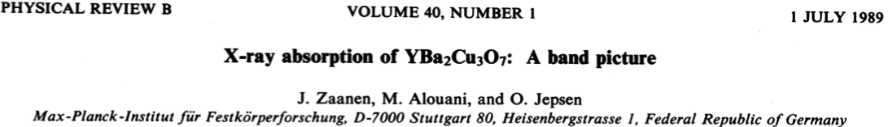
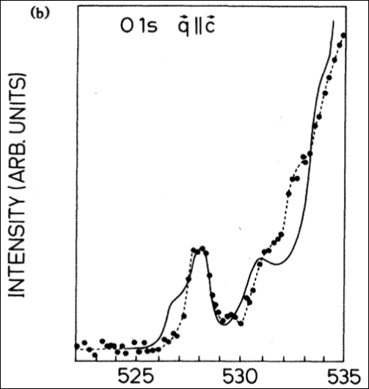
X-ray absorption spectroscopy – a band picture
1s

Slide 21
X-ray absorption spectroscopy – one electron selection rules
Fermi’s golden rule
Energy conservation
Initial state
Final state
Dipole (transition) operator

Slide 22
X-ray absorption spectroscopy – one electron selection rules

Slide 23
X-ray absorption spectroscopy – one electron selection rules

Slide 24
X-ray absorption spectroscopy – one electron selection rules

Slide 25
X-ray absorption spectroscopy – one electron selection rules
C. T. Chen et al. Phys. Rev. Lett. 68, 2543 (1992)

Slide 26
X-ray absorption spectroscopy – correlations in the d-shell
2p

Slide 27

Use NiO as an example material
O²⁻ - 2p⁶
Ni²⁺ - 4s⁰ 3d⁸

Slide 28
Partly filled degenerate d-shell – in LDA NiO is a metal

Slide 29
X-ray absorption spectroscopy – correlations in the d-shell
Experiment is sharper than LDA empty density of states
Branching ratio (L₂, L₃ intensity ratio is not 3:2)
Experiment shows more structure (multiplets) than DOS
2p

Slide 30
X-ray absorption spectroscopy – correlations in the d-shell
Experiment is sharper than LDA empty density of states
Branching ratio (L₂, L₃ intensity ratio is not 3:2)
Experiment shows more structure (multiplets) than DOS
2p

Slide 31
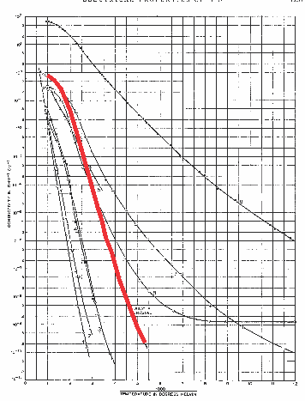
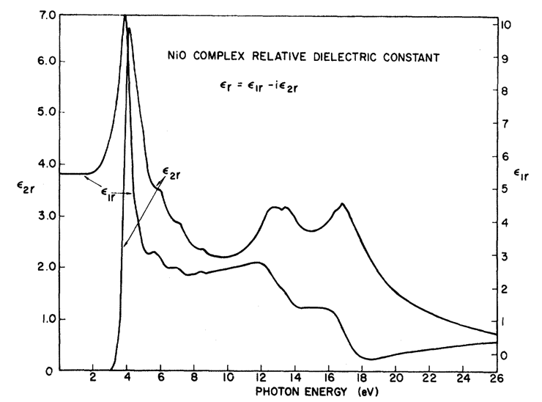
In LDA NiO is a metal: Experimentally it is a good insulator
F. J. Morin, Phys. Rev. 93, 1199 (1954)
R. Newman and R. M. Chrenko,
Phys. Rev 114 1507 (1959)
Room temperature
ρ~10⁵ Ο cm
Conductivity (Ω⁻¹ cm⁻¹)
Optical-gap
3.5 – 4.0 eV
Temperature⁻¹

Slide 32
Mott-Hubbard insulator
Difference between anti-ferromagnetic Neel order and spin-singlet configurations
Energy gain W
Energy cost U
vs.

Slide 33
Mott-Hubbard insulator
Keep all correlations on a single central site – use a (dynamical) mean-field approximation for the rest of the solid.

Slide 34
correlations in the d-shell
2p

Slide 35
correlations in the d-shell
2p

Slide 36
correlations in the d-shell
2p

Slide 37
correlations in the d-shell
2p

Slide 38
correlations in the d-shell
2p

Slide 39
correlations in the d-shell
2p

Slide 40
correlations in the d-shell
2p

Slide 41
correlations in the d-shell
2p

Slide 42
correlations in the d-shell
2p

Slide 43
X-ray absorption spectroscopy – excitons
W=1
U=20
Q=0
Core – valence interaction
Intensity
2p
Energy (eV)

Slide 44
X-ray absorption spectroscopy – excitons
W=1
U=20
Q=0.25
Intensity
2p
Energy (eV)

Slide 45
X-ray absorption spectroscopy – excitons
W=1
U=20
Q=0.5
Intensity
2p
Energy (eV)

Slide 46
X-ray absorption spectroscopy – excitons
W=1
U=20
Q=1.0
Intensity
2p
Energy (eV)

Slide 47
X-ray absorption spectroscopy – excitons
W=1
U=20
Q=1.25
Intensity
2p
Energy (eV)

Slide 48
X-ray absorption spectroscopy – excitons
W=1
U=20
Q=1.5
Intensity
2p
Energy (eV)

Slide 49
X-ray absorption spectroscopy – excitons
W=1
U=20
Q=1.75
Intensity
2p
Energy (eV)

Slide 50
X-ray absorption spectroscopy – excitons
W=1
U=20
Q=2.0
Exciton
Intensity
Continuum edge jump
2p
Energy (eV)

Slide 51
X-ray absorption spectroscopy – excitons
2p

Slide 52



X-ray absorption spectroscopy – excitons
2p

Slide 53
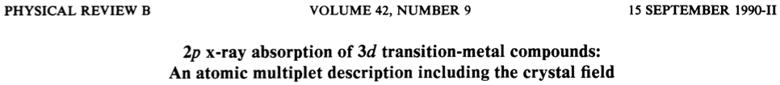
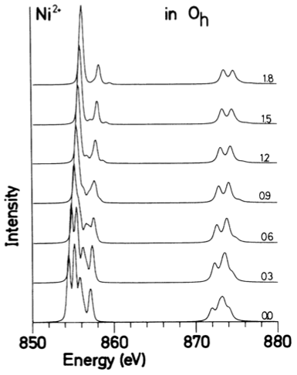
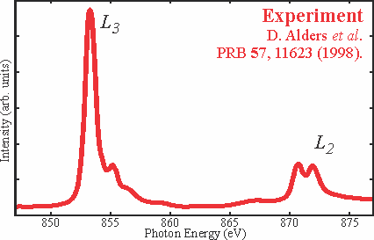
Local many body calculations based on parameters

Slide 54
Ligand field theory for NiO
O²⁻ - 2p⁶
Ni²⁺ - 4s⁰ 3d⁸

Slide 55
Orbital energy level diagram
e_{g}
t_{2g}

Slide 56
Coulomb repulsion
d_{x2-y2}
d_{xy}
Notes:
----- Meeting Notes (12/7/12 17:29) -----
Quantitative (real might be offending ...)
----- Meeting Notes (12/7/12 18:14) -----
What did I do
Development of model based on DFT wannier

Slide 57
Coulomb repulsion
Coulomb repulsion is smaller when electrons are farther apart
d_{z2}
d_{x2-y2}
d_{xy}

Slide 58
Coulomb repulsion
Coulomb repulsion is smaller when electrons are farther apart
d_{z2}
d_{x2-y2}
d_{xy}
d_{xy}

Slide 59
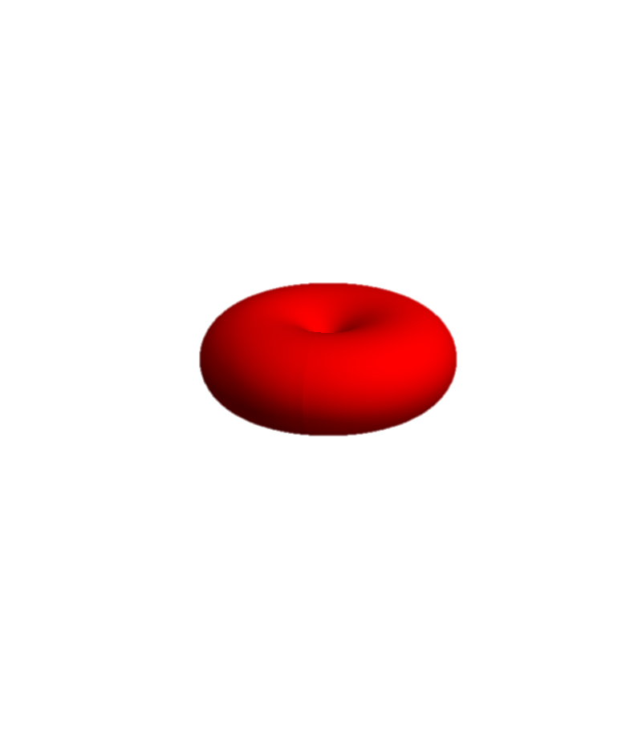
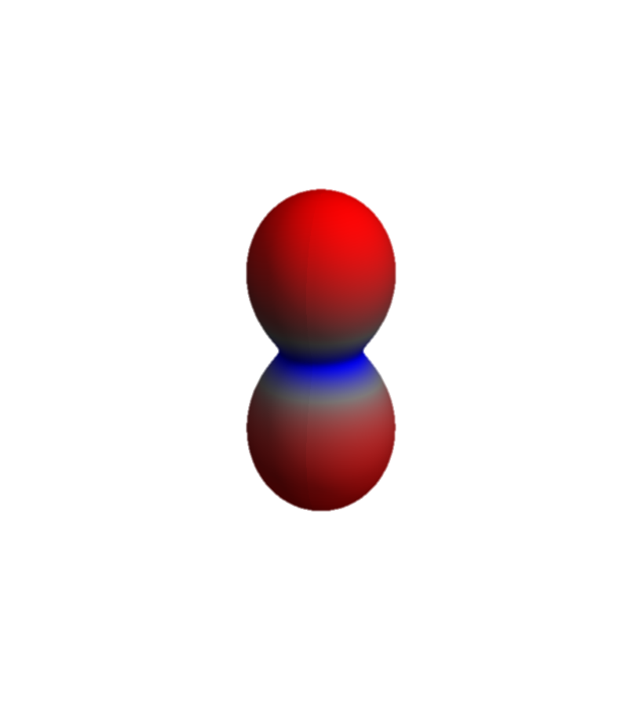
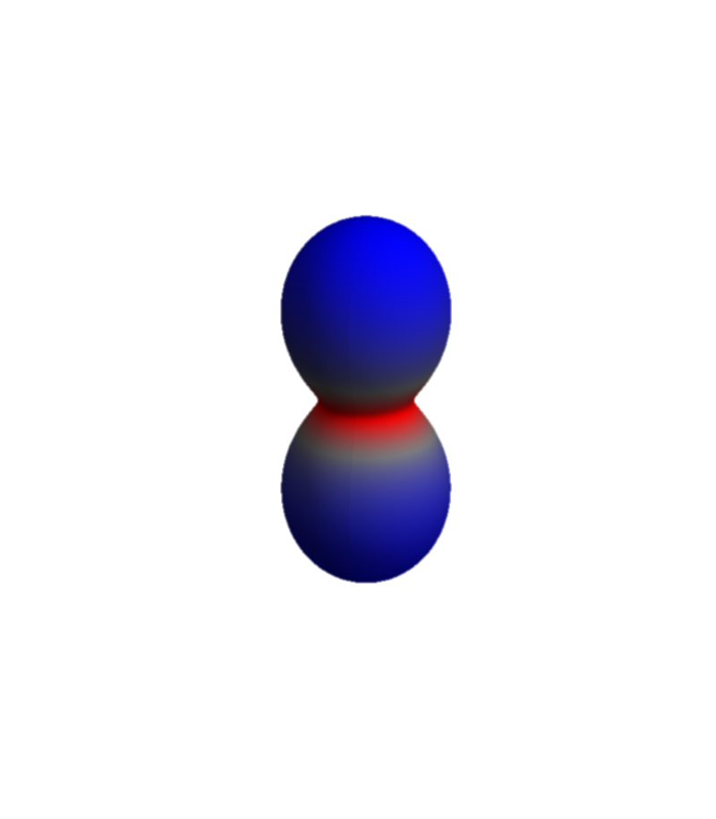
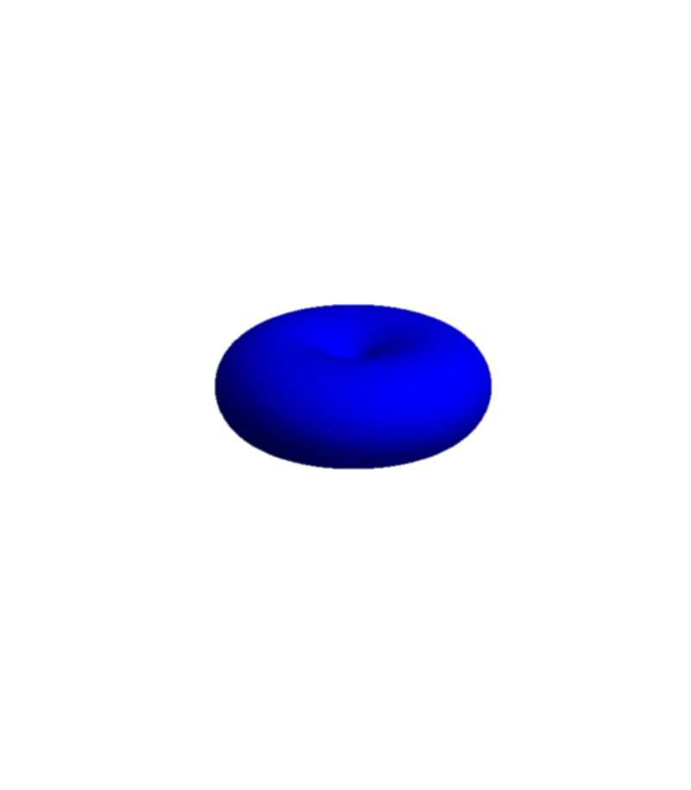

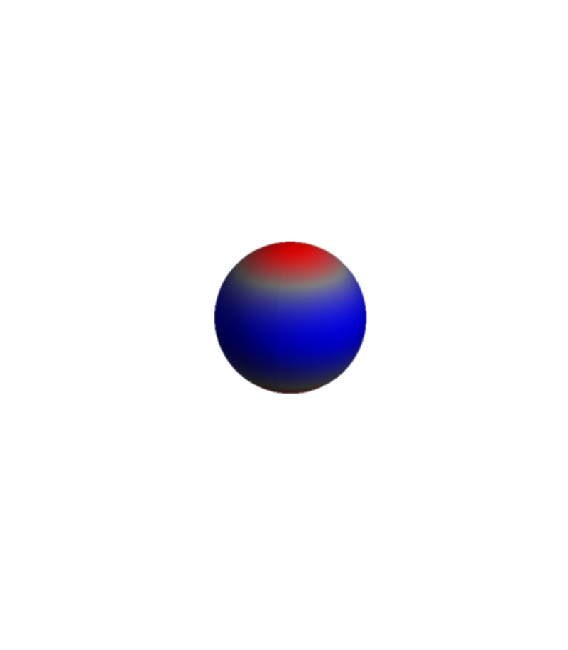
XAS final state for NiO 2p⁵3d⁹
Ni – 2p
Ni – 3d
L₃ edge
L₂ edge

Slide 60
Local many body calculations based on parameters
Parameters
Size of the Coulomb interaction
Size of the crystal-field

Slide 61
Can we calculate these parameters?
Parameters
Size of the Coulomb interaction
Size of the crystal-field
Notes:
-

Slide 62
Obtain parameters from LDA

Slide 63
In LDA NiO is a metal: Experimentally it is a good insulator
F. J. Morin, Phys. Rev. 93, 1199 (1954)
R. Newman and R. M. Chrenko,
Phys. Rev 114 1507 (1959)
Room temperature
ρ~10⁵ Ο cm
Conductivity (Ω⁻¹ cm⁻¹)
Optical-gap
3.5 – 4.0 eV
Temperature⁻¹

Slide 64
Although NiO is a metal in LDA, there are many things correct

Slide 65
“Downfold” the DFT results to obtain basis of choice

Slide 66
Pick a basis of “TM-d” and “O-p” Wannier orbitals

Slide 67
Full multiplet ligand field model based on DFT

Slide 68
How to calculate 2p X-ray Absorption Spectroscopy
Theory
Experiment
Start from LDA potential
Create Wannier functions
On this basis and potential build local Hamiltonian including all local many body interactions
Solve by exact diagonalization
Phys. Rev. B 85, 165113 (2012)
2p

Slide 69
Two levels of theory, how to decide which one to use
Example of d-d excitations in NiO
nIXS

Slide 70
Correlations, Multiplets and entanglement
An example from d-d excitations NiO
M. W. Haverkort et al. PRB 85, 165113 (2012)

Slide 71
NiO some basic properties
e_{g}
t_{2g}

Slide 72
First peak, excitation from t_{2g} to e_{g}
First peak, understandable on the level of LDA+U
M. W. Haverkort et al. PRB 85, 165113 (2012)

Slide 73
Third peak – Coulomb repulsion
Coulomb repulsion is smaller when electrons are farther apart
d_{z2}
d_{x2-y2}
d_{xy}

Slide 74
Third peak – Coulomb repulsion
Coulomb repulsion is smaller when electrons are farther apart
d_{z2}
d_{x2-y2}
d_{xy}
d_{xy}

Slide 75
Third peak – Coulomb repulsion
Third peak understandable on the level of time dependent LDA+U
M. W. Haverkort et al. PRB 85, 165113 (2012)

Slide 76
Second peak, double excitation from t_{2g} to e_{g}
Need to go beyond mean field theory
M. W. Haverkort et al. PRB 85, 165113 (2012)

Slide 77
Second peak, double excitation from t_{2g} to e_{g}
Warning!!! A single photon can only excite a single electron. The reason you see these strong double excitations is a true quantum many-body effect!
- Need to solve locally the full many-body problem
M. W. Haverkort et al. PRB 85, 165113 (2012)

Slide 78
Two levels of theory, how to decide which one to use
Correlations give rise to additional peaks in the spectrum

Slide 79
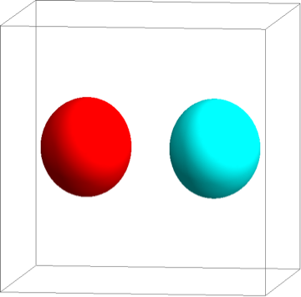

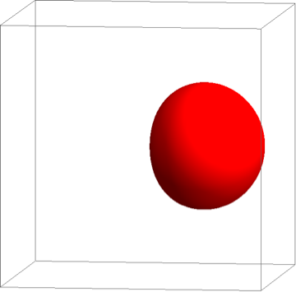
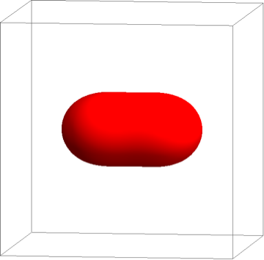
Example on an H₂ molecule
1s
1s

Slide 80
Time dependent perturbation theory
Fermi’s golden rule
Green’s function – spectral representation (energy domain)
Green’s function – (time domain)

Slide 81
Time dependent perturbation theory
Green’s function – (time domain)
At time t=0 an excitation is created
In spectroscopy one probes if at time t the excitation is still at the same place, or if it moved away.
Spectroscopy probes the dynamics of the system

Slide 82
Example on an H₂ molecule
1s
1s

Slide 83
Example on an H₂ molecule
1s
1s

Slide 84
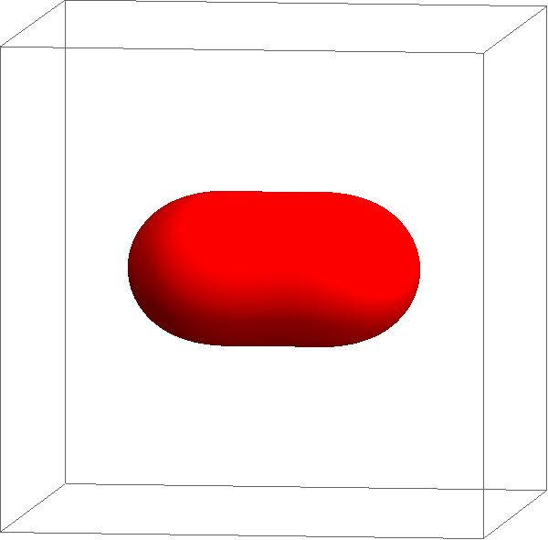
Example on an H₂ molecule
1s
1s

Slide 85

Example on an H₂ molecule
Intensity
Excitation energy

Slide 86

Example on an H₂ molecule – with correlations

Slide 87
Example on an H₂ molecule – with correlations

Slide 88

Example on an H₂ molecule – with correlations

Slide 89

Example on an H₂ molecule – with correlations

Slide 90
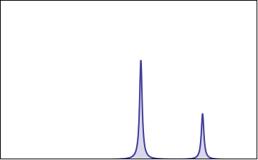
Example on an H₂ molecule – with correlations
Intensity
Excitation energy

Slide 91
Example on an H₂ molecule – with correlations
1s
1s
Intensity
Excitation energy

Slide 92
Core level photo electron spectroscopy
PES

Slide 93
Example on Gold (Au)
PES

Slide 94
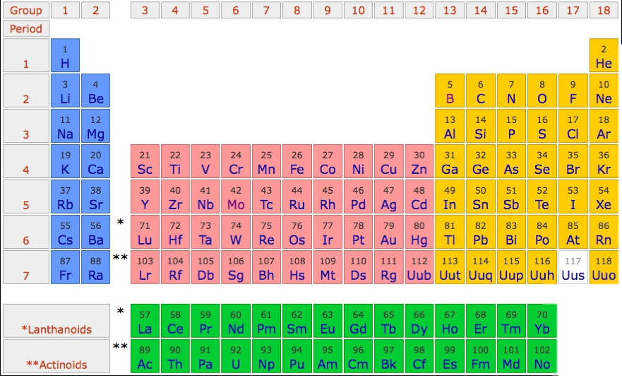
Example on Gold (Au)

Slide 95
Example on Gold (Au)
Au – [Xe] 6s² 5d⁹

Slide 96
Example on Gold (Au)
Au – [Xe] 5d¹⁰ 6(sp)¹

Slide 97
Example on Gold (Au) – 5d and 6s

Slide 98
Example on Gold (Au) – 5p

Slide 99
Example on Gold (Au) – 5s

Slide 100
Example on Gold (Au) – 4f

Slide 101
Example on Gold (Au) – 4d

Slide 102
Example on Gold (Au) – 4p

Slide 103
Example on Gold (Au) – 4s
760 eV or
880000 Kelvin

Slide 104
Naming conventions
n | l | j | degeneracy | edge
1 | s | 1/2 | 2 | K
2 | s | 1/2 | 2 | L₁
 | p | 1/2 | 2 | L₂
 |  | 3/2 | 4 | L₃
3 | s | 1/2 |  | M₁
 | p | 1/2 |  | M₂
 |  | 3/2 |  | M₃
 | d | 3/2 |  | M₄
 |  | 5/2 |  | M₅
4 | s | 1/2 |  | N₁
 | p | 1/2 |  | N₂
 |  | 3/2 |  | N₃
 | …
N₁
N₂
N₃
N₄
N₅
N_{6,7}

Slide 105
Example on Gold (Au) – valence band

Slide 106
Example on Gold (Au) – valence band

Slide 107
Example on Gold (Au) – valence band
Experiment

Slide 108
Example on Gold (Au) – valence band
Density functional theory
Experiment
s
p
d

Slide 109
Example on Gold (Au) – valence band
Density functional theory
Experiment
s
p
d

Slide 110
Example on Gold (Au) – valence band

Slide 111
Example on Gold (Au) – valence band

Slide 112
Example on Gold (Au) – 4f core level

Slide 113
Example on Gold (Au) – XPS

Slide 114
2p_{3/2} PES of Ni metal is not a delta function

Slide 115
2p_{3/2} PES of Ni metal is not a delta function

Slide 116
2p_{3/2} PES of Ni metal is not a delta function

Slide 117
Edge singularity – a model with core-valence interaction
PES
Core – valence interaction: Q

Slide 118
Edge singularity – a model with core-valence interaction
PES

Slide 119
Edge singularity – a model with core-valence interaction
PES

Slide 120
Edge singularity – a model with core-valence interaction
PES

Slide 121
Edge singularity – a model with core-valence interaction
PES

Slide 122
Edge singularity – a model with core-valence interaction
PES

Slide 123
Edge singularity – a model with core-valence interaction
PES

Slide 124
Edge singularity
PES

Slide 125
Edge singularity – a model with core-valence interaction
PES

Slide 126
Edge singularity – a model with core-valence interaction
PES

Slide 127
Edge singularity – a model with core-valence interaction
PES

Slide 128
2p_{3/2} PES of Ni metal is not a delta function
PES

Slide 129
4f_{7/2} PES of Au metal is not a delta function

Slide 130
4f_{7/2} PES of Au metal is not a delta function

Slide 131
4f_{7/2} PES of Au metal is not a delta function

Slide 132
2p_{3/2} PES of Ni metal is not a delta function
PES
Core – valence interaction: Q

Slide 133
Multiple peaks from metal to correlated metal to insulator
PES
Groundstate: ψ = α s⁰ + β s¹ + γ s²
Final states: Energy:
cs⁰ ½ U + Q
cs¹ 0
cs² ½ U - Q
cs⁰
cs¹
cs²

Slide 134
Multiple peaks from metal to correlated metal to insulator
PES
Multiple peaks can be used to determine mixed valence contributions to ground-state – measure of correlations
For an fully itinerant system the different possible valences are statistically distributed.
example of H₂ molecule
Groundstate: ψ = α s⁰ + β s¹ + γ s²
ψ = ½ s⁰ + ¼ s¹ + ½ s²
For a strongly correlated system only one valence contributes to the ground-state.
example of H₂ molecule
Groundstate: ψ = α s⁰ + β s¹ + γ s²
ψ = 0 s⁰ + 1 s¹ + 0 s²

Slide 135
correlations in the d-shell
DMFT
Locally all correlations
Non-local mean-field
See talk of Silke?

Slide 136
correlations in the d-shell
DMFT
Locally all correlations
Non-local mean-field
See talk of Silke?

Slide 137
correlations in the d-shell
DMFT
Locally all correlations
Non-local mean-field
See talk of Silke?

Slide 138
correlations in the d-shell
DMFT
Locally all correlations
Non-local mean-field
See talk of Silke?

Slide 139
correlations in the d-shell
DMFT
Locally all correlations
Non-local mean-field
See talk of Silke?

Slide 140
correlations in the d-shell
DMFT
Locally all correlations
Non-local mean-field
See talk of Silke?

Slide 141
correlations in the d-shell
DMFT
Locally all correlations
Non-local mean-field
See talk of Silke?

Slide 142
correlations in the d-shell
DMFT
Locally all correlations
Non-local mean-field
See talk of Silke?

Slide 143
correlations in the d-shell
DMFT
Locally all correlations
Non-local mean-field
See talk of Silke?

Slide 144
Multiple peaks from metal to correlated metal to insulator
PES
cs⁰
cs¹
cs²

Slide 145
Multiple peaks from metal to correlated metal to insulator
PES
cs⁰
cs¹
cs²

Slide 146
Multiple peaks from metal to correlated metal to insulator
PES
cs⁰
cs¹
cs²

Slide 147
Multiple peaks from metal to correlated metal to insulator
PES
cs⁰
cs¹
cs²

Slide 148
Multiple peaks from metal to correlated metal to insulator
PES
cs⁰
cs¹
cs²

Slide 149
2p PES of CuO is truly not a delta function
PES

Slide 150
Electronic structure of CuO
O²⁻ - 2p⁶
Cu²⁺ - 4s⁰ 3d⁹

Slide 151
2p PES final state for CuO 2p⁵3d⁹ and 2p⁵3d¹⁰L
Groundstate locally: ψ = α d⁹ + β d¹⁰L
Energy
d⁹ 0
d¹⁰L Δ
Final states Energy
cd⁹ 0
cd¹⁰L Δ-Q

Slide 152
CuO
PES

Slide 153
2p PES final state for CuO 2p⁵3d⁹
Ni – 2p
Ni – 3d
L₃ edge
L₂ edge

Slide 154
Quiz: what happens when a photon hits an atom?
For example an H atom with one electron in the s-shell
A) At some point in time the photon gets absorbed, the photon disappears and the electron in the s-shell is excited to the p-shell
B) Photons are electromagnetic waves. The electron starts to oscillate around the nucleus with the photon frequency
C) Electrons are particles. The photon bounces like a ball of the electron, thereby transferring part of its energy to the electron
Notes:
I know that the 1s to 2p excitation of H is not in the x-ray range ( ¾ Rydberg, 10.2 eV) but all our theories are conveniently rather independent from the actual energy scale. (Linear response does not depend on the value of omega) For the purist replace H by Fe25+ (also a single electron around a nucleus, but as Z=26 in this case the excitation energy is 26^2 * ¾ = 507 Rydberg or 6898 eV)

