Slide 1
Core level spectroscopy of transition metal and rare earth compounds
Transition metal and rare earth compounds show a wealth of different properties. They are used as materials for energy storage (battery compounds), dyes in solar cells, elements in the read head of hard disks, high temperature superconductors, or the active centers in many of the known enzymes. The large variety of tunable properties of these materials is related to the large number of low energy degrees of freedom of the transition metal or rare earth ion. Correlations between the electrons in a solid lead to a detailed interplay between the local spin, charge, orbital and lattice degrees of freedom. The result is extremely rich physics of these open shell systems. At the same time the interplay between several low energy degrees of freedom make these materials involved to understand. Although enormous theoretical progress has been made during the last years in the understanding of correlated materials one often needs experimental input to understand particular phenomenon.
Core level spectroscopy in many cases turns out to be a very efficient method to study the many body properties of these systems. Core level photoelectron spectroscopy allows one to determine how the low energy Hamiltonian arises from the high-energy scale interactions. It thus provides information on the low energy model parameters of the system. X-ray absorption spectroscopy contains information on the local electronic structure. It provides information on the symmetry of the wave function, such as the local spin-state or orbital occupation. Resonant x-ray diffraction is related to x-ray absorption, in addition to x-ray absorption it allows one to study the special dependence of local electronic order in the system. Resonant inelastic x-ray scattering allows one to study the dynamics of low energy excitations. Non-resonant inelastic x-ray scattering of core level excitations is a technique rather comparable to x-ray absorption spectroscopy with the difference that it allows for non-dipole transitions, useful in the study of involved orbital or multipole ordering.
For the understanding of these spectra, in this class of materials, it is important to realize that one needs to treat the interactions between the electrons beyond mean field approximations. It is not sufficient to assume independent electrons interacting with an average potential, but one has to consider the interaction between each pair of electrons explicitly. In the spectra, this leads to excitons and multiplets that dominate the spectral line-shape.
In this talk I will discuss these various forms of core level spectroscopy, which material properties one can obtain with these techniques and how to theoretically understand these spectra. During the tutorial, I will introduce Quanty, (www.quanty.org) a versatile many body quantum script language that allows one to relatively easily write small programs that can calculate core level spectra of a variety of materials using different levels of approximation or models.

Slide 2
Core level spectroscopy
of transition metal and rare earth compounds
http://www.thphys.uni-heidelberg.de/~haverkort/teaching/
Maurits W. Haverkort
Institute for theoretical physics, Heidelberg University, Heidelberg, Germany
M.W.Haverkort@thphys.uni-heidelberg.de

Slide 3
Quiz: what happens when a photon hits an atom?
For example an H atom with one electron in the s-shell
A) At some point in time the photon gets absorbed, the photon disappears and the electron in the s-shell is excited to the p-shell
B) Photons are electromagnetic waves. The electron starts to oscillate around the nucleus with the photon frequency
C) Electrons are particles. The photon bounces like a ball of the electron, thereby transferring part of its energy to the electron
Notes:
I know that the 1s to 2p excitation of H is not in the x-ray range ( ¾ Rydberg, 10.2 eV) but all our theories are conveniently rather independent from the actual energy scale. (Linear response does not depend on the value of omega) For the purist replace H by Fe25+ (also a single electron around a nucleus, but as Z=26 in this case the excitation energy is 26^2 * ¾ = 507 Rydberg or 6898 eV)

Slide 4
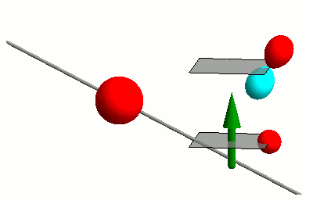
Interaction of photons with matter
RIXS
nIXS

Slide 5

Interaction of photons with matter
RIXS
nIXS

Slide 6
Response theory (linear)
Fermi’s golden rule
Energy conservation
Initial state
Final state

Slide 7
Response theory (linear)
Fermi’s golden rule
The math simplifies with the use of Green’s functions

Slide 8
Response theory (linear)
Fermi’s golden rule
The math simplifies with the use of Green’s functions

Slide 9
Response theory (linear)
Fermi’s golden rule
The math simplifies with the use of Green’s functions

Slide 10
Response theory
First order response functions
Higher order response functions (two photon, second order)

Slide 11
Second talk
XAS
RXD
RIXS
nIXS
Slide 63
Slide 98
Slide 115
Slide 17

Slide 12
Need tools to measure: Orbital, Spin, Charge
X-ray Absorption Spectroscopy (XAS) at the TM 2p to 3d edge
Technique developed in late 1980’s
Fink, Sawatzky, Fuggle
Thole, van der Laan
Chen, Sette
2p

Slide 13
Need tools to measure: Orbital, Spin, Charge
X-ray Absorption Spectroscopy (XAS) at the TM 2p to 3d edge
Resonant X-ray Diffraction (RXD)
Hannon, Trammel, Bloom, Gibbs
Phys. Rev. Lett. 61, 1245 (1988)
Phys. Rev. B 43, 5663 (1991)
Cara, Thole
Rev. Mod. Phys. 66, 1509 (1994)
2p

Slide 14
Need tools to measure: Orbital, Spin, Charge
X-ray Absorption Spectroscopy (XAS) at the TM 2p to 3d edge
Resonant X-ray Diffraction (RXD)
Resonant Inelastic X-ray Scattering (RIXS)
Theory prediction of magnetic excitations
J. Luo, G. T. Trammell, and J. P. Hannon,
Phys. Rev. Lett. 71, 287 (1993).
F.M.F. de Groot, P. Kuiper, and G. A. Sawatzky,
Phys. Rev. B 57, 14584 (1998).
Experimental realization
L. Braicovich, G. Ghiringhelli, N. B. Brookes, et al.
Phys. Rev. Lett. 102, 167401 (2009).
2p

Slide 15
Need tools to measure: Orbital, Spin, Charge
X-ray Absorption Spectroscopy (XAS) at the TM 2p to 3d edge
Resonant X-ray Diffraction (RXD)
Resonant Inelastic X-ray Scattering (RIXS)
non-resonant Inelastic X-ray Scattering (IXS)
Nobelprize Compton
Light elements – band excitations:
Keijo Hämäläinen, W. Schulke
Excitonic excitations TM and RE compounds:
B. C. Larson et al. PRL 99, 026401 (2007)
M. W. Haverkort et al. PRL 99, 257401 (2007)
R. A. Gordon, et al. EPL 81, 26004 (2008)
T. Willers, et al. PRL 109, 046401 (2012)
3p

Slide 16
non-resonant Inelastic X-ray Scattering (IXS)
X-ray Absorption Spectroscopy (XAS) at the TM 2p to 3d edge
3p

Slide 17
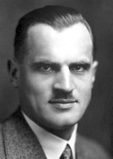
Compton scattering
CeO₂
The Nobel Prize in Physics 1927
Data R. Gordon et al.

Slide 18
Compton scattering
CeO₂
The Nobel Prize in Physics 1927
Data R. Gordon et al.

Slide 19
Compton scattering
CeO₂
The Nobel Prize in Physics 1927
Data R. Gordon et al.

Slide 20
Compton scattering
CeO₂
Resonances
(4d to 4f excitation)
The Nobel Prize in Physics 1927
Data R. Gordon et al.

Slide 21
Compton scattering
CeO₂
Resonances
(4d to 4f excitation)
The Nobel Prize in Physics 1927
Data R. Gordon et al.

Slide 22
Compton scattering
CeO₂
These are resonances
in non-resonant IXS
Resonances
(4d to 4f excitation)
The Nobel Prize in Physics 1927
Data R. Gordon et al.

Slide 23
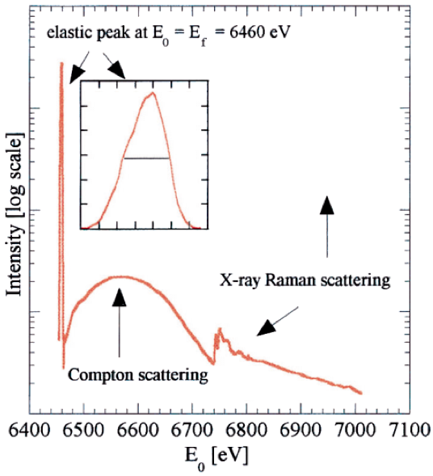
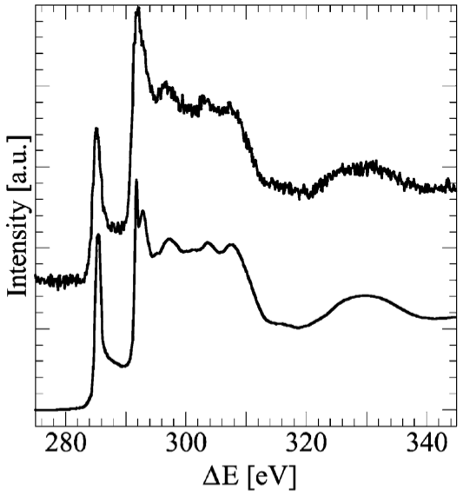
Bulk-sensitive XAS characterization of light elements
U. Bergmann, P. Glatzel, S. P. Cramer
Microchemical Journal 71, 221 (2002)
C
Resonances
(1s to 2p excitation)
IXS
XAS

Slide 24
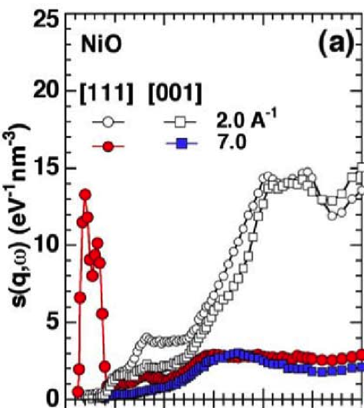

Not so light elements – clear dd excitations in NiO and CoO
B. C. Larson et al.
Phys. Rev. Lett. 99, 026401 (2007).

Slide 25
Two years later with good statistics and fine structure
Experiment:
R. Verbeni, et al. J. Synchrotron Rad. 16, 469 (2009).
Ab initio theory:
M. W. Haverkort et al. PRB 85, 165113 (2012).

Slide 26
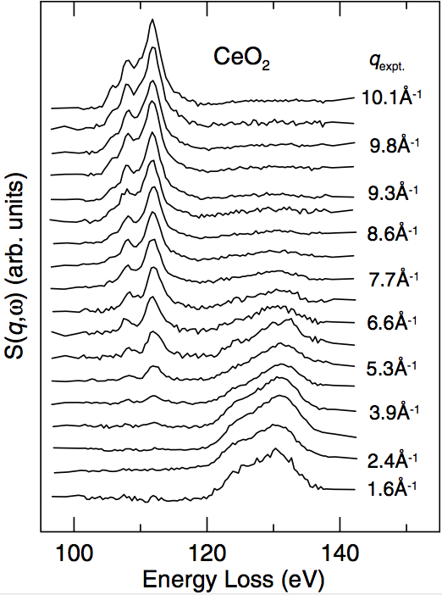
And even clear core-valence excitations in CeO₂
R. A. Gordon, et al.
Euro. Phys. Lett. 81, 26004 (2008)

Slide 27
And even clear core-valence excitations in CeO₂
R. A. Gordon, et al.
Euro. Phys. Lett. 81, 26004 (2008)

Slide 28
And even clear core-valence excitations in CeO₂
R. A. Gordon, et al.
Euro. Phys. Lett. 81, 26004 (2008)

Slide 29
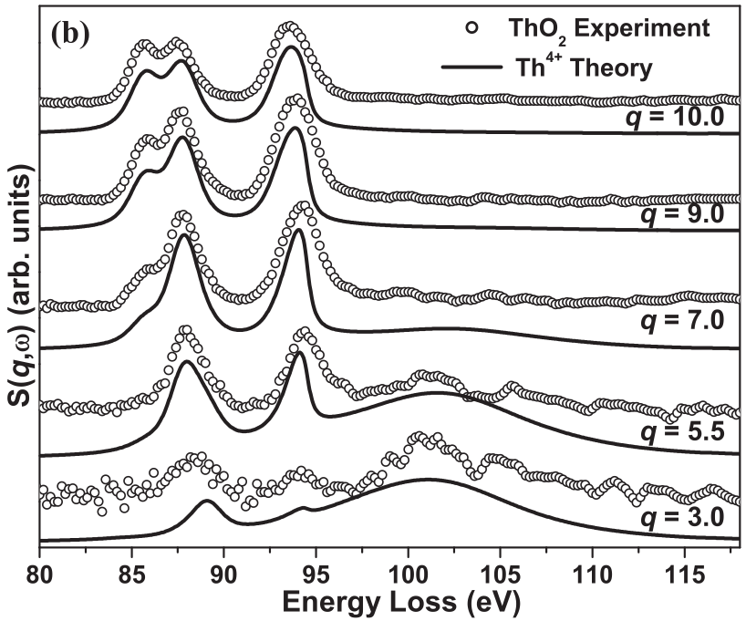
And in U and Th compounds
J. A. Bradley et al.
Phys. Rev. B 81, 193104
(2010).
Subhra Sen Gupta et al.
Phys. Rev. B 84, 075134
(2011).

Slide 30
How can one understand these spectra?
Good intensities (spectra in less than an hour) in some cases
Strong momentum dependence, independent of the Brillouine zone
In CeO₂ at the 4d to 4f edge, the energy of the d to f excitations shift by 20 eV depending if one looks in forward scattering or backward scattering…

Slide 31
Non-resonant inelastic x-ray scattering

Slide 32
Non-resonant inelastic x-ray scattering

Slide 33
Non-resonant inelastic x-ray scattering

Slide 34
Non-resonant inelastic x-ray scattering

Slide 35
Non-resonant inelastic x-ray scattering
Dynamical (charge) structure factor

Slide 36
Introducing atomic form factors for excitonic excitations
Bloch waves
Dispersion within a Brillouine zone
“Atomic” form factor
For example localized Wannier orbitals

Slide 37
Atomic like orbitals as basis states in a solids

Slide 38
Atomic like orbitals as basis states in a solids

Slide 39
Atomic like orbitals – Multipole expansion

Slide 40
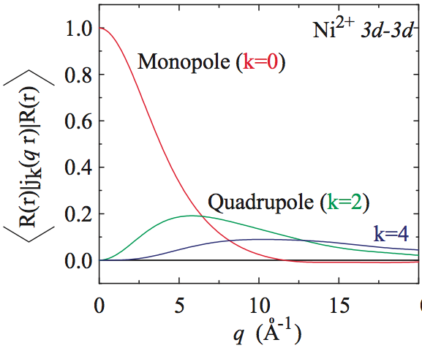
Multipole expansion – |q| dependence

Slide 41
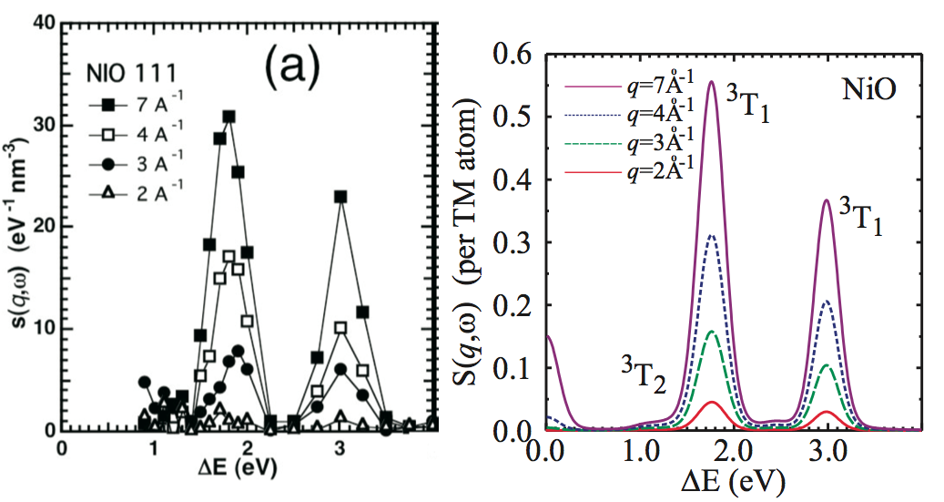
Multipole expansion – |q| dependence
Experiment: B. C. Larson et al. PRL 99, 026401 (2007) – Theory: M. W. Haverkort et al. PRL 99, 257401 (2007).

Slide 42
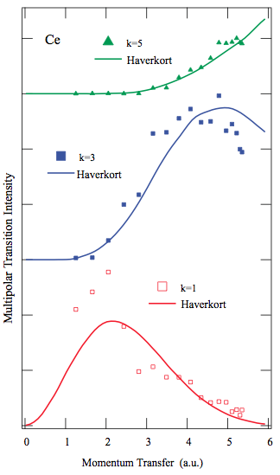
Multipole expansion – |q| dependence
Why are the multipole excitations at lower energy so much sharper and thus clearer to see?
Phys. Rev. Lett. 99, 257401 (2007)
J. A. Bradley et al.,
Phys. Rev. B 84, 205105 (2011).
R. A. Gordon, et al.
Euro. Phys. Lett. 81, 26004 (2008)

Slide 43
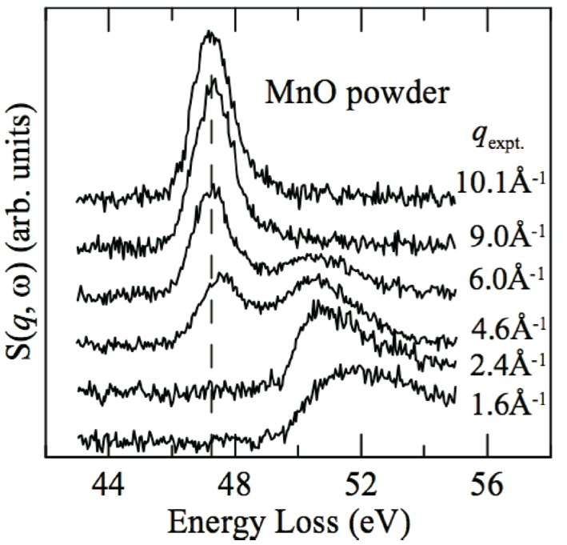
Multipole expansion – |q| dependence
R. A. Gordon, et al.
J. Phys.: Conf. Series 190, 012047
(2009)

Slide 44
Multipole expansion – |q| dependence
J. A. Bradley et al.
Phys. Rev. B 81, 193104
(2010).
Subhra Sen Gupta et al.
Phys. Rev. B 84, 075134
(2011).

Slide 45
Multipole expansion – |q| dependence
5d to 5f in Actanides
4d to 4f in Lanthanides
3p to 3d in Transition metal compounds

Slide 46
Multipole expansion – |q| dependence
Core – valence coulomb interaction
5d to 5f in Actanides
4d to 4f in Lanthanides
3p to 3d in Transition metal compounds

Slide 47
Multipole expansion – |q| dependence
Multiplet splitting
5d to 5f in Actanides
4d to 4f in Lanthanides
3p to 3d in Transition metal compounds

Slide 48
Multipole expansion – |q| dependence
Interaction with continuum
5d to 5f in Actanides
4d to 4f in Lanthanides
3p to 3d in Transition metal compounds

Slide 49
Multipole expansion – |q| dependence
J. A. Bradley et al.
Phys. Rev. B 81, 193104
(2010).
Subhra Sen Gupta et al.
Phys. Rev. B 84, 075134
(2011).

Slide 50
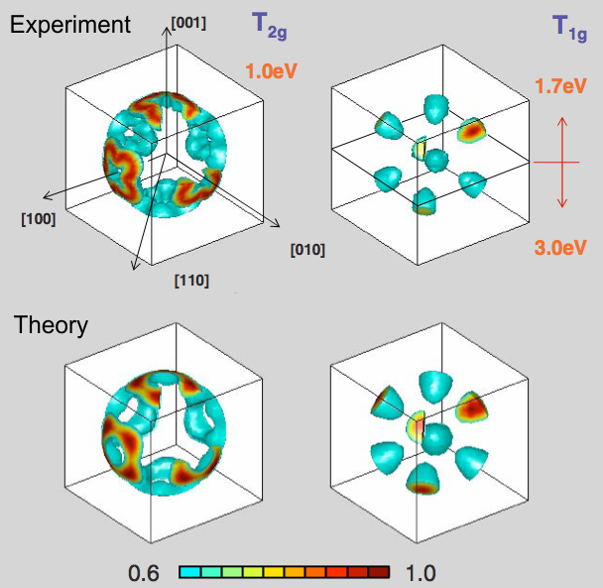
Multipole expansion – direction of q dependence
N. Hiraoka et al.,
Euro. Phys. Lett. 96, 37007 (2011).

Slide 51
Multipole expansion – direction of q dependence
Experiment:
R. Verbeni, et al. J. Synchrotron Rad. 16, 469 (2009).
Ab initio theory:
M. W. Haverkort et al. PRB 85, 165113 (2012).

Slide 52
Multipole expansion – direction of q dependence

Slide 53
Multipole expansion – direction of q dependence
Single transition

Slide 54
Multipole expansion – direction of q dependence
Double transition

Slide 55
Multipole expansion – direction of q dependence

Slide 56
Multipole expansion – direction of q dependence

Slide 57
Multipole expansion – direction of q dependence
N. Hiraoka et al.,
Euro. Phys. Lett. 96, 37007 (2011).

Slide 58
Angle dependence in cubic MnO

Slide 59
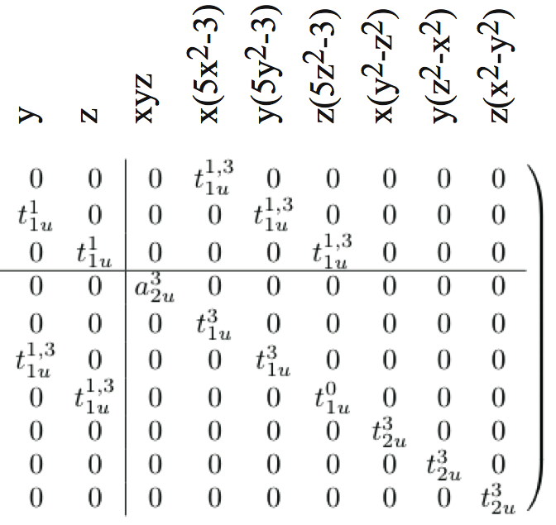
Angle dependence in cubic MnO

Slide 60
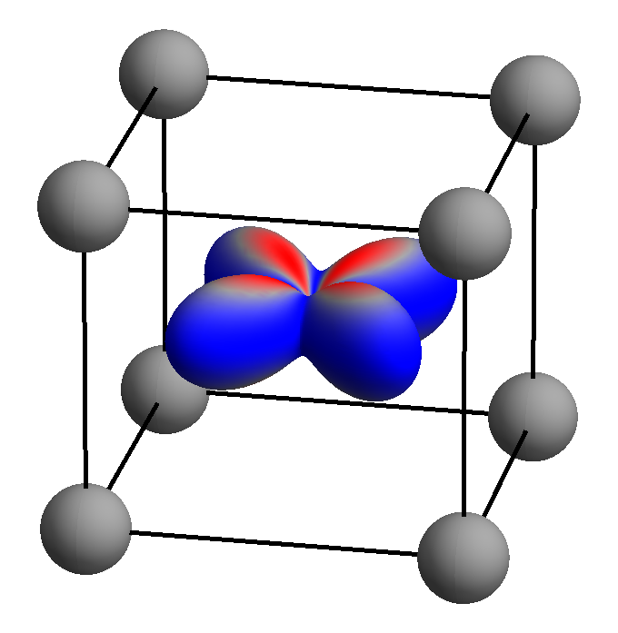
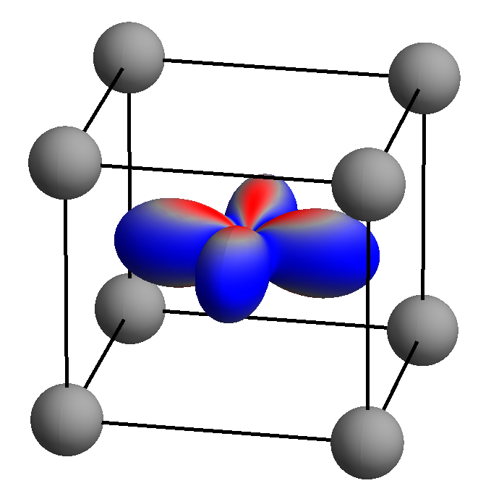
Ground-state wave-function in CeCu₂Si₂
Two possible ground-state symmetries in CeCu₂Si₂, that show exactly the same dipole spectra
Notes:
----- Meeting Notes (12/7/12 18:46) -----
explain collors
put atoms in there

Slide 61
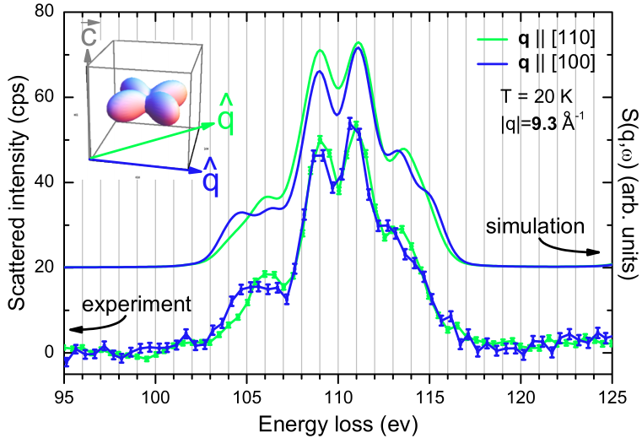
Solution – triacontadipole transitions
T. Willers et al.PRL 109, 046401 (2012)
Notes:
----- Meeting Notes (12/7/12 18:46) -----
explain collors
put atoms in there

Slide 62
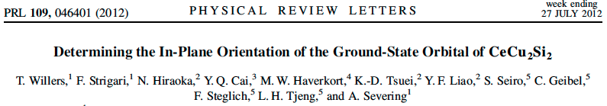
The use of higher than dipole transitions, as present in inelastic x-ray scattering allowed us to distinguish.
Important for ground-state symmetry of many 4f heavy fermion compounds
Could be important for the understanding of chemical binding in 5f compounds:
(Am, Pu, U, Th)
Notes:
----- Meeting Notes (12/7/12 18:46) -----
emphesise this entanglement
allowed us to dischtingus between the two orbitals

Slide 63
Back to XAS
X-ray Absorption Spectroscopy (XAS) at the TM 2p to 3d edge
Technique developed in late 1980’s
Fink, Sawatzky, Fuggle
Thole, van der Laan
Chen, Sette
2p

Slide 64
Two ways to calculate XAS

Slide 65

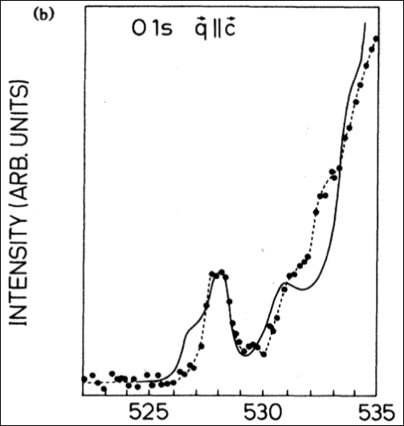
Two ways to calculate XAS – bands
1s

Slide 66
Two ways to calculate XAS – excitons
Theory
Experiment
Start from LDA potential
Create Wannier functions
On this basis and potential build local Hamiltonian including all local many body interactions
Solve by exact diagonalization
Phys. Rev. B 85, 165113 (2012)
2p

Slide 67
Interpretation without theory – sum rules
Theory
Experiment
2p

Slide 68
Sum rules for circular dichroism: orbital and spin momentum

Slide 69
Sum rules for circular dichroism: orbital and spin momentum

Slide 70
Sum rules for circular dichroism: orbital and spin momentum

Slide 71
Sum rules for circular dichroism: orbital and spin momentum

Slide 72
Sum rules for circular dichroism: orbital and spin momentum

Slide 73
Sum rules for circular dichroism: orbital and spin momentum

Slide 74
Sum rules for linear dichroism: orbital occupation

Slide 75
XAS and the conductivity tensor (σ) – an example for s to p
Real
Imaginary
Absorption –Im[σ]
(in Landau Lifschitz absorption is Re[σ])
ω₀

Slide 76
But the conductivity tensor (σ) is a TENSOR

Slide 77
But the conductivity tensor (σ) is a TENSOR
Absorption
–Im[ε.σ.ε]

Slide 78
But the conductivity tensor (σ) is a TENSOR
Spectrum measured with
x-polarized light

Slide 79
But the conductivity tensor (σ) is a TENSOR
Spectrum measured with
y-polarized light

Slide 80
But the conductivity tensor (σ) is a TENSOR
Spectrum measured with
z-polarized light

Slide 81
But the conductivity tensor (σ) is a TENSOR
Spectrum measured with
(y+z)-polarized light

Slide 82
But the conductivity tensor (σ) is a TENSOR
Spectrum measured with
(y+z)-polarized light
½

Slide 83
But the conductivity tensor (σ) is a TENSOR
Spectrum measured with
(y+z)-polarized light
½

Slide 84
But the conductivity tensor (σ) is a TENSOR
Spectrum measured with
(y+z)-polarized light
½

Slide 85
But the conductivity tensor (σ) is a TENSOR
Spectrum measured with
(y+z)-polarized light
½

Slide 86
The conductivity tensor (σ) in cubic symmetry

Slide 87
The conductivity tensor (σ) in tetragonal symmetry

Slide 88
The conductivity tensor (σ) in orthorhombic symmetry

Slide 89
The conductivity tensor (σ) in monoclinic symmetry

Slide 90
The conductivity tensor (σ) in triclinic symmetry

Slide 91
The conductivity tensor (σ) in magnetic materials

Slide 92
The conductivity tensor (σ) in magnetic materials

Slide 93
Sum rules for circular dichroism: orbital and spin momentum

Slide 94
Thole et al.’s sum-rules in tensor form. s to p excitations

Slide 95
And now momentum, i.e. spatial resolved, from XAS to RXD
X-ray Absorption Spectroscopy (XAS) at the TM 2p to 3d edge
Resonant X-ray Diffraction (RXD)
Hannon, Trammel, Bloom, Gibbs
Phys. Rev. Lett. 61, 1245 (1988)
Phys. Rev. B 43, 5663 (1991)
Cara, Thole
Rev. Mod. Phys. 66, 1509 (1994)
2p

Slide 96
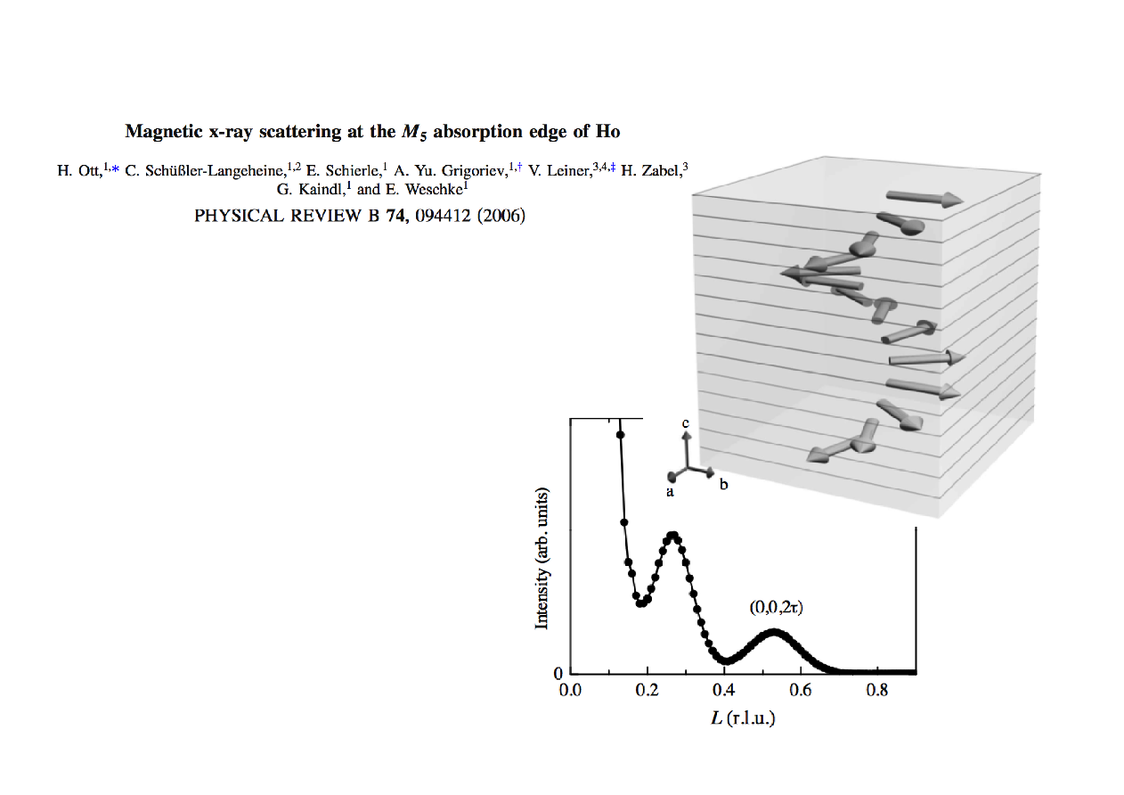
An example magnetic Bragg reflection of Ho metal film
2p

Slide 97
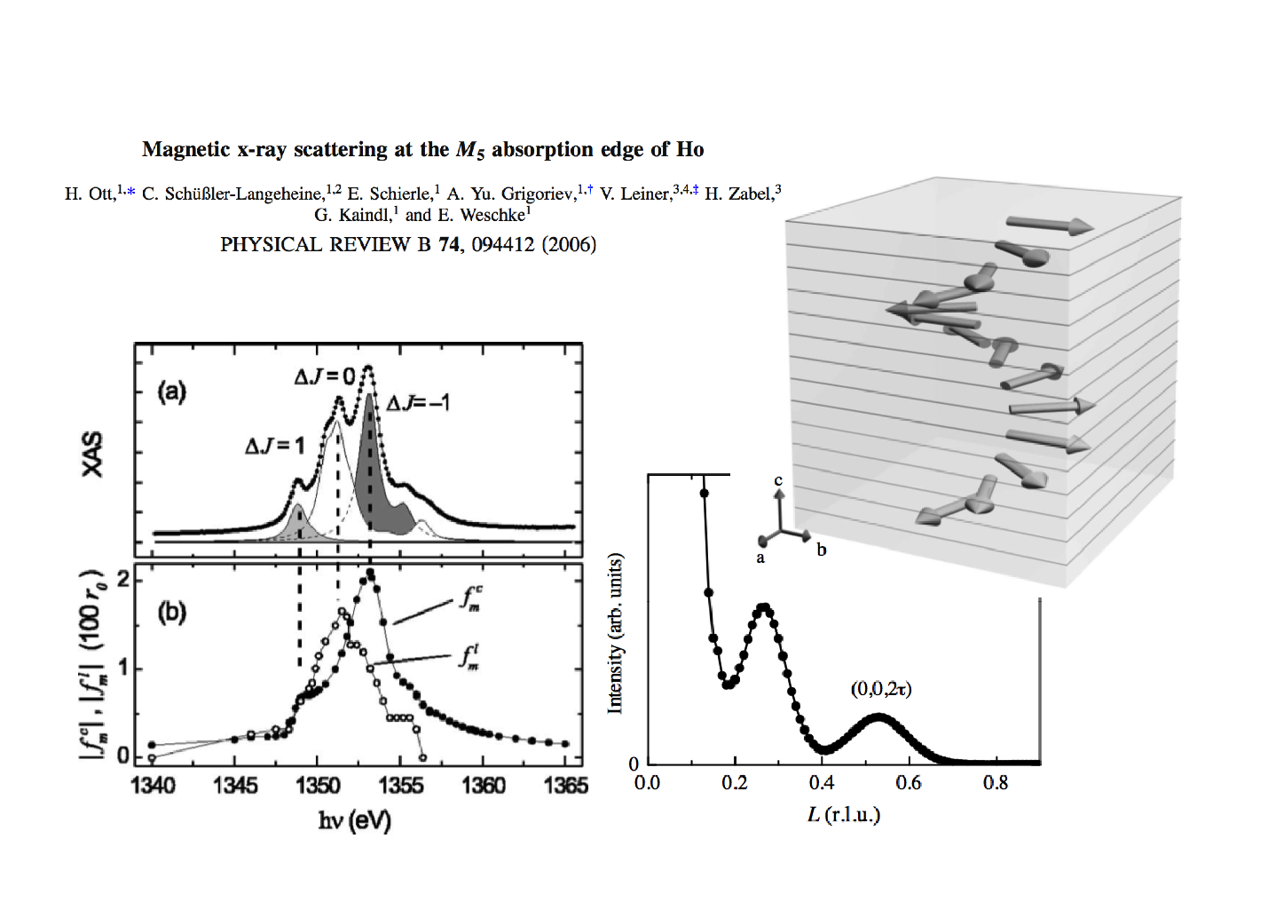
An example magnetic Bragg reflection of Ho metal film

Slide 98
Absorption and diffraction – two sides of the same coin

Slide 99
Absorption and diffraction – two sides of the same coin
Crystalline sollid
Each site gets polarized by the photon field and the local charge density starts to oscillate.
Absorption
Scattering
σ_{i}
σ_{i}
σ_{i}
σ_{i}

Slide 100
Relation between resonant x-ray diffraction and absorption
2p
2p

Slide 101
Absorption and diffraction – two sides of the same coin
Crystalline sollid
Each site gets polarized by the photon field and the local charge density starts to oscillate.
Absorption
Scattering
σ_{i}
σ_{i}
σ_{i}
σ_{i}
Diffraction at given momentum determined by the sum of local scattering with correct phase:

Slide 102
An example magnetic Bragg reflection of Ho metal film

Slide 103
Fundamental spectra from the literature

Slide 104
Fundamental spectra from the literature

Slide 105
Fundamental spectra from the literature

Slide 106
Fundamental spectra from the literature

Slide 107
An example magnetic Bragg reflection of Ho metal film

Slide 108
Can we use sum-rules to get quantitative information

Slide 109
Can we use sum-rules to get quantitative information

Slide 110
Can we use sum-rules to get quantitative information

Slide 111
Can we use sum-rules to get quantitative information

Slide 112
Can we use sum-rules to get quantitative information

Slide 113
Can we use sum-rules to get quantitative information

Slide 114
Solve Maxwell's equations (with side conditions)

Slide 115
And now excitations , from RXD to RIXS
X-ray Absorption
Spectroscopy
Resonant X-ray
Diffraction
Resonant Inelastic
X-ray scattering
2p
2p
2p

Slide 116
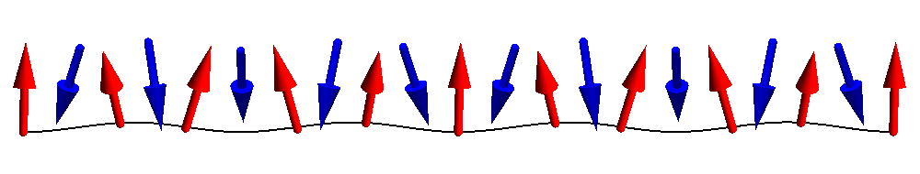
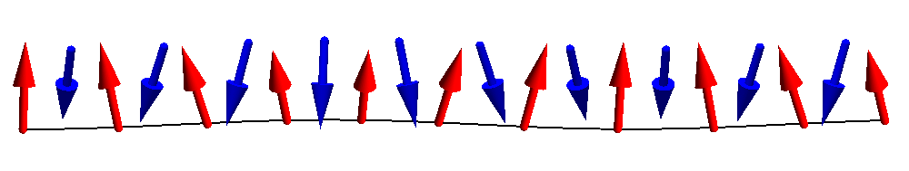
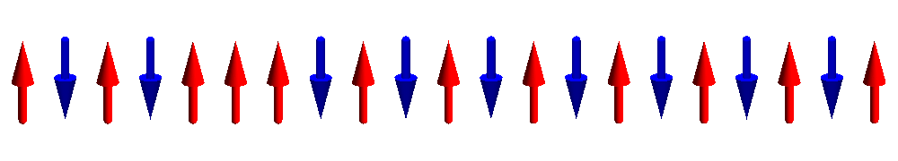
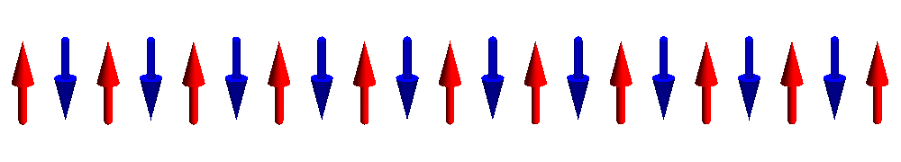
Dispersing magnons

Slide 117
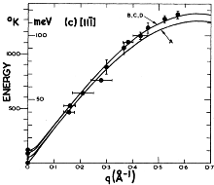
Dispersing magnons – Neutron scattering
Interaction of Neutrons with matter is well understood (magnetic dipole),
single magnon intensity
q-dispersion
M. T. Hutchings and E. J. Samuelsen,
Phys. Rev. B 6, 3447 (1972)

Slide 118
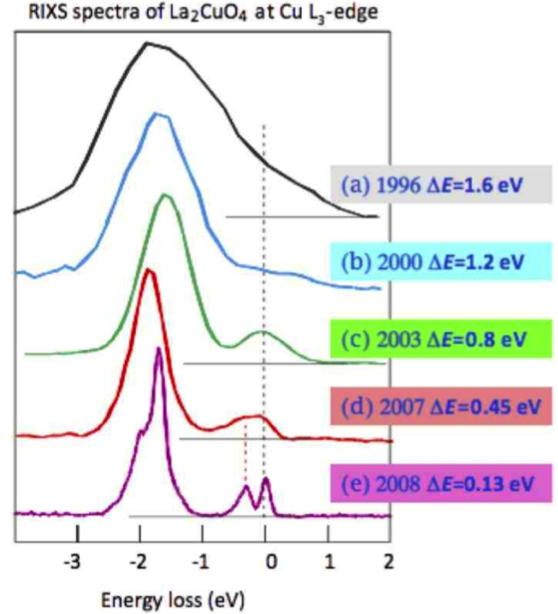
Recent development – measure spin dynamics with x-rays
Resonant Inelastic
X-ray Scattering
RIXS
It now becomes feasible to measure the dynamics of low energy excitations in:
thin films
surfaces
Interfaces
nano-crystals
molecules
Picture by G. Ghiringhelli and L. Braicovich

Slide 119
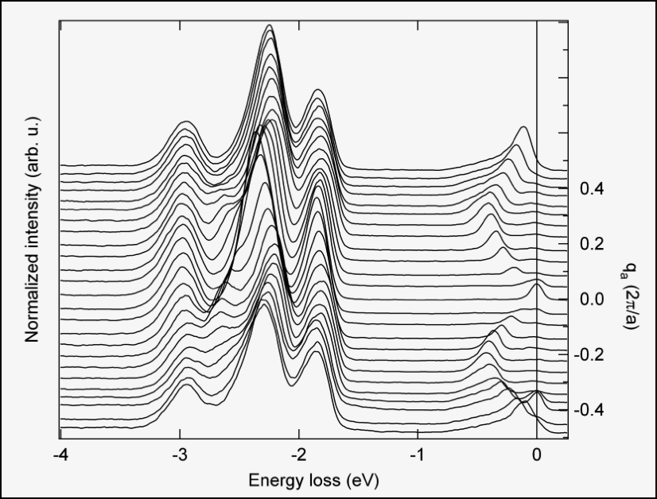
RIXS – very high quality data on small samples
orbitons
spinons

Slide 120
What is Resonant Inelastic X-ray Scattering (RIXS)
Intermediate state with core hole and one extra valence electron
Outgoing light of
~ 0.5 to 10 keV
minus
10 meV to 10 eV
Incoming light of
~ 0.5 to 10 keV

Slide 121
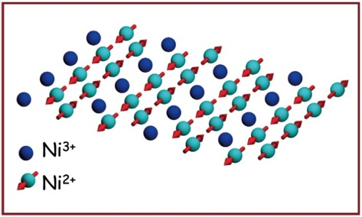
RIXS – what does one measure
Intermediate state
Initial state
Final state

Slide 122
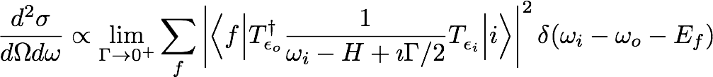
RIXS – what does one measure
Interaction of Neutrons with matter is easy (magnetic dipole),
but for resonant inelastic x-ray scattering nothing is obvious.
A lot is known though…

Slide 123
RIXS – what does one measure
Interaction of Neutrons with matter is easy (magnetic dipole),
but for resonant inelastic x-ray scattering nothing is obvious.
A lot is known though…

Slide 124
RIXS – what is the cross section
Interaction of Neutrons with matter is easy (magnetic dipole),
but for resonant inelastic x-ray scattering nothing is obvious.
A lot is known though…

Slide 125
RIXS – what does one measure
Interaction of Neutrons with matter is easy (magnetic dipole),
but for resonant inelastic x-ray scattering nothing is obvious.
A lot is known though…

Slide 126
RIXS – what does one measure
Interaction of Neutrons with matter is easy (magnetic dipole),
but for resonant inelastic x-ray scattering nothing is obvious.
A lot is known though…

Slide 127
RIXS – what does one measure
Interaction of Neutrons with matter is easy (magnetic dipole),
but for resonant inelastic x-ray scattering nothing is obvious.
A lot is known though…

Slide 128
RIXS – what does one measure
Interaction of Neutrons with matter is easy (magnetic dipole),
but for resonant inelastic x-ray scattering nothing is obvious.
A lot is known though…

Slide 129
RIXS – what does one measure
Interaction of Neutrons with matter is easy (magnetic dipole),
but for resonant inelastic x-ray scattering nothing is obvious.
A lot is known though…

Slide 130
RIXS – what does one measure
Interaction of Neutrons with matter is easy (magnetic dipole),
but for resonant inelastic x-ray scattering nothing is obvious.
A lot is known though…

Slide 131
XAS – XRD – RIXS – a time dependent picture

Slide 132

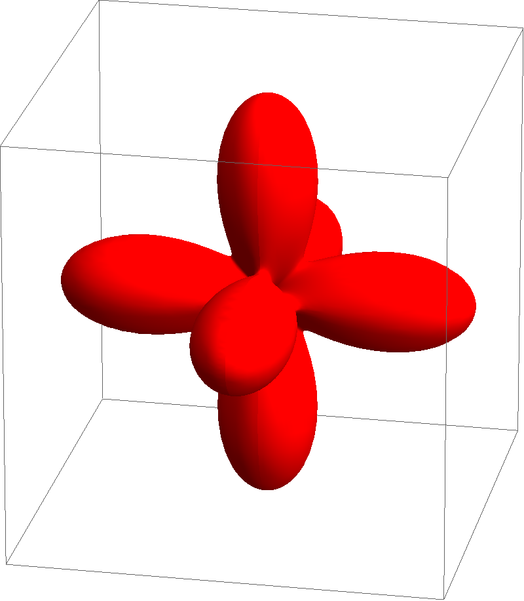
XAS – XRD – RIXS – a time dependent picture in NiO
e_{g}
t_{2g}

Slide 133
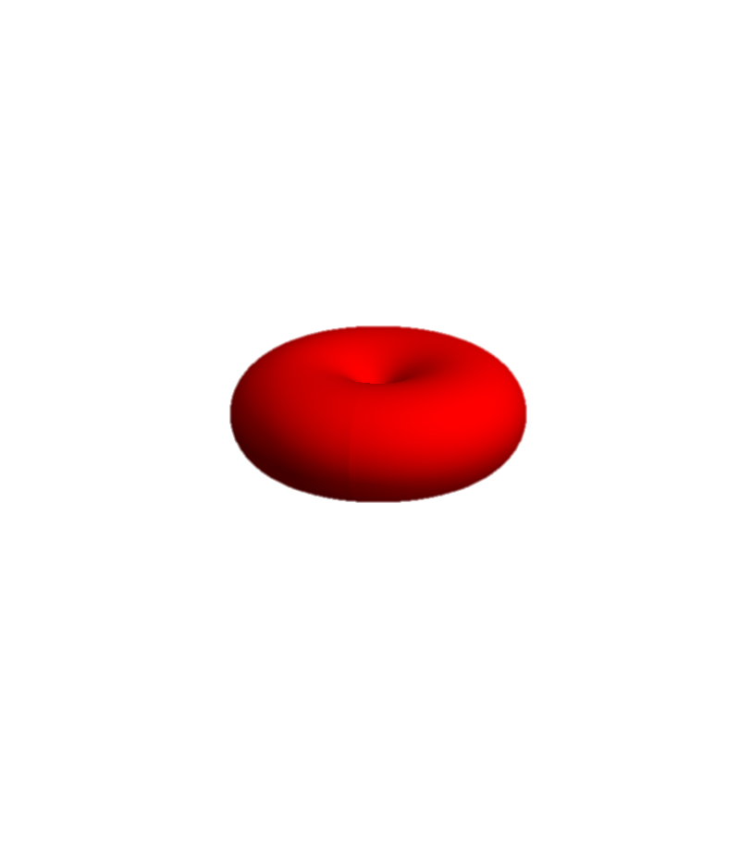
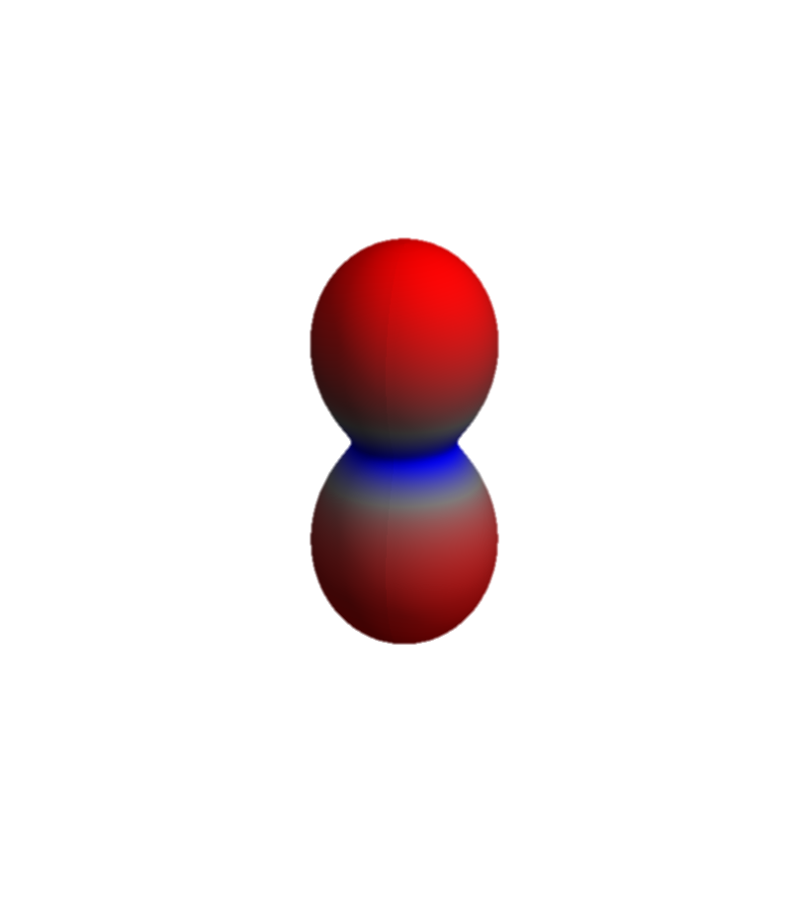
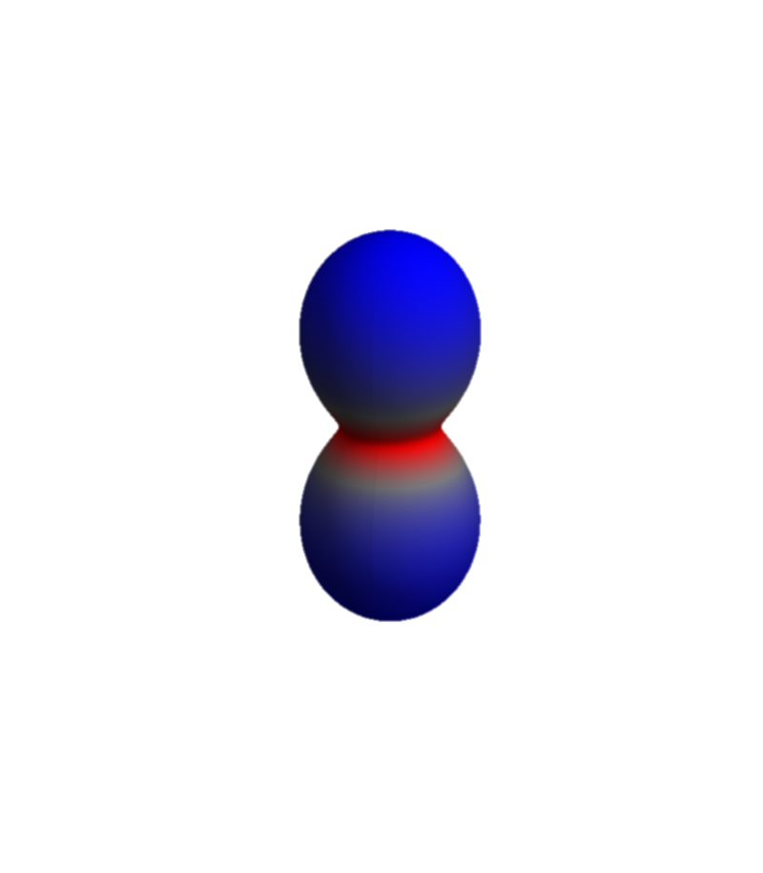
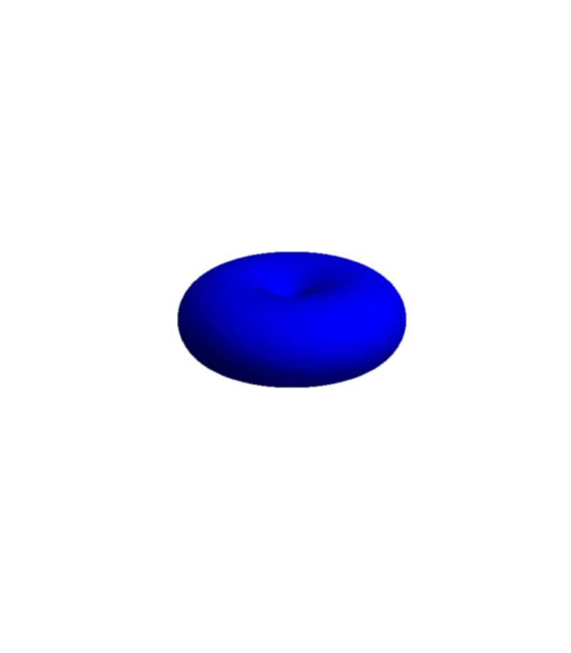
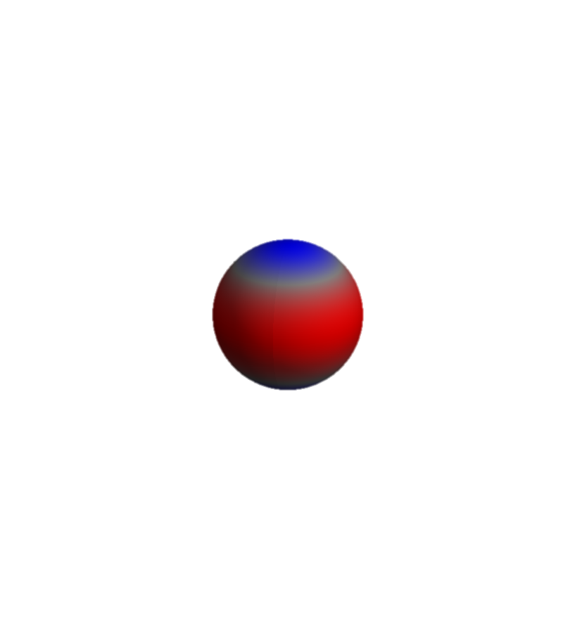
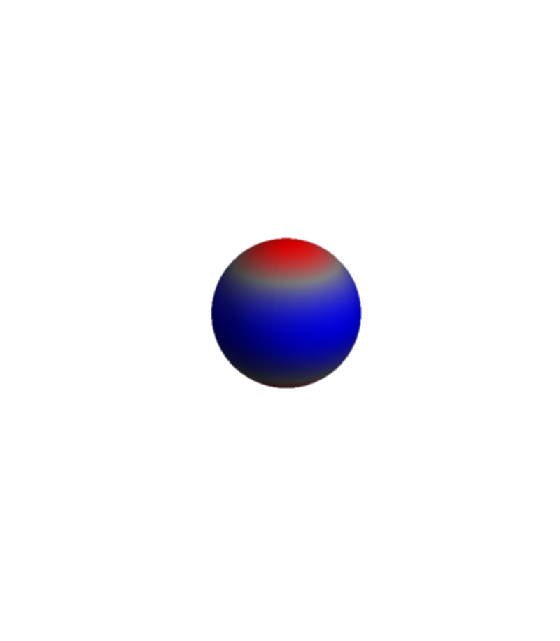
NiO – Ni 2p to Ni 3d excitation
Ni-3d and O-2p on level of DMFT. (locally all interactions included)
e_{g}
After excitation Auger decay is possible, and included:
Ni-3d, Ni-3p, or Ni-3s scatters into the Ni-2p core hole and a Ni-3d, Ni-3p or Ni-3s orbital is emitted into εs,p,d,f,g or h orbital
t_{2g}
Ni-3d and Ni-2p Coulomb interactions are local and included

Slide 134
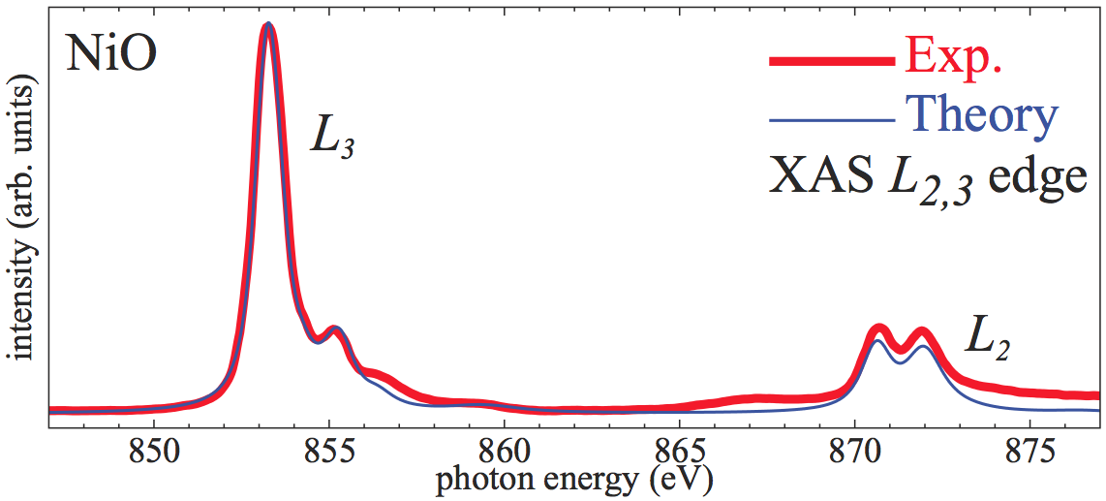
NiO – Ni 2p to Ni 3d excitation
X-ray absorption of NiO (L₂₃ edge) is well described.
How does the wave-function (charge density) evolve as a function of time when the sample is hit by an x-ray pulse?

Slide 135
NiO – Ni 2p to Ni 3d excitation
We include a light field of 1 kV per Angstrom (possible at SLAC) at an energy of 852 eV.
e_{g}
t_{2g}
Pulse duration is 100 atto seconds
Upto χ₇ (4-th-order) response functions are included

Slide 136
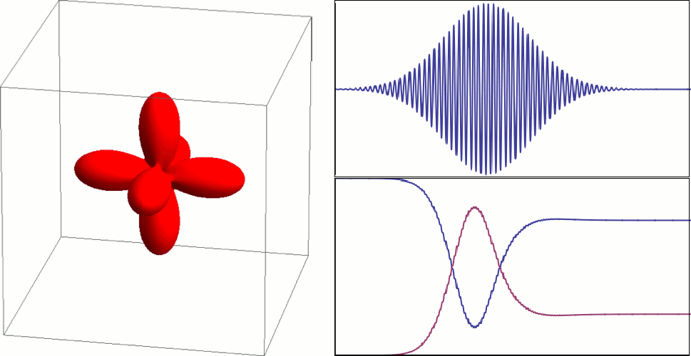
NiO 2p to 3d excitation in the time domain
Energy of pulse 852 eV
FWHM 100 as
41 eV
1 kV Å⁻¹
holes in Ni 3d-shell
holes in Ni 2p-shell
350 attosecond

Slide 137
RIXS – what does one measure
Interaction of Neutrons with matter is easy (magnetic dipole),
but for resonant inelastic x-ray scattering nothing is obvious.
A lot is known though…

Slide 138
RIXS – what does one measure
Interaction of Neutrons with matter is easy (magnetic dipole),
but for resonant inelastic x-ray scattering nothing is obvious.
A lot is known though…
BOOM

Slide 139


RIXS – what does one measure
Interaction of Neutrons with matter is easy (magnetic dipole),
but for resonant inelastic x-ray scattering nothing is obvious.
A lot is known though…

Slide 140
Challenge – No small parameter – perturbation theory fails
Different interactions are of similar scale
Perturbation theory leads to divergent series
i.e. summing part of the series gives a different result from the full solution!

Slide 141
RIXS – what does one measure
Intermediate state
Initial state
Final state

Slide 142
Understand RIXS by numerical solving a model
The equation to solve
with,
and

Slide 143
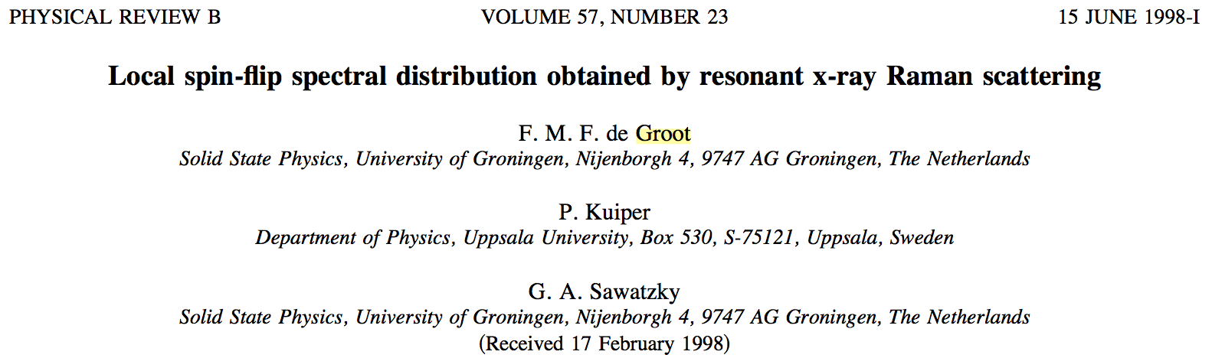
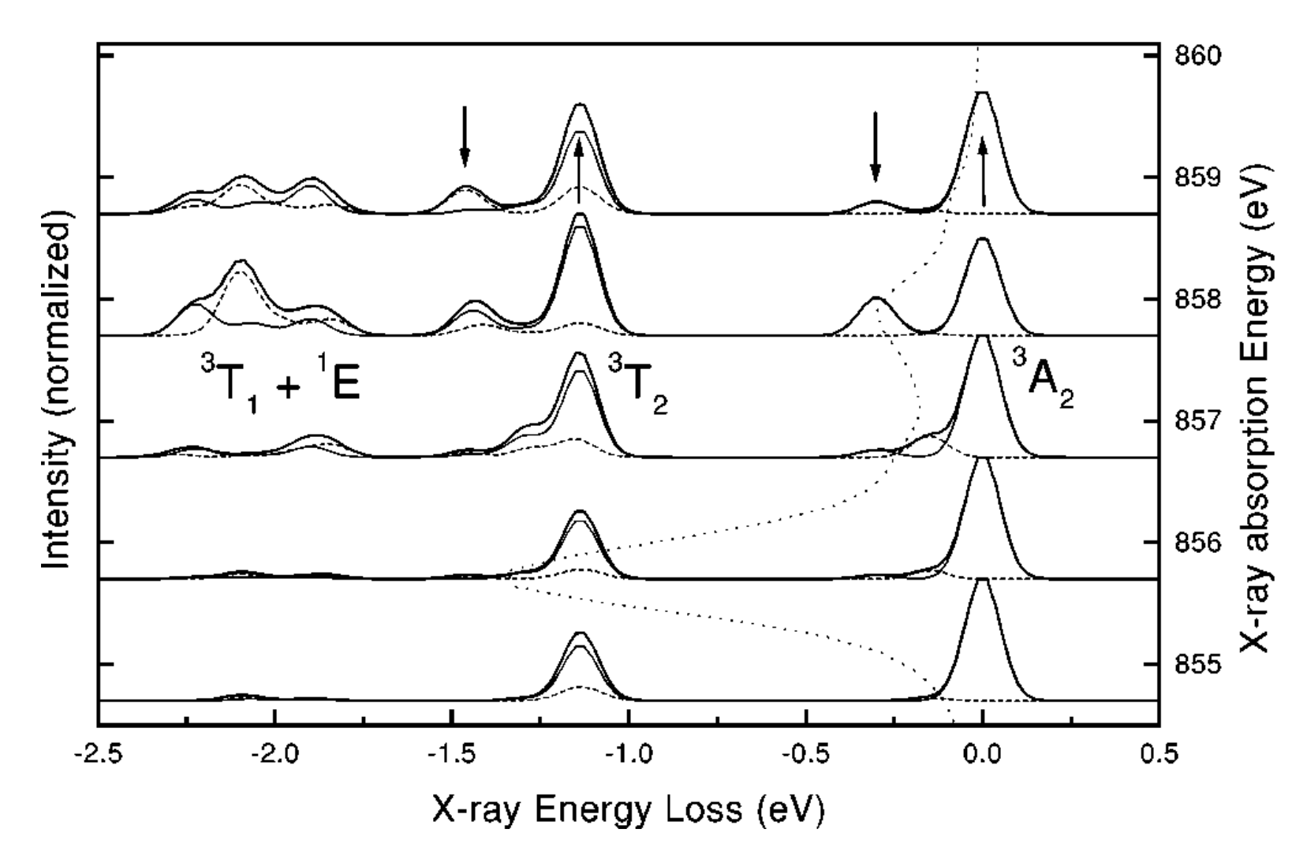
Single Ni atom in crystal-field theory

Slide 144
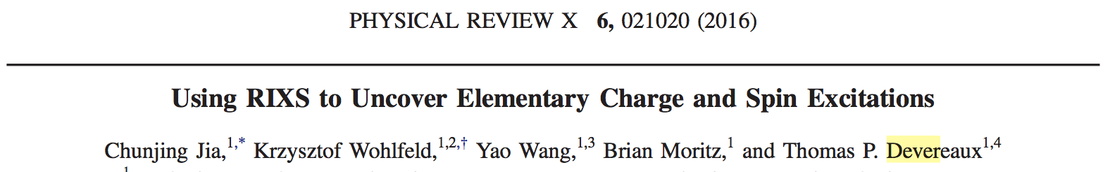
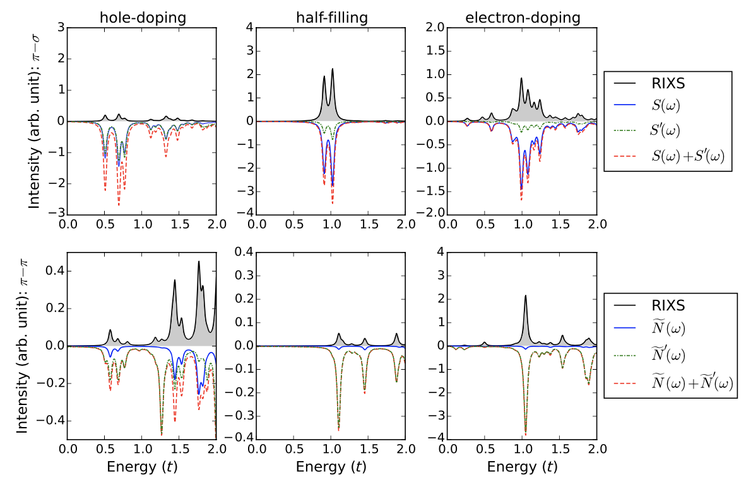
Hubbard model on finite (12) size cluster

Slide 145
Understand RIXS as effective operator
Replace the exact RIXS operator by a low energy effective operator
Write the exact RIXS operator as a series
Possible operators in the series could be
Task: find all operators
and all coefficients

Slide 146
Challenge – No small parameter – perturbation theory fails
Different interactions are of similar scale
Perturbation theory leads to divergent series
i.e. summing part of the series gives a different result from the full solution!

Slide 147
Divergent series – example from functions
The following function is smooth, continues and infinite differentiable on the real axis
We can write the function as an expansion on powers of x:

Slide 148
Divergent series – example from functions
The following function is smooth, continues and infinite differentiable on the real axis
We can write the function as an expansion on powers of x:
Truncate at i=2

Slide 149
Divergent series – example from functions
The following function is smooth, continues and infinite differentiable on the real axis
We can write the function as an expansion on powers of x:
Truncate at i=4

Slide 150
Divergent series – example from functions
The following function is smooth, continues and infinite differentiable on the real axis
We can write the function as an expansion on powers of x:
Truncate at i=10

Slide 151
Divergent series – example from functions
The following function is smooth, continues and infinite differentiable on the real axis
We can write the function as an expansion on powers of x:
Truncate at i=20

Slide 152
Divergent series – example from functions
The following function is smooth, continues and infinite differentiable on the real axis
We can write the function as an expansion on powers of x:
Truncate at i=50

Slide 153
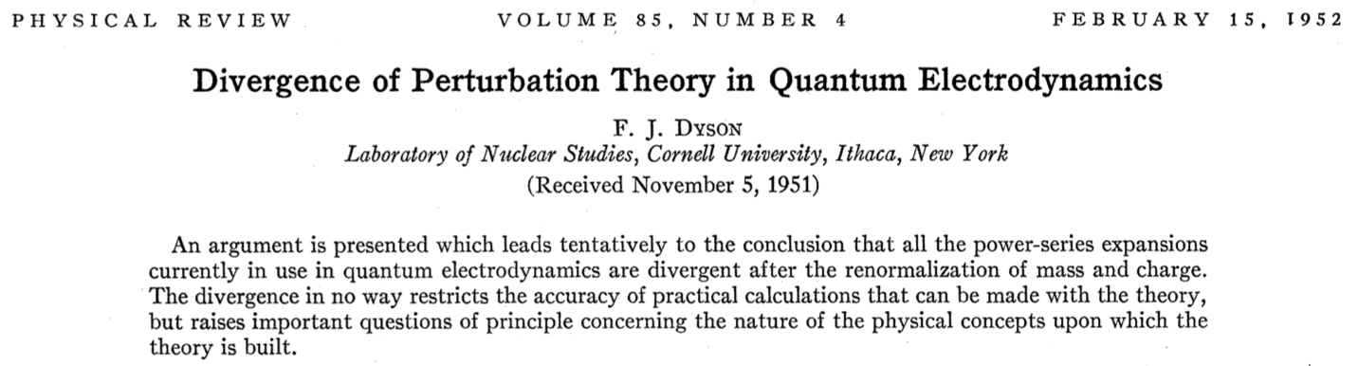
General problem in many particle physics

Slide 154
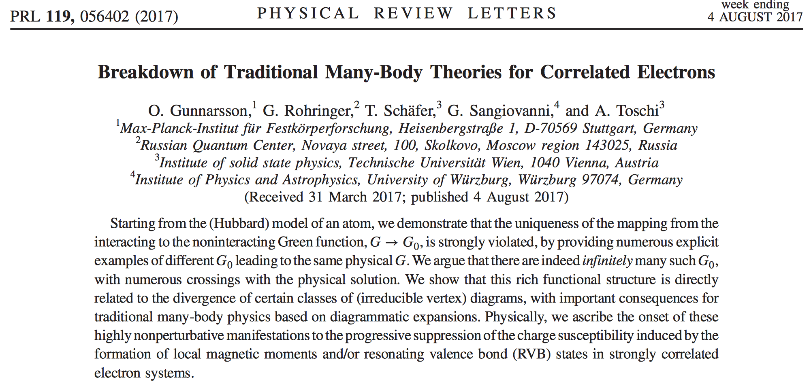
General problem in many particle physics
Need for a non-divergent (non perturbative) series expansion

Slide 155
Fourier v.s. Taylor – example from functions
The following function is smooth, continues and infinite differentiable on the real axis
We can write the function as a sum of orthonormal functions:

Slide 156
Fourier v.s. Taylor – example from functions
The following function is smooth, continues and infinite differentiable on the real axis
We can write the function as a sum of orthonormal functions:
Truncate at n=1

Slide 157
Fourier v.s. Taylor – example from functions
The following function is smooth, continues and infinite differentiable on the real axis
We can write the function as a sum of orthonormal functions:
Truncate at n=2

Slide 158
Fourier v.s. Taylor – example from functions
The following function is smooth, continues and infinite differentiable on the real axis
We can write the function as a sum of orthonormal functions:
Truncate at n=3

Slide 159
Fourier v.s. Taylor – example from functions
The following function is smooth, continues and infinite differentiable on the real axis
We can write the function as a sum of orthonormal functions:
Truncate at n=4

Slide 160
Fourier v.s. Taylor – example from functions
The following function is smooth, continues and infinite differentiable on the real axis
We can write the function as a sum of orthonormal functions:
Truncate at n=5

Slide 161
An alternative expansion for operators
Projection expansions for functions
with
if
Projection expansions for operators
with
if

Slide 162
An alternative expansion for operators
Trivial example
with
and
an orthonormal complete set
we have
The trivial example needs exponentially many weird operators
Alternative:
O^{m,n} an operator that transforms exponentially many states that share property n into states that share property m

Slide 163
Expansion of the RIXS operator
Create a local (j) expansion
Lattice model

Slide 164
Expansion of the RIXS operator
Create a local (j) expansion
Lattice model
Site j
Level L=0 only include operators acting on site j

Slide 165
Expansion of the RIXS operator
Create a local (j) expansion
Lattice model
j
Level L=1 include operators acting on site j and n.n.

Slide 166
Expansion of the RIXS operator
Create a local (j) expansion
Lattice model
j
Level L=2 include operators acting on site j, n.n. and n.n.n.

Slide 167
Expansion of the RIXS operator
Create a local (j) expansion
Lattice model
j
Level L=3 include operators acting on site j, n.n., n.n.n. and n.n.n.n.
etc.

Slide 168
Expansion of the RIXS operator
Convergence of this series is guaranteed by linear algebra!
define

Slide 169
Expansion of the RIXS operator
Convergence of this series is guaranteed by linear algebra!
As RIXS intensity is bounded:
Sufficient condition to guarantee absolute convergence of series

Slide 170
Example for doped Hubbard model
with
As a first step we need to create all possible O_{m,n}
For L=0 we only look at local operators
The local Fock space is given by 4 states
Operators on that basis as
4 by 4 matrices

Slide 171
Example for doped Hubbard model
For L=1 we look at two sites
The Fock space is given by 16 states
Resulting in 16²=256 operators

Slide 172
Example for doped Hubbard model
We can get back to more familiar representations by linear combing these operators (unitary transformation)
For L=0 (only keeping the particle number conserving operators)

Slide 173
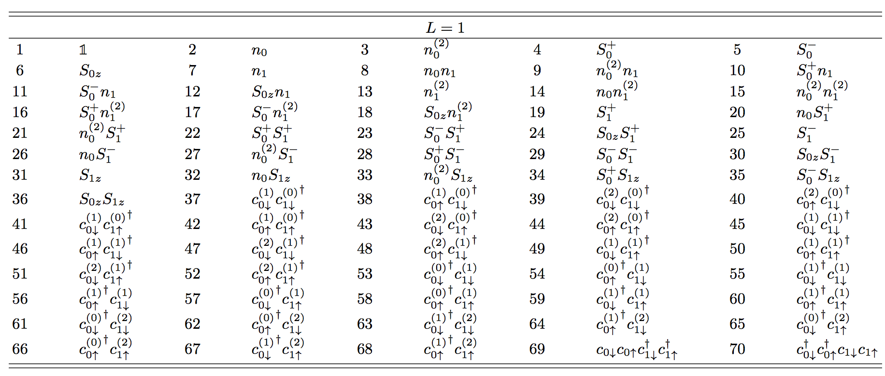
Example for doped Hubbard model
We can get back to more familiar representations by linear combing these operators (unitary transformation)
For L=1 (only keeping the particle number conserving operators)

Slide 174



RIXS – effective operator – spin excitations
Effective operator for spin excitations only

Slide 175
RIXS – effective operator – spin excitations
Need to calculate x-ray absorption spectra
… and spin susceptibilities

Slide 176
RIXS – effective operator – spin excitations
Theory
Experiment
Need to calculate x-ray absorption spectra
σ⁽⁰⁾=

Slide 177
Predicted RIXS spectra with cross polarized light
spin susceptibility, same as neutron scattering

Slide 178
General polarization: RIXS is a mixture of 1 and 2 spin flips

Slide 179
Spin excitations in 1-dimension

Slide 180
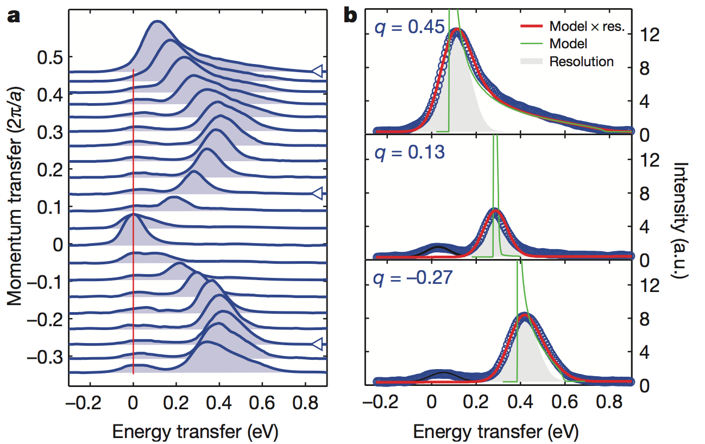
Spin excitations in 1 dimension – Sr₂CuO₃

Slide 181
Dispersing orbitals
orbitons
spinons

Slide 182
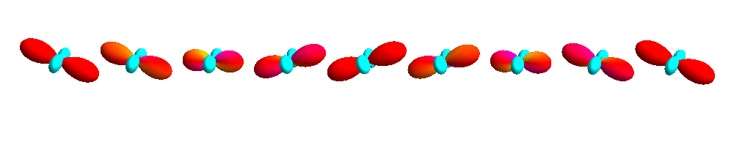
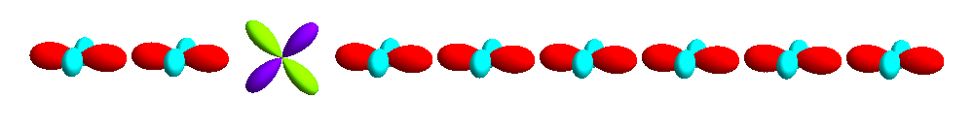
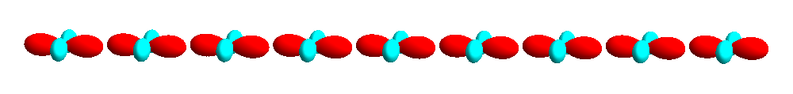
Dispersing orbitals

Slide 183
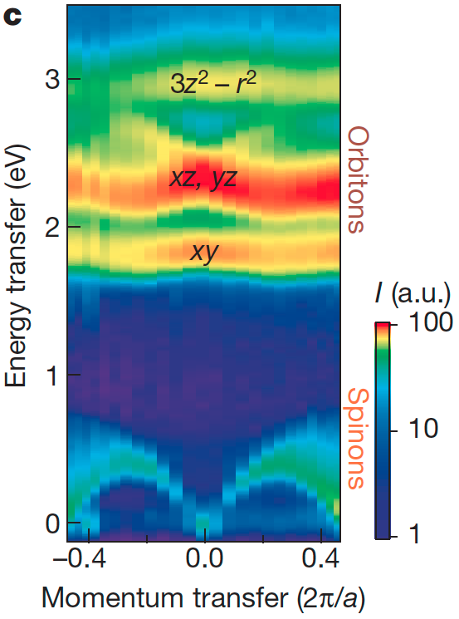
Dispersing orbitals

Slide 184
Additional literature
Core level spectroscopy of Solids
Frank M. F. de Groot and Akio Kotani
NEXAFS Spectroscopy
Joachim Stöhr
Introduction to ligand field theory (chapter 1 – 6)
Carl Johan Ballhausen (1962)
Physical Chemistry (chapter 13 – 18, (10 – 15) edition 5 (8))
Peter Atkins (2006)

