Slide 1
DFT to multiplet ligand field theory
Maurits W. Haverkort
Institute for theoretical physics – Heidelberg University
M.W.Haverkort@thphys.uni-heidelberg.de

Slide 2
The aim
In order to understand materials and their properties theoretically we need to make a model that contains enough information to describe the system and a model that is simple enough such that we can solve it
Mean-field theory (Hartree-fock or DFT within the LDA / Kohn-Sham formalism) is such a model that works for itinerant systems. (Materials and or experiment type)
Crystal-field theory and Ligand field theory are such models that work for localized experiments and materials.
Can we reduce the number of parameters in crystal-field theory?
Can we find models for correlated metals?

Slide 3
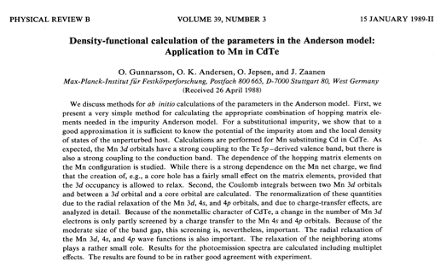
The method we use

Slide 4
“Review” paper

Slide 5
Four examples
MgO
Band-structure and Wannier orbitals
NiO
Band-structure and Wannier orbitals and a local ligand field model
Alkali metals
Can one make a tight binding model?
Sr₂IrO₄
A possible realization of a Kitaev model. Using ab intio ligand field theory and spectroscopy to get insight

Slide 7
MgO – rocksalt structure
O
Mg

Slide 8
MgO – band-structure
Mg-3s character
O-2p character

Slide 9
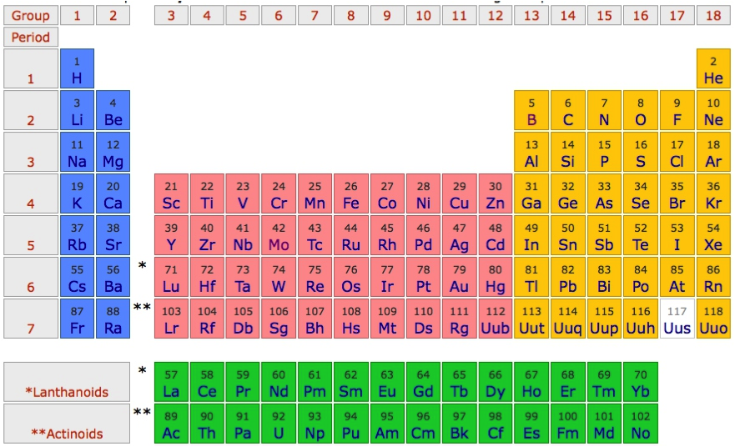
MgO – band-structure

Slide 10
MgO – band-structure
1s²2s²2p⁴
1s²2s²2p⁶3s²

Slide 11
MgO – band-structure
1s²2s²2p⁶
1s²2s²2p⁶3s⁰

Slide 12
MgO – band-structure
Mg-3s character
O-2p character

Slide 13
MgO – band-structure – minimal basis O-p and Mg-s

Slide 14
MgO – atomic orbitals
Mg-3s

Slide 15
MgO – atomic orbitals
O-2p

Slide 16
MgO – atomic orbitals
Mg-3s
O-2p

Slide 17
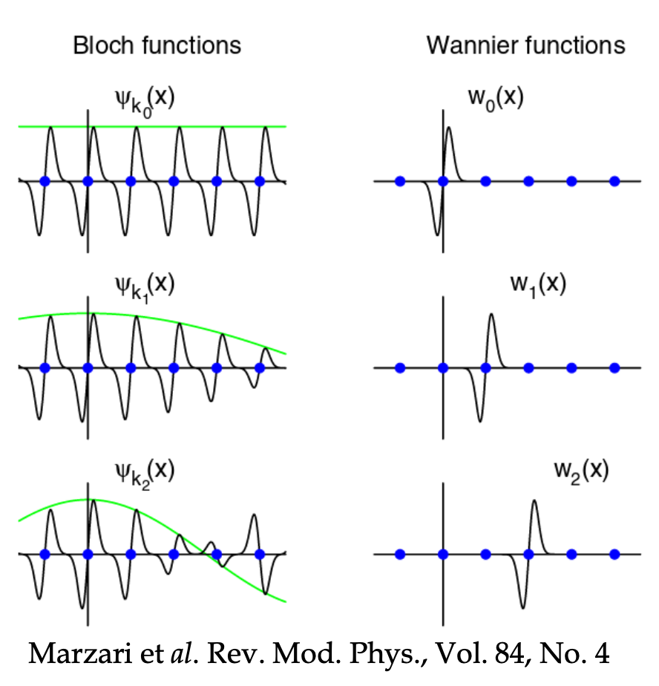
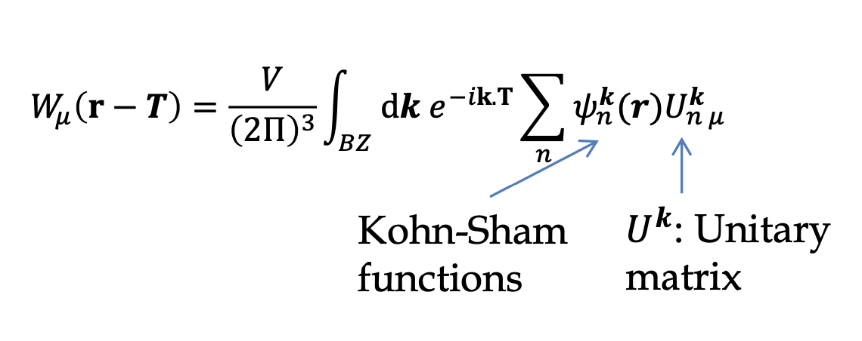
Use Wannier functions as a better basis
Fourier transform a set of Bloch eigenstates, within a specific window
Choice in phase of the Eigenstate leads to different Wannier functions

Slide 18
MgO – wannier orbitals
Mg-3s
atomic
Mg-3s
Wannier

Slide 19
MgO – wannier orbitals
O-2p
atomic
O-2p
Wannier

Slide 20
MgO – wannier orbitals

Slide 21
MgO – wannier orbitals
Mg-3s
Wannier
O-2p
Wannier
Mg-3s
atomic
O-2p
atomic

Slide 22
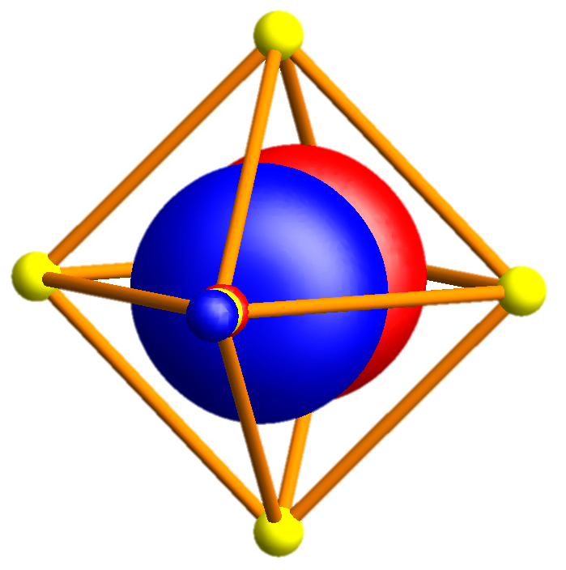
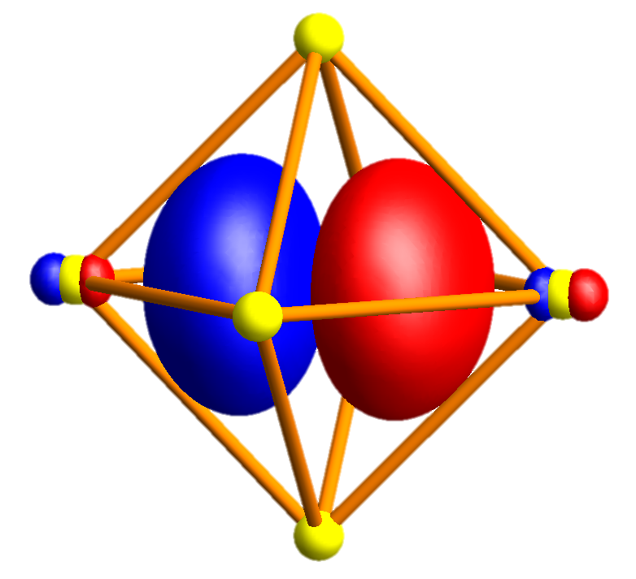
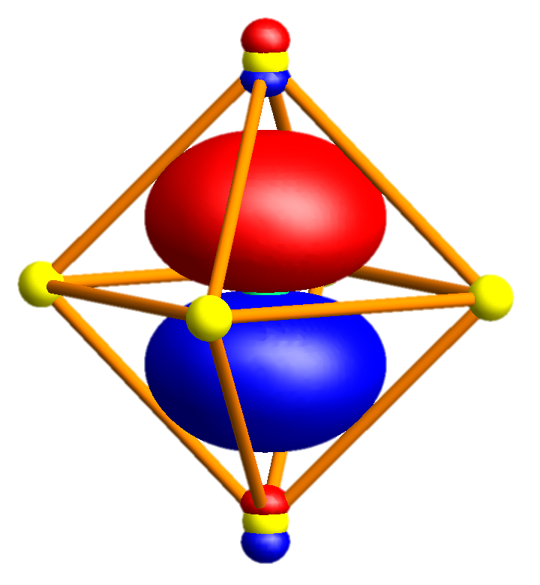
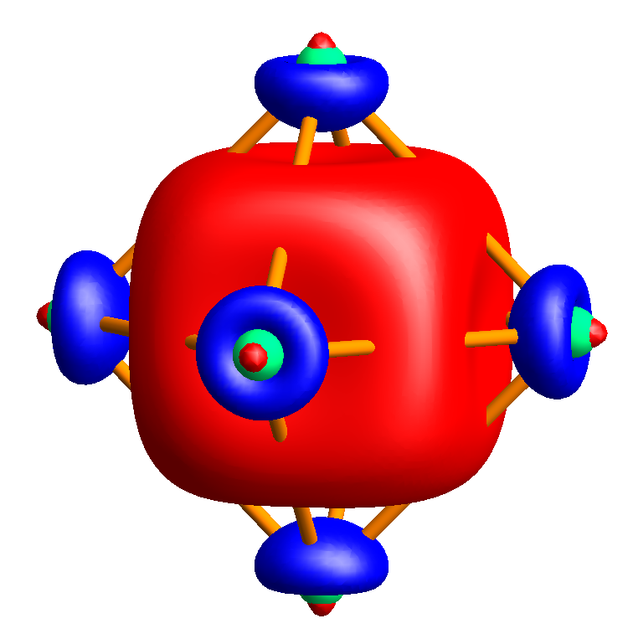
MgO – wannier orbitals

Slide 23
MgO – band-structure
Mg-3s character
O-2p character

Slide 24
MgO – band-structure – minimal basis O-p and Mg-s

Slide 25
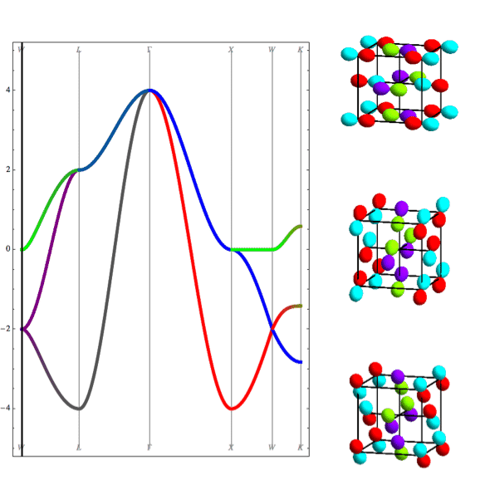
MgO – band-structure
Nearest neighbor tight binding
Full DFT calculation
L
Γ
X
W

Slide 26
MgO – band-structure – minimal basis O-p and Mg-s
Mg 3s
O 2p
O 2s
Mg 2p

Slide 27
MgO – band-structure – minimal basis O-p and Mg-s
Mg 3s
O 2p
O 2s
Mg 2p

Slide 28
MgO – band-structure – minimal basis O-p and Mg-s
Mg 3s
Mg 3s
O 2p
O 2p
O 2s
Mg 2p

Slide 29
MgO – band-structure – minimal basis O-p and Mg-s
Mg 3s
Mg 3s
O 2p
O 2p
O 2s
Mg 2p

Slide 30
NiO – rocksalt structure
O
Ni

Slide 31
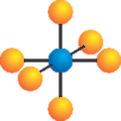
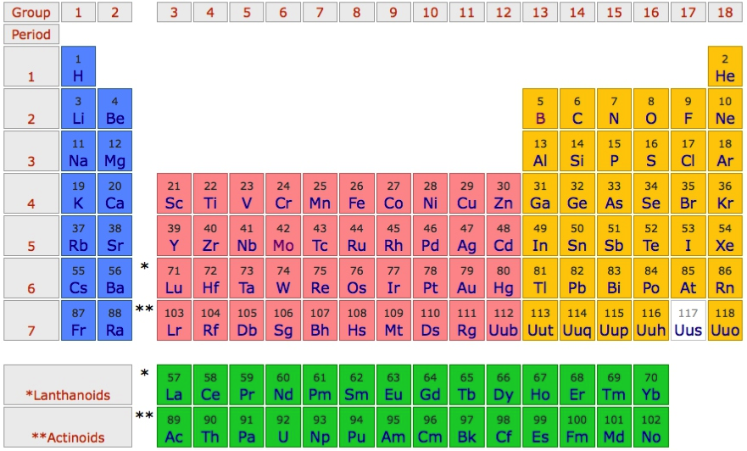
Use NiO as an example material
O²⁻ - 2p⁶
Ni²⁺ - 4s⁰ 3d⁸

Slide 32
“Downfold” the DFT results to obtain basis of choice

Slide 33
Pick a basis of “TM-d” and “O-p” Wannier orbitals
e_{g} σ bond
t_{2g} π bond

Slide 34
The TM-d Wannier orbitals are very close to atomic orbitals

Slide 35
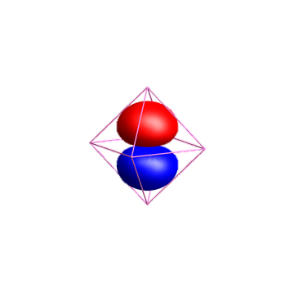
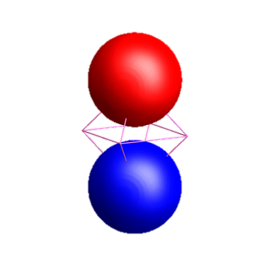
The O-p Wannier orbitals have tails!!!
O-2p
Ni-4s

Slide 36
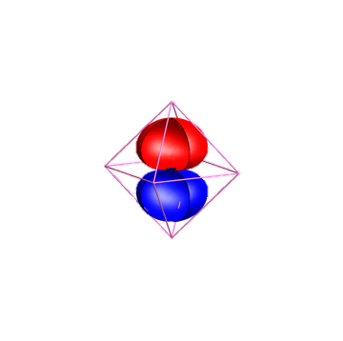
The O-p Wannier orbitals have tails!!!
O-2p
Ni-4s

Slide 37
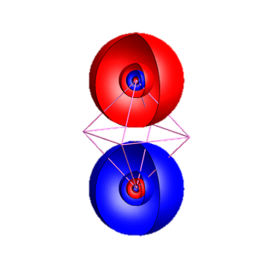
The O-p Wannier orbitals have tails!!!
O-2p
Ni-4s

Slide 38
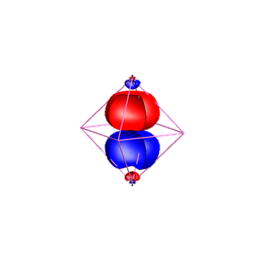
The O-p Wannier orbitals have tails!!!
Ni-4s
O-2p

Slide 39
Pick a basis of “TM-d” and “O-p” Wannier orbitals

Slide 40
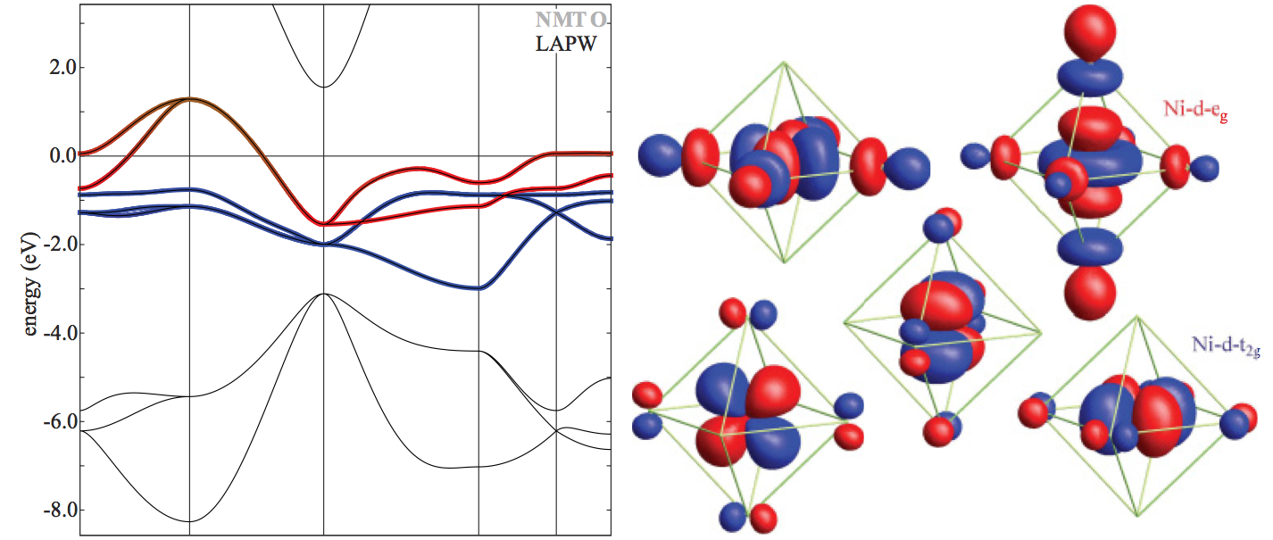
Pick a basis of “TM-d” Wannier orbitals

Slide 41
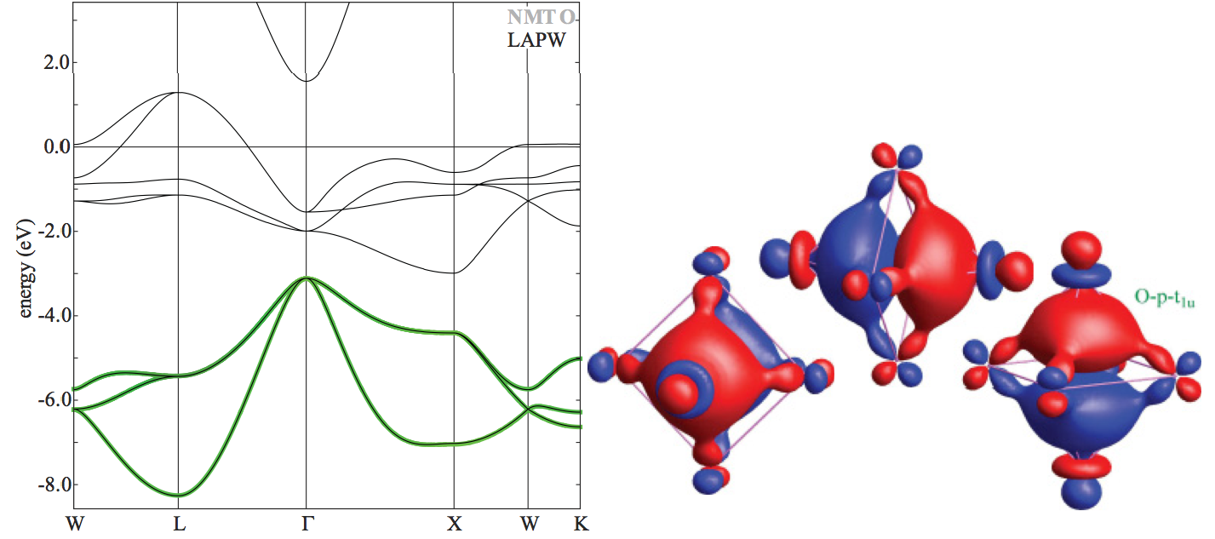
Pick a basis of “O-p” Wannier orbitals

Slide 42
NiO in a LDA band-structure picture

Slide 43
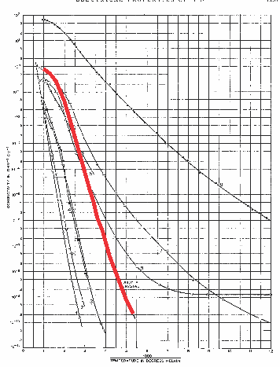
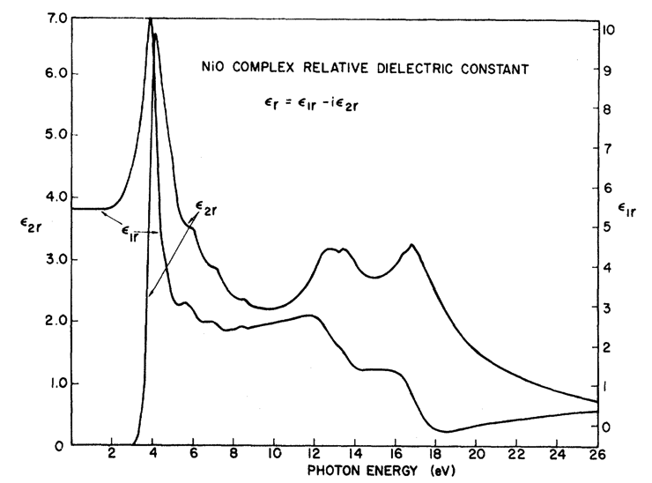
In LDA NiO is a metal: Experimentally it is a good insulator
F. J. Morin, Phys. Rev. 93, 1199 (1954)
R. Newman and R. M. Chrenko,
Phys. Rev 114 1507 (1959)
Room temperature
ρ~10⁵ Ο cm
Optical-gap
3.5 – 4.0 eV

Slide 44
“Downfold” the DFT results to obtain basis of choice

Slide 45
Orbital energy level diagram obtained from LDA

Slide 46
Orbital energy level diagram obtained from LDA

Slide 47
Orbital energy level diagram obtained from LDA

Slide 48
Orbital energy level diagram obtained from LDA

Slide 49
Orbital energy level diagram obtained from LDA

Slide 50
Create ligand orbitals from O-2p Wannier orbitals

Slide 51
Create ligand orbitals from O-2p Wannier orbitals

Slide 52
Create ligand orbitals from O-2p Wannier orbitals

Slide 53
Create ligand orbitals from O-2p Wannier orbitals

Slide 54
Create ligand orbitals from O-2p Wannier orbitals

Slide 55
Create ligand orbitals from O-2p Wannier orbitals

Slide 56
Create ligand orbitals from O-2p Wannier orbitals

Slide 57
Create ligand orbitals from O-2p Wannier orbitals

Slide 58
Create ligand orbitals from O-2p Wannier orbitals

Slide 59
Create ligand orbitals from O-2p Wannier orbitals

Slide 60
Create ligand orbitals from O-2p Wannier orbitals

Slide 61
Create ligand orbitals from O-2p Wannier orbitals

Slide 62
Create ligand orbitals from O-2p Wannier orbitals

Slide 63
Create ligand orbitals from O-2p Wannier orbitals

Slide 64
Orbital energy level diagram obtained from LDA

Slide 65
Tight binding description of Alkali metals
Alkali metals are close to free electron like

Slide 66
Free electron like description
Energy momentum relation of a free electron
Maximal velocity is given by the Fermi momentum

Slide 67
Free electron like description – Brillouin zone folding

Slide 68
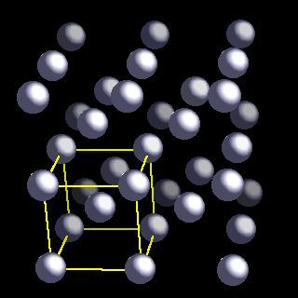
Brillion zone of Li (bcc)

Slide 69
Brillion zone of Li

Slide 70
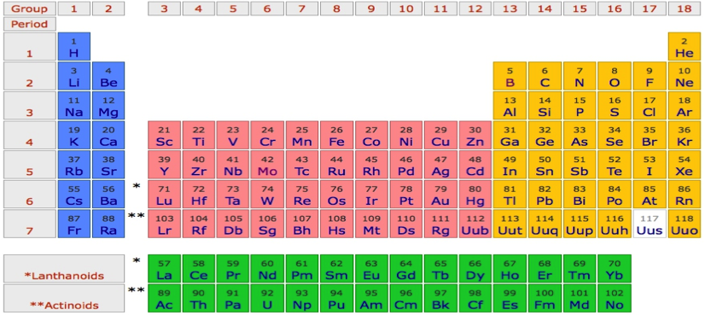
Li
P
Γ
P
H
P
Γ
P
H
P
Γ
P

Slide 71
Na
P
Γ
P
H
P
Γ
P
H
P
Γ
P

Slide 72
K
P
Γ
P
H
P
Γ
P
H
P
Γ
P

Slide 73
Rb
P
Γ
P
H
P
Γ
P
H
P
Γ
P

Slide 74
Cs
P
Γ
P
H
P
Γ
P
H
P
Γ
P

Slide 75
Fr
P
Γ
P
H
P
Γ
P
H
P
Γ
P

Slide 76
Li - Tigth binding description – “atomic” orbitals
φ_{2s}(r)
Li-atom
neighbor
Li-atom
neighbor
Li-atom

Slide 77
Li - Tigth binding description – “atomic” orbitals

Slide 78
Li - Tigth binding description – “atomic” orbitals
Non-orthogonal
Basis, but that is ok.

Slide 79
Li - Tigth binding description – “atomic” orbitals
Tight binding description of free electron like state

Slide 80
Li - Tigth binding description – “atomic” orbitals

Slide 81
Li - Tigth binding description – “atomic” orbitals

Slide 82
Li - Tigth binding description – “atomic” orbitals

Slide 83
Li - Tigth binding description – “atomic” orbitals

Slide 84
Li - Tigth binding description – “atomic” orbitals

Slide 85
Li - Tigth binding description – “atomic” orbitals

Slide 86
Li - Tigth binding description – “atomic” orbitals

Slide 87
Li - Tigth binding description – “atomic” orbitals

Slide 88
Li - Tigth binding description – “atomic” orbitals
p_{x}
s

Slide 89
Li - Tigth binding description – “atomic” orbitals
p_{z}
s
p_{x}
p_{y}

Slide 90
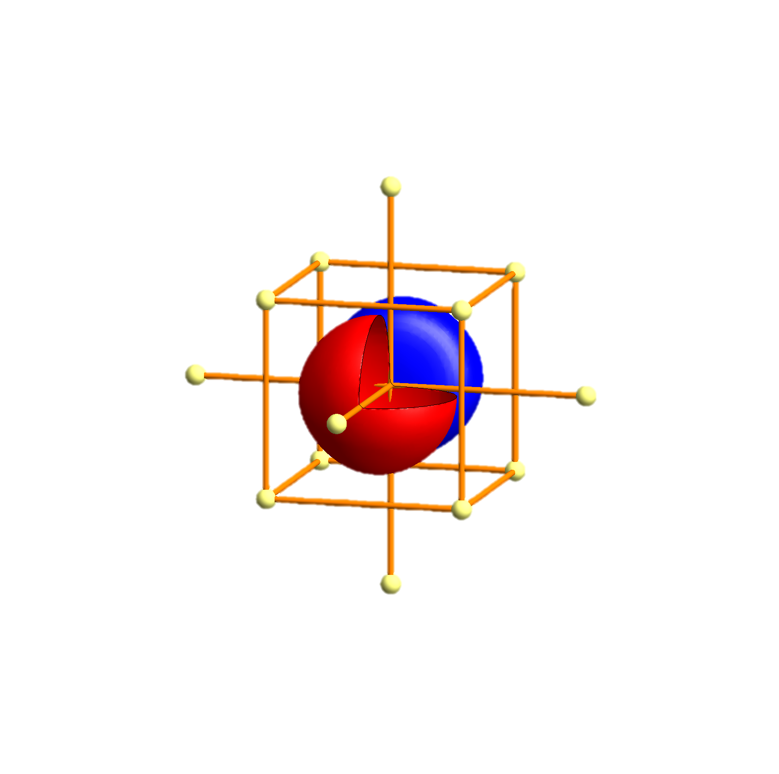
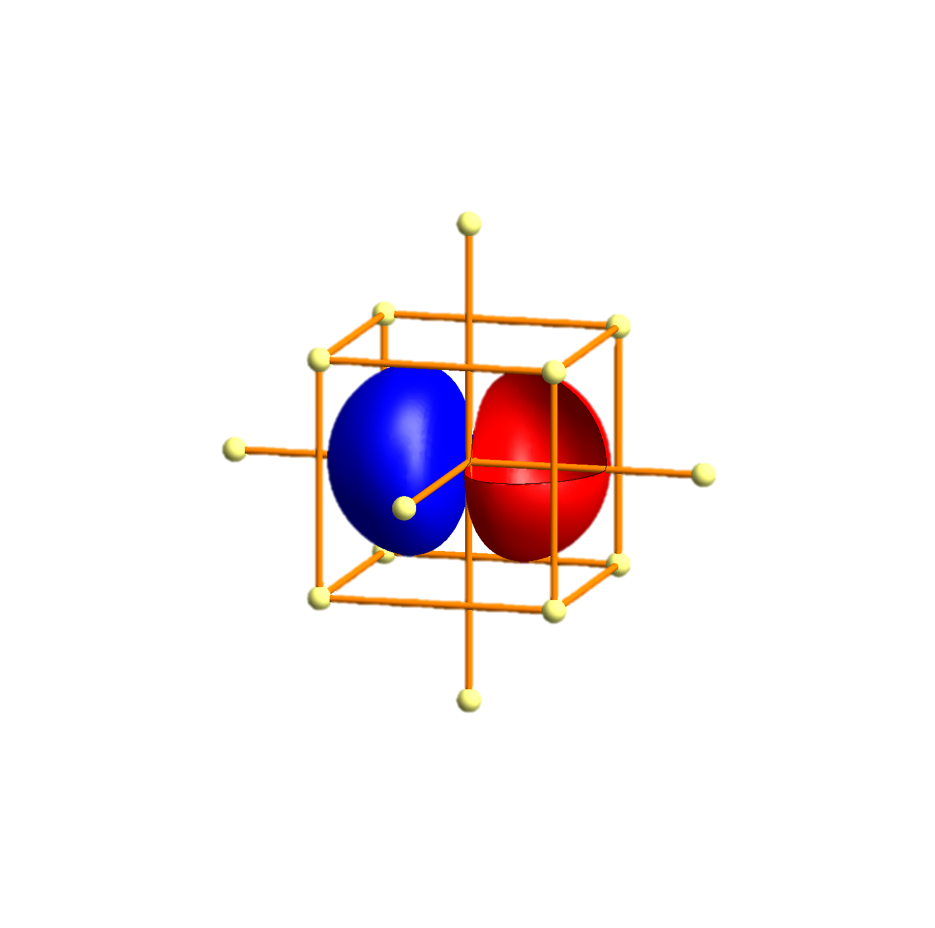
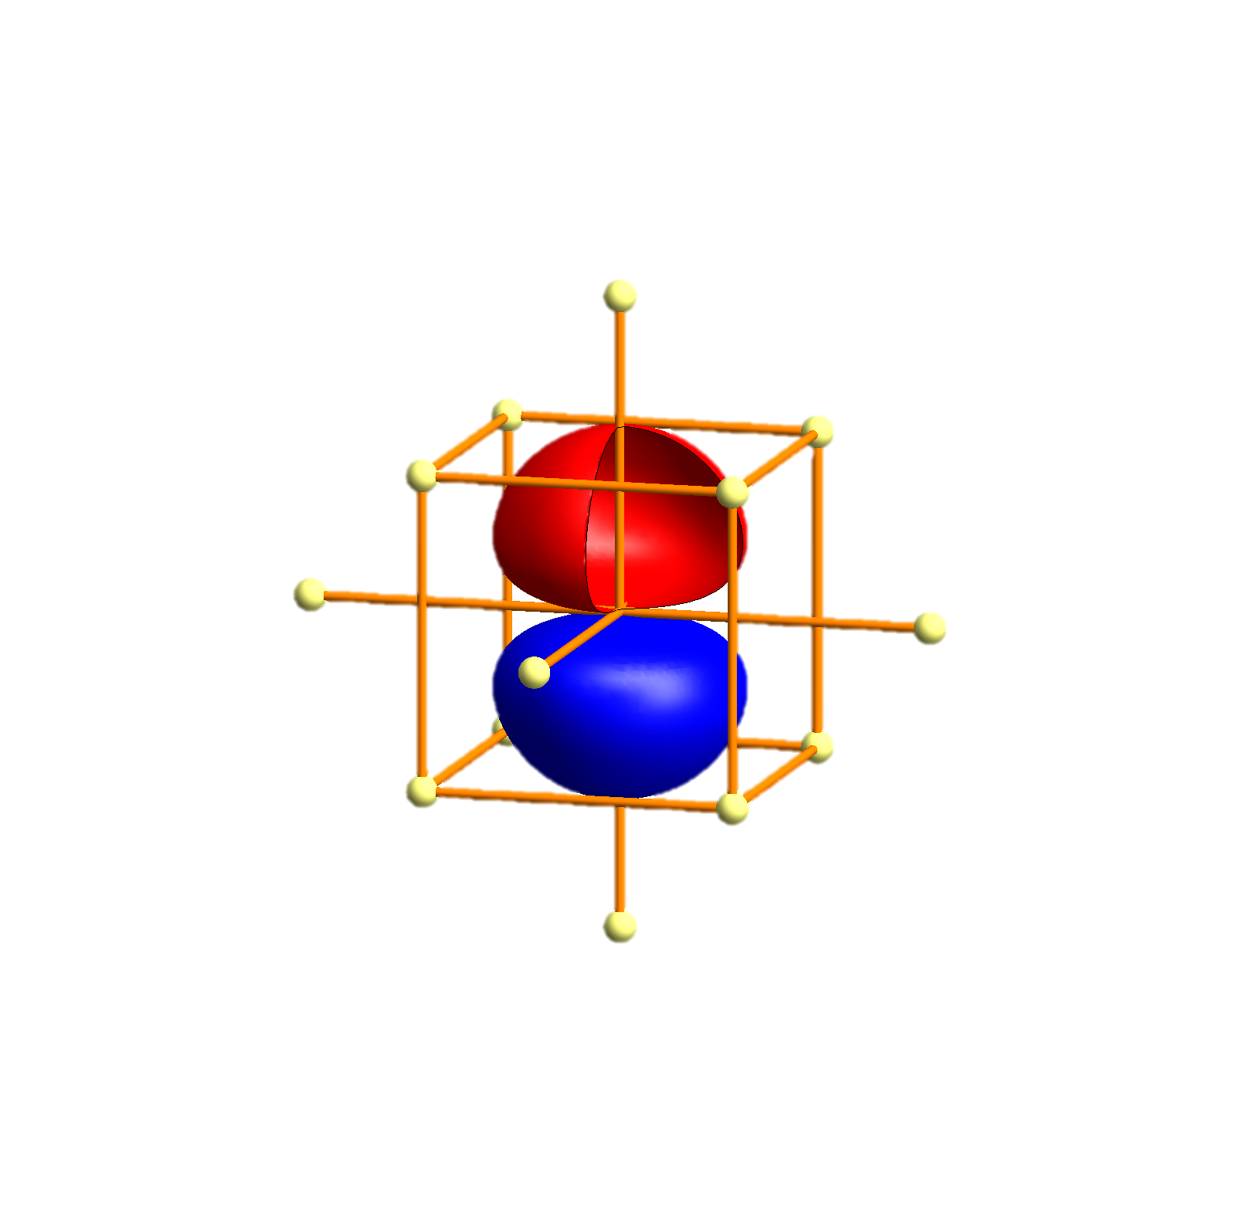
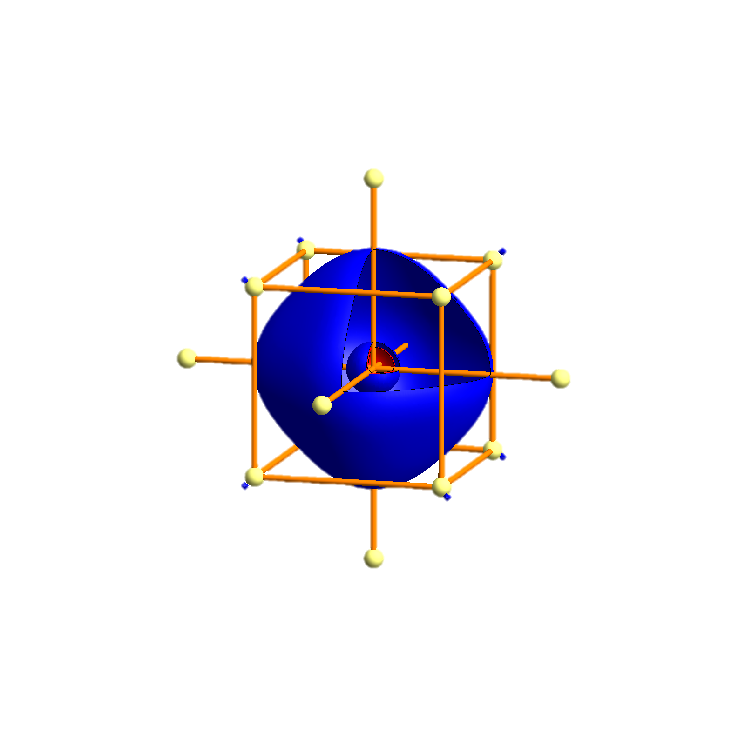
Li - Tigth binding description – atomic orbitals
p_{x}
p_{x}
p_{y}
p_{z}
s
s
P
Γ
P
H
P
Γ
P
H
P
Γ
P

Slide 91
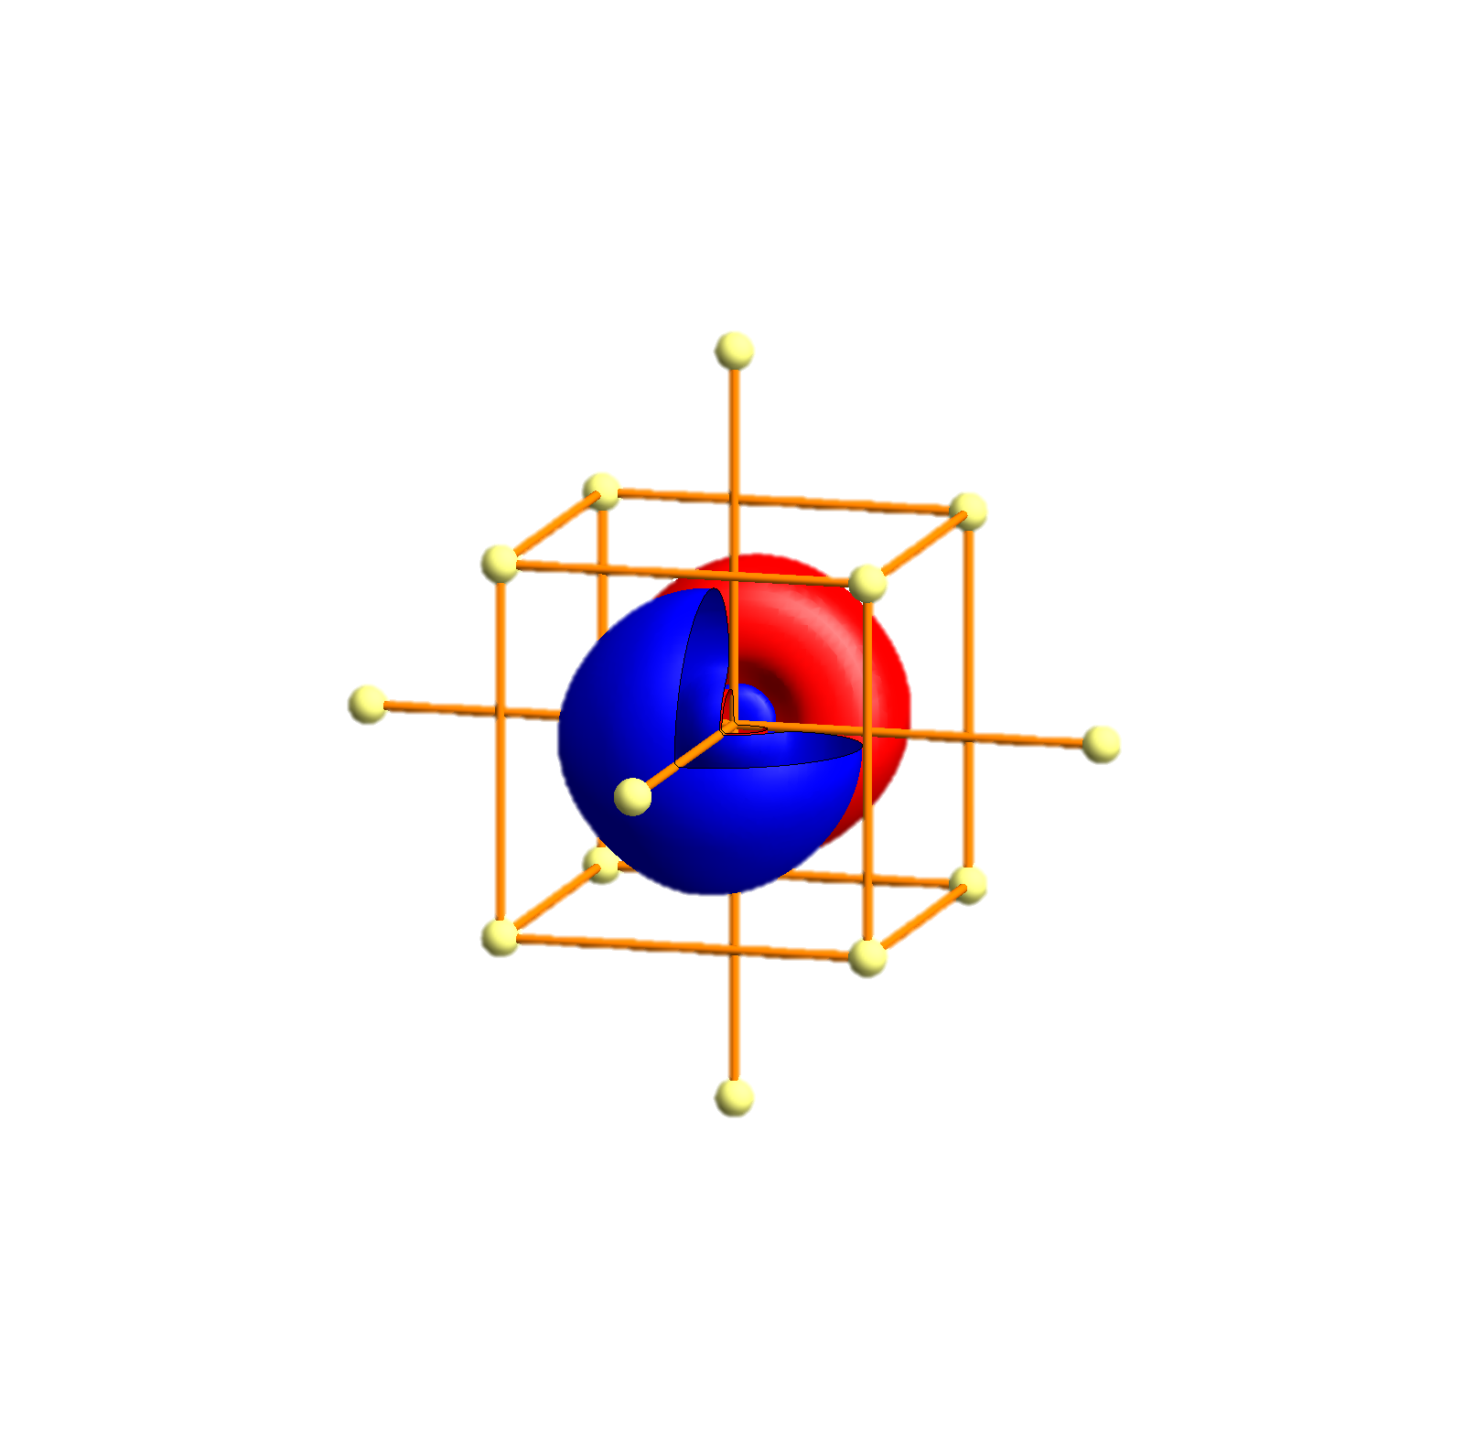
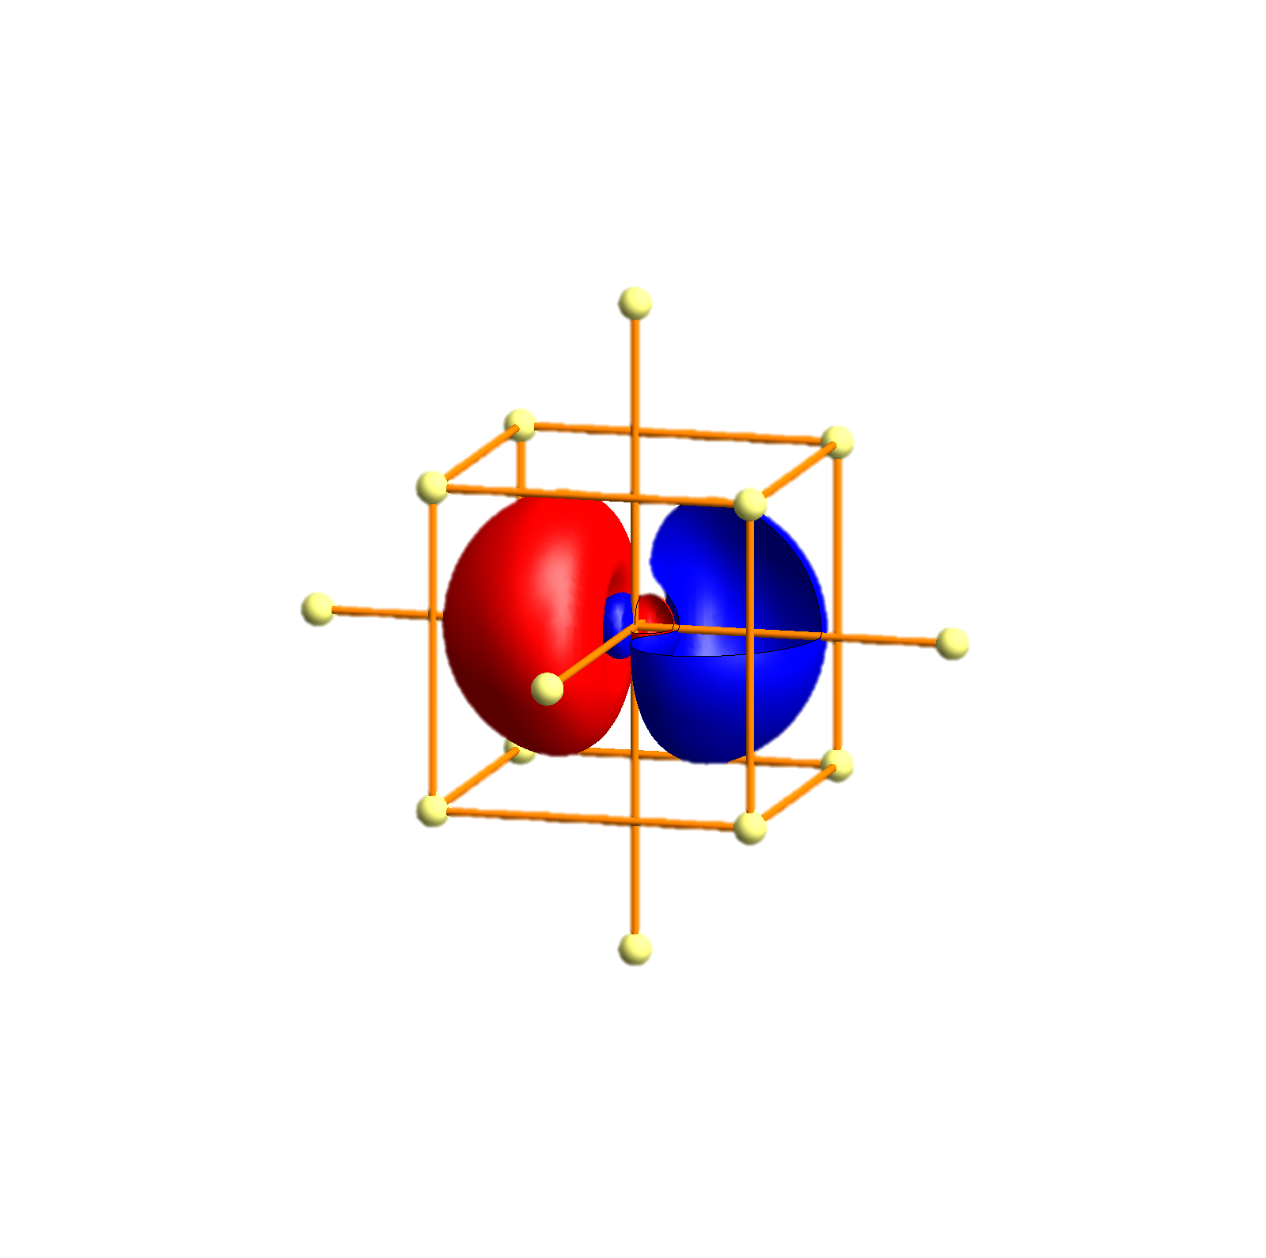
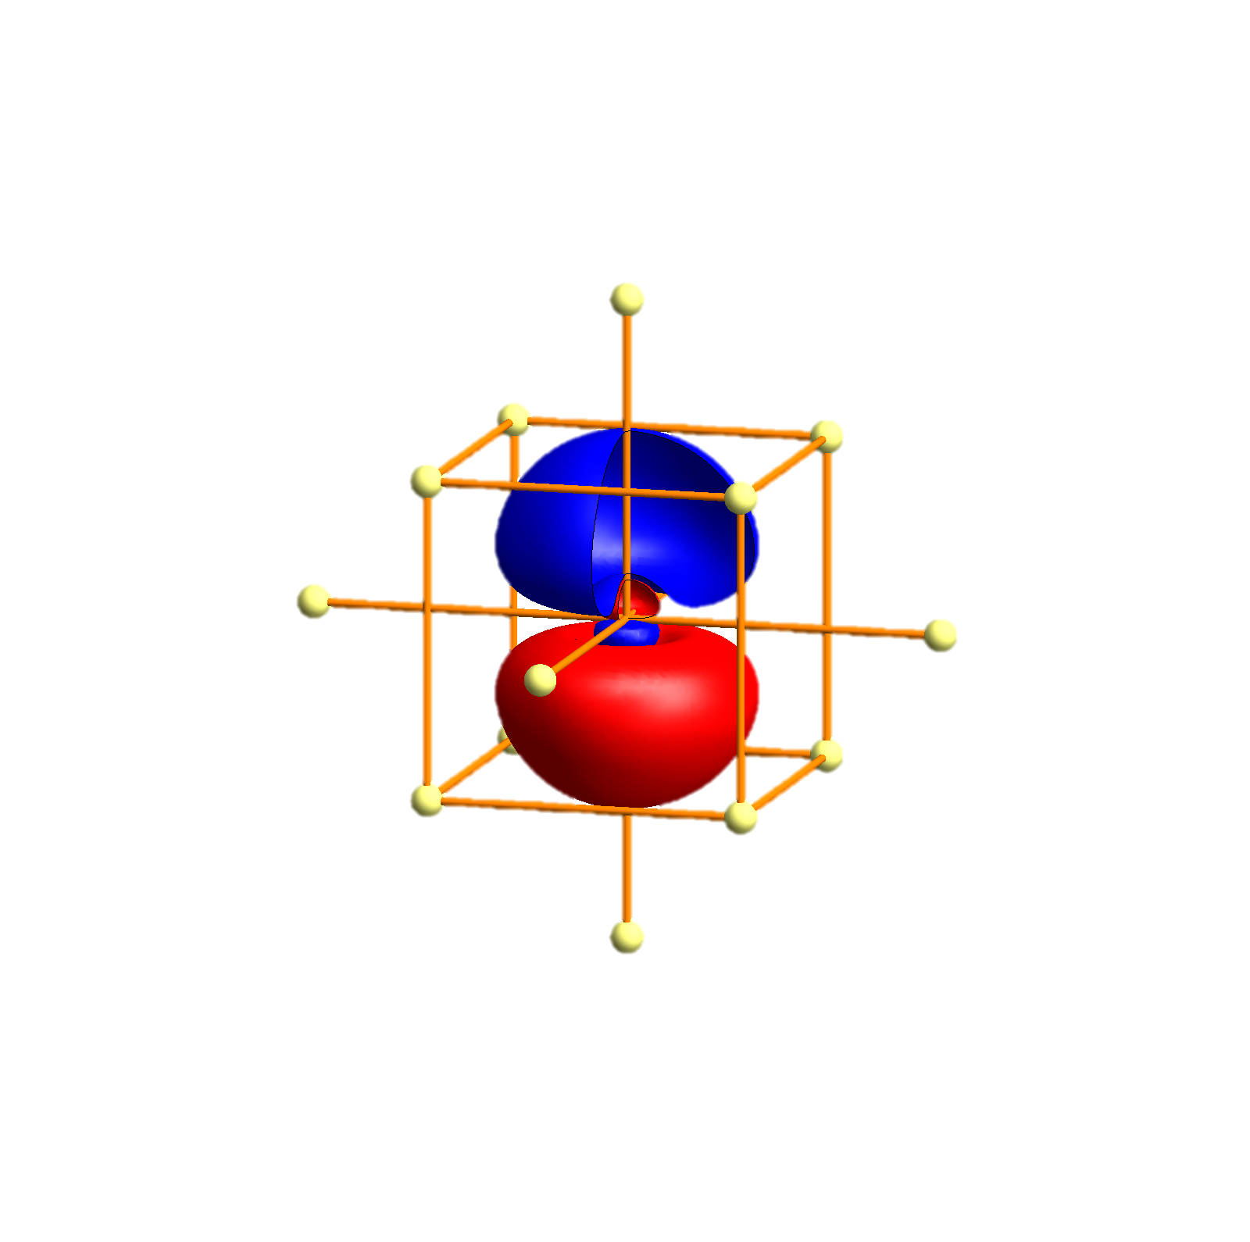
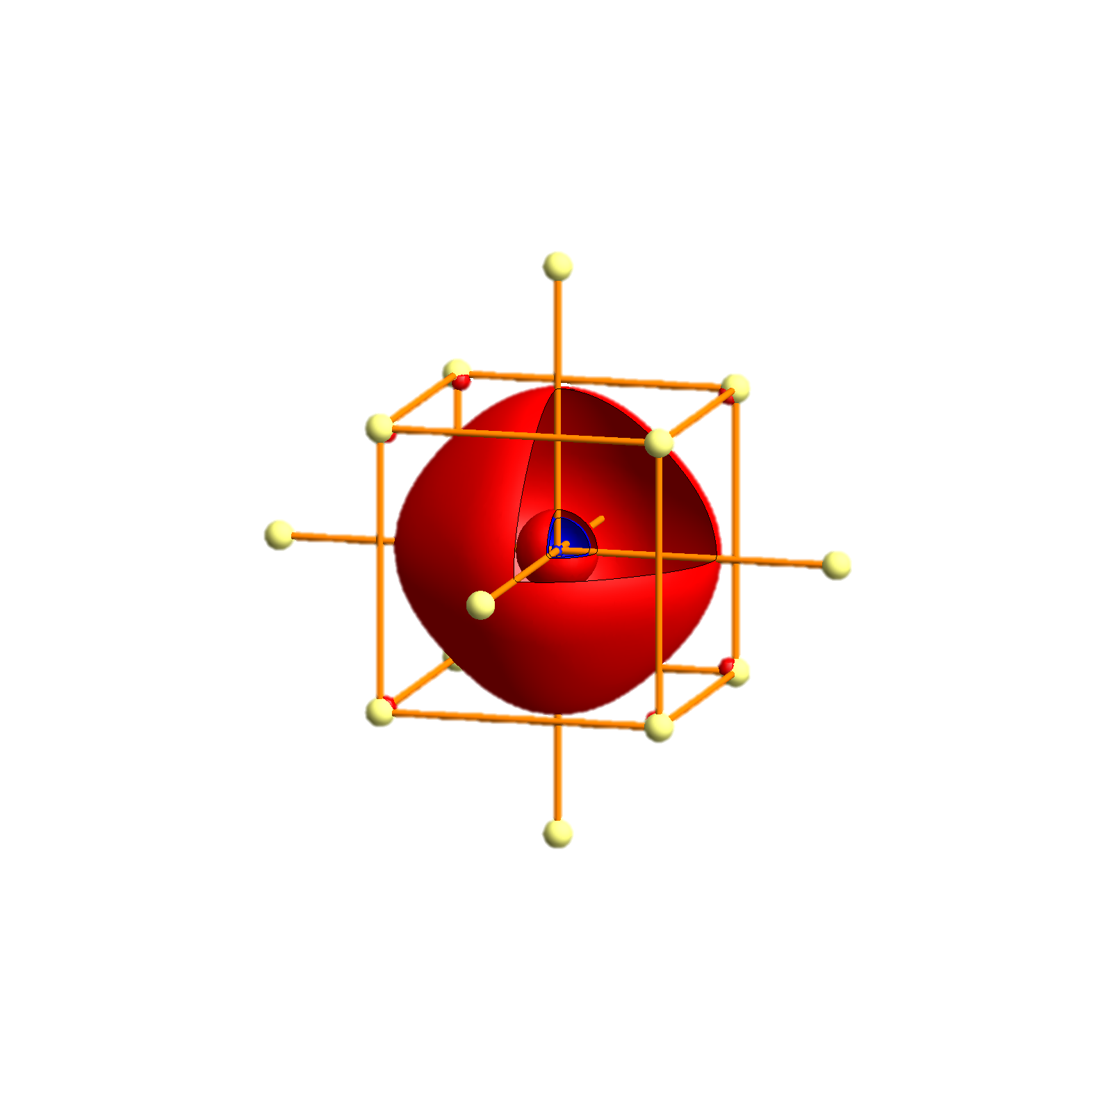
Na - Tigth binding description – atomic orbitals
p_{x}
p_{y}
p_{z}
s

Slide 92
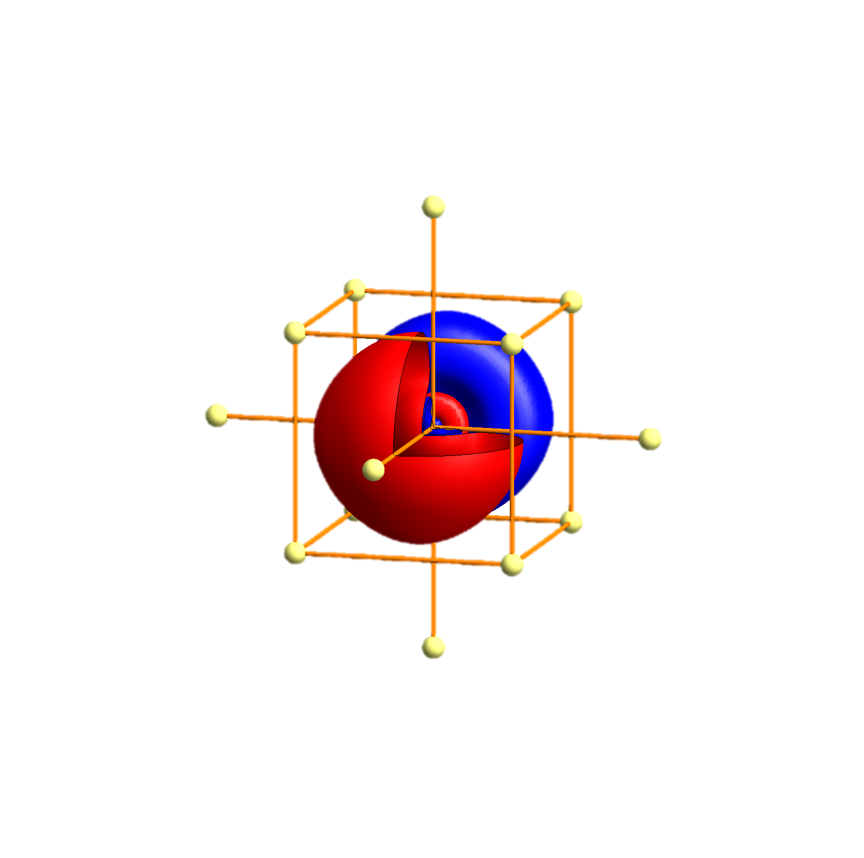
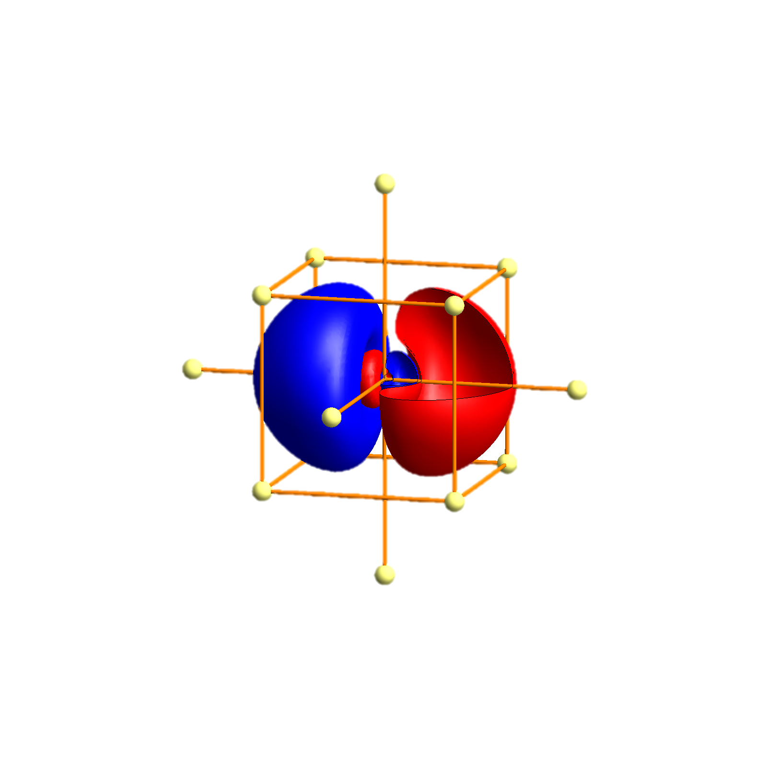
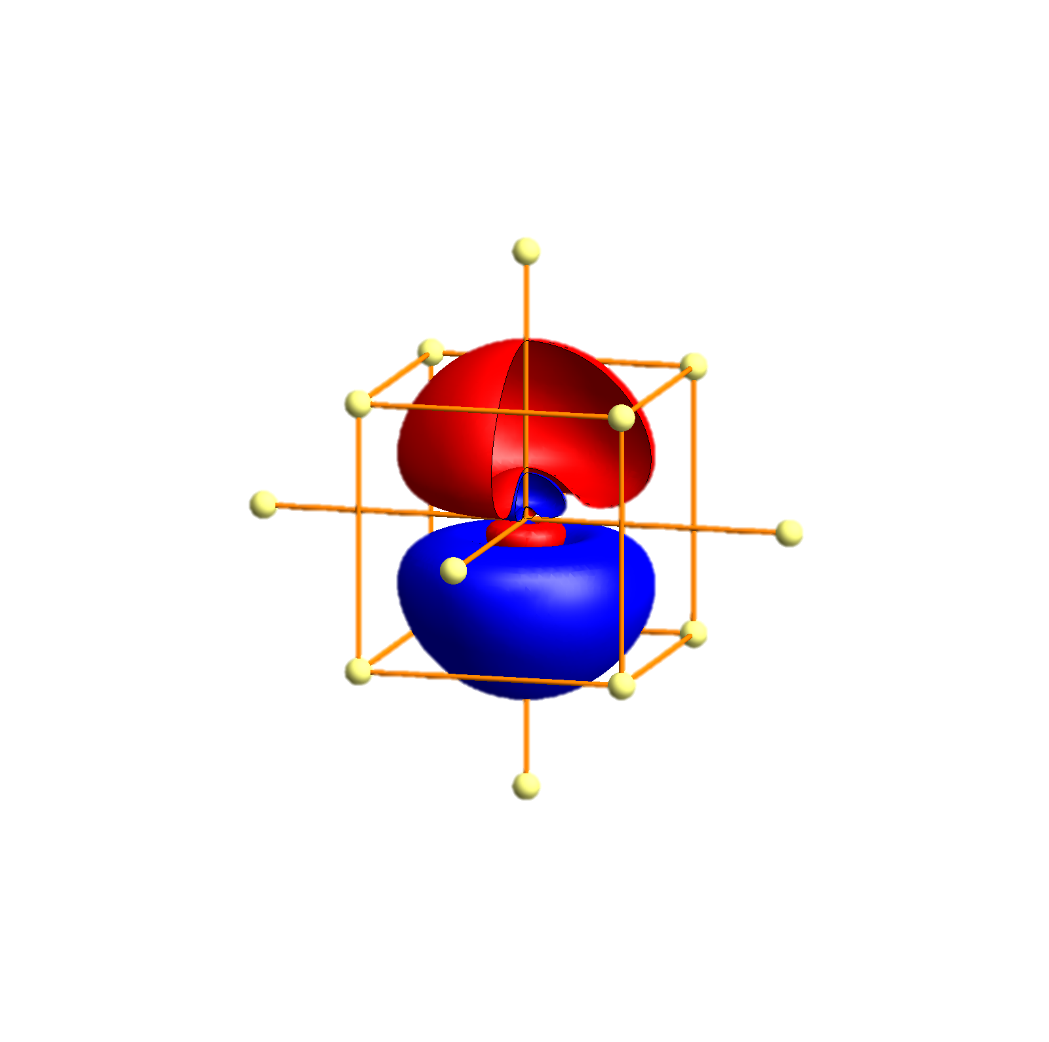
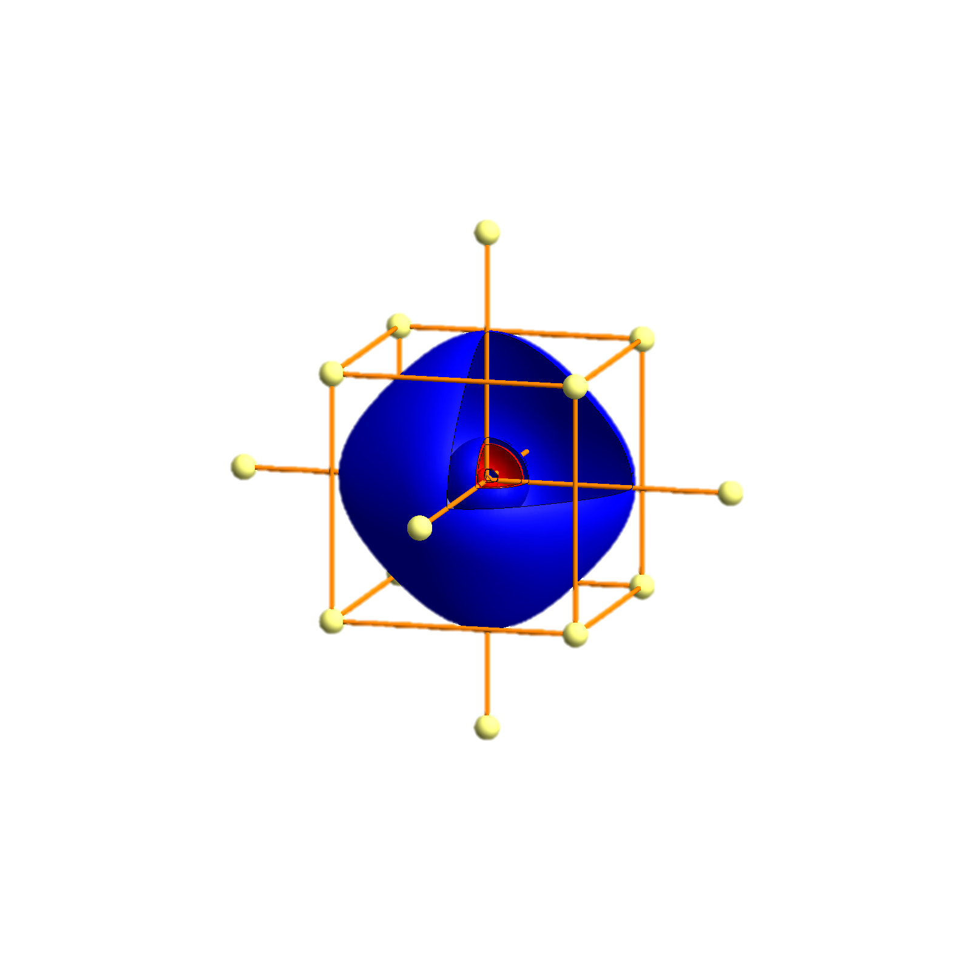
K- Tigth binding description – atomic orbitals
p_{x}
p_{y}
p_{z}
s
P
Γ
P
H
P
Γ
P
H
P
Γ
P

Slide 93
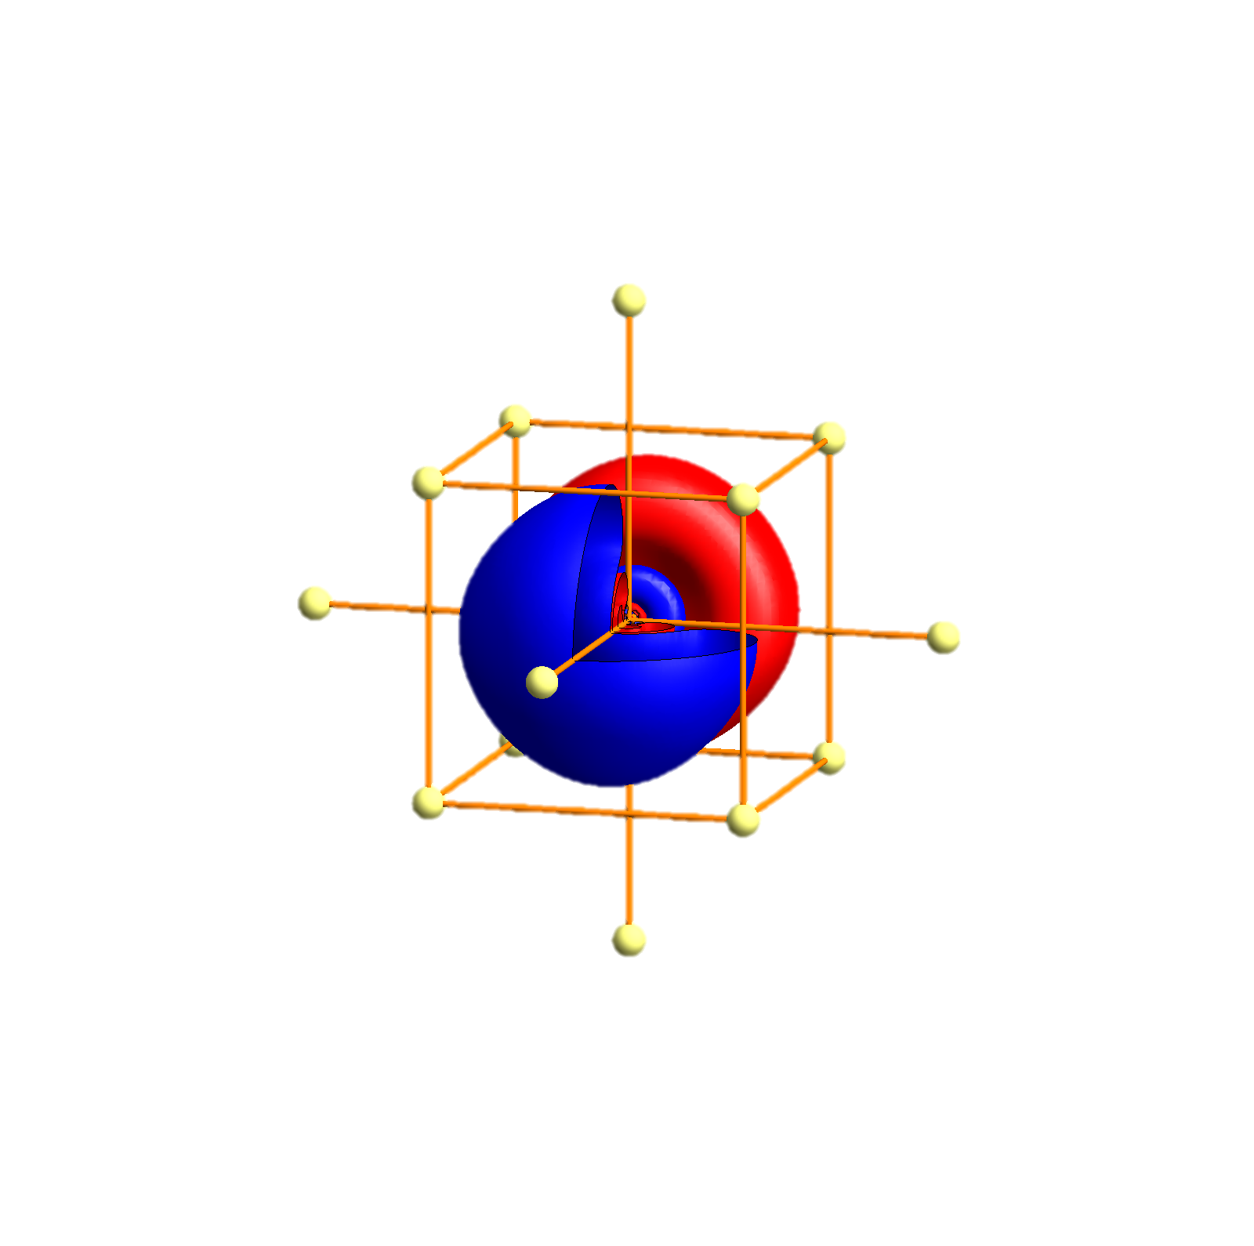
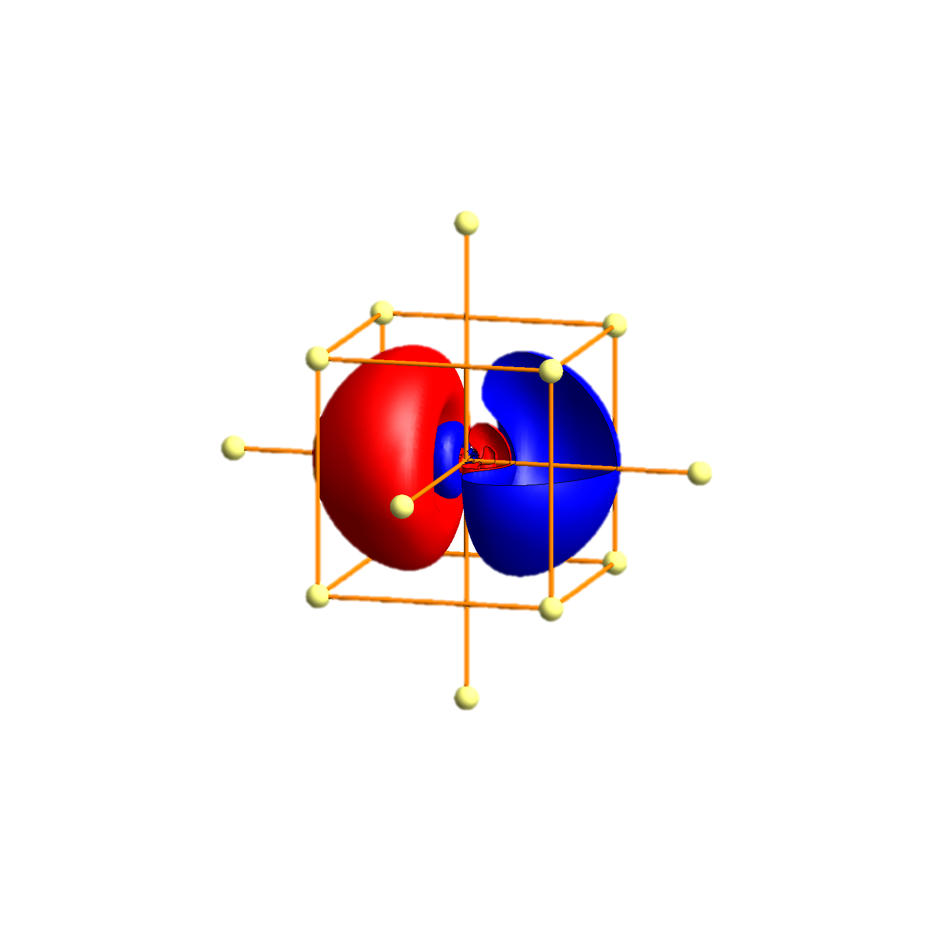
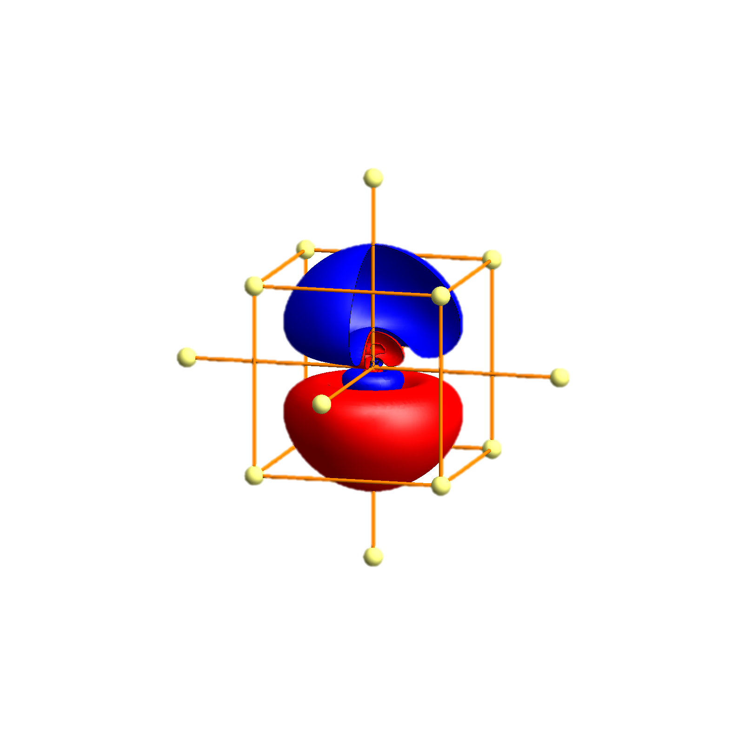
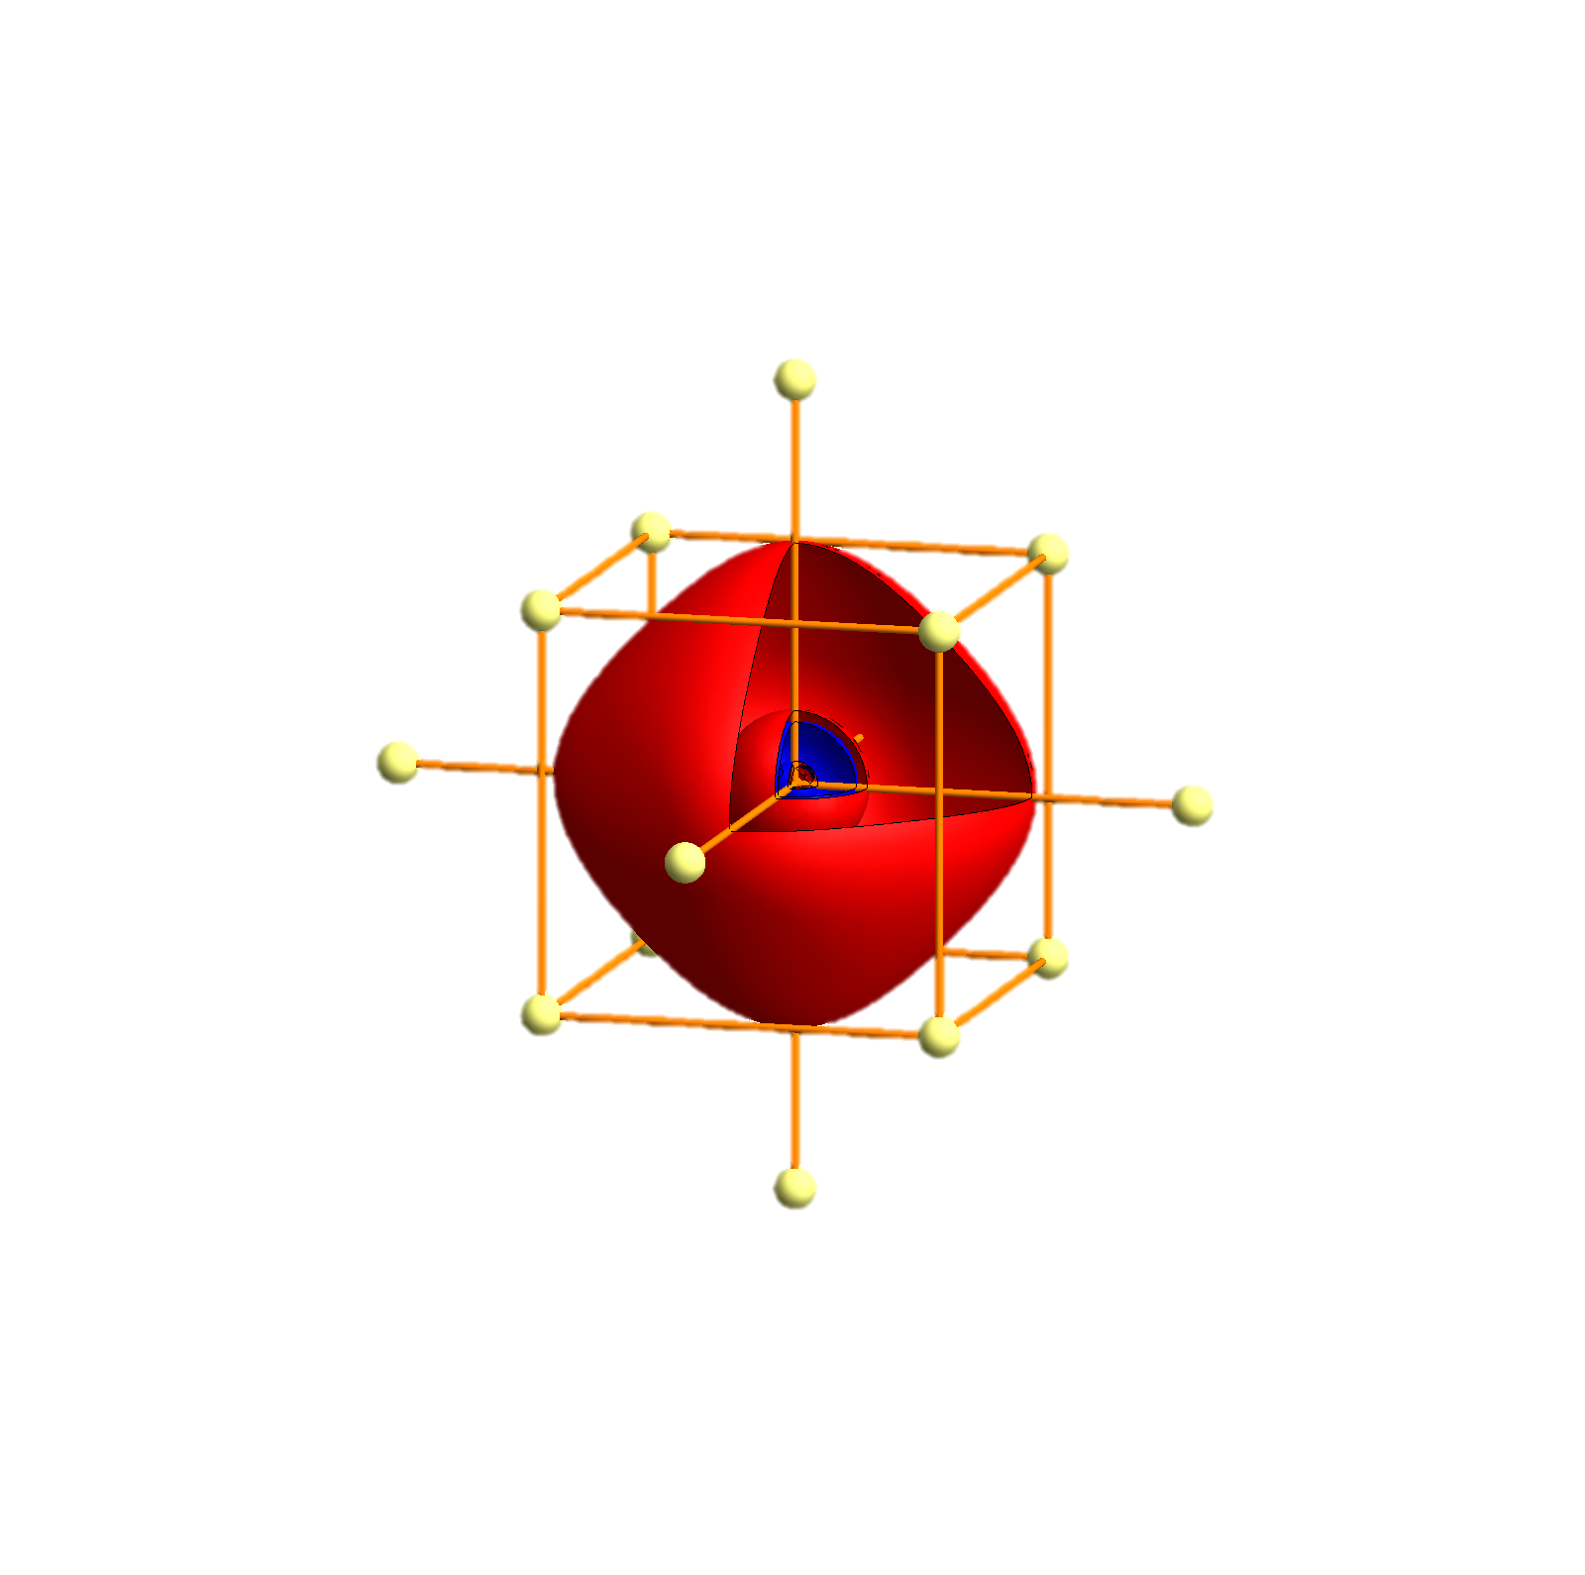
Rb - Tigth binding description – atomic orbitals
p_{x}
p_{y}
p_{z}
s
P
Γ
P
H
P
Γ
P
H
P
Γ
P

Slide 94


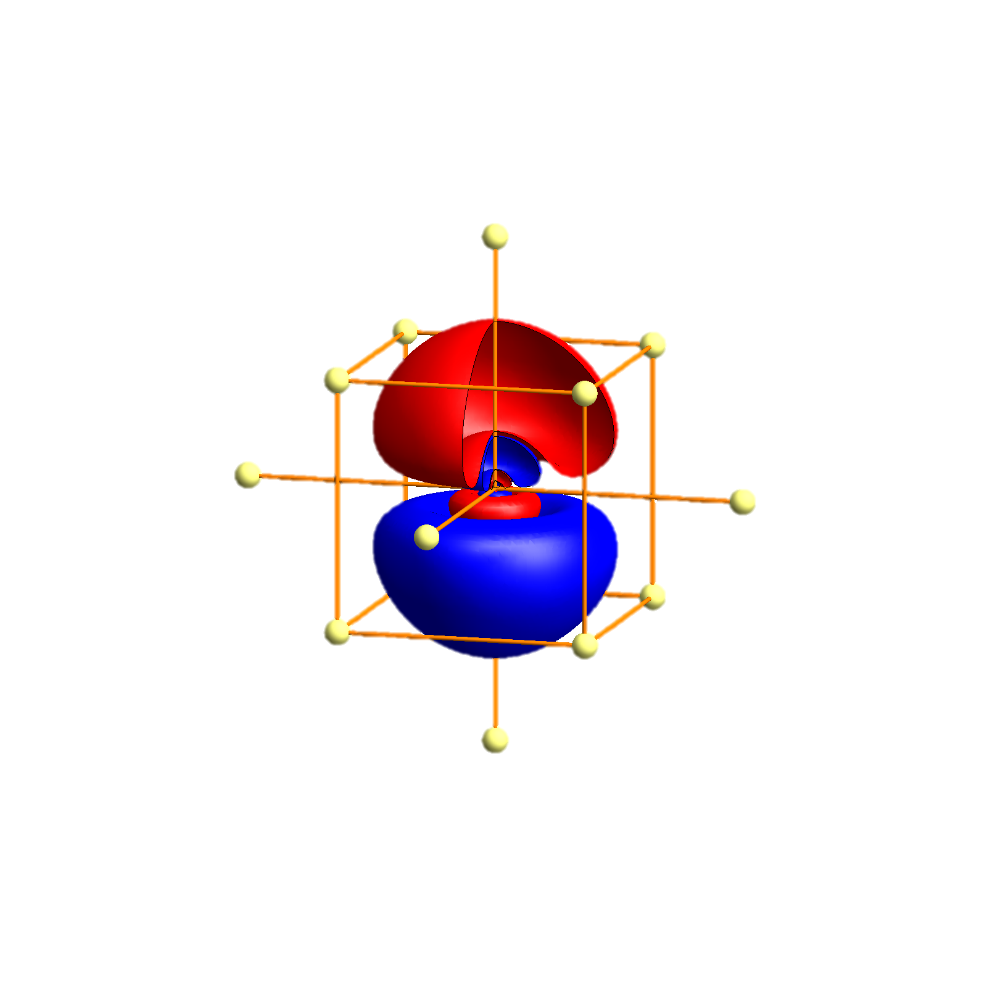
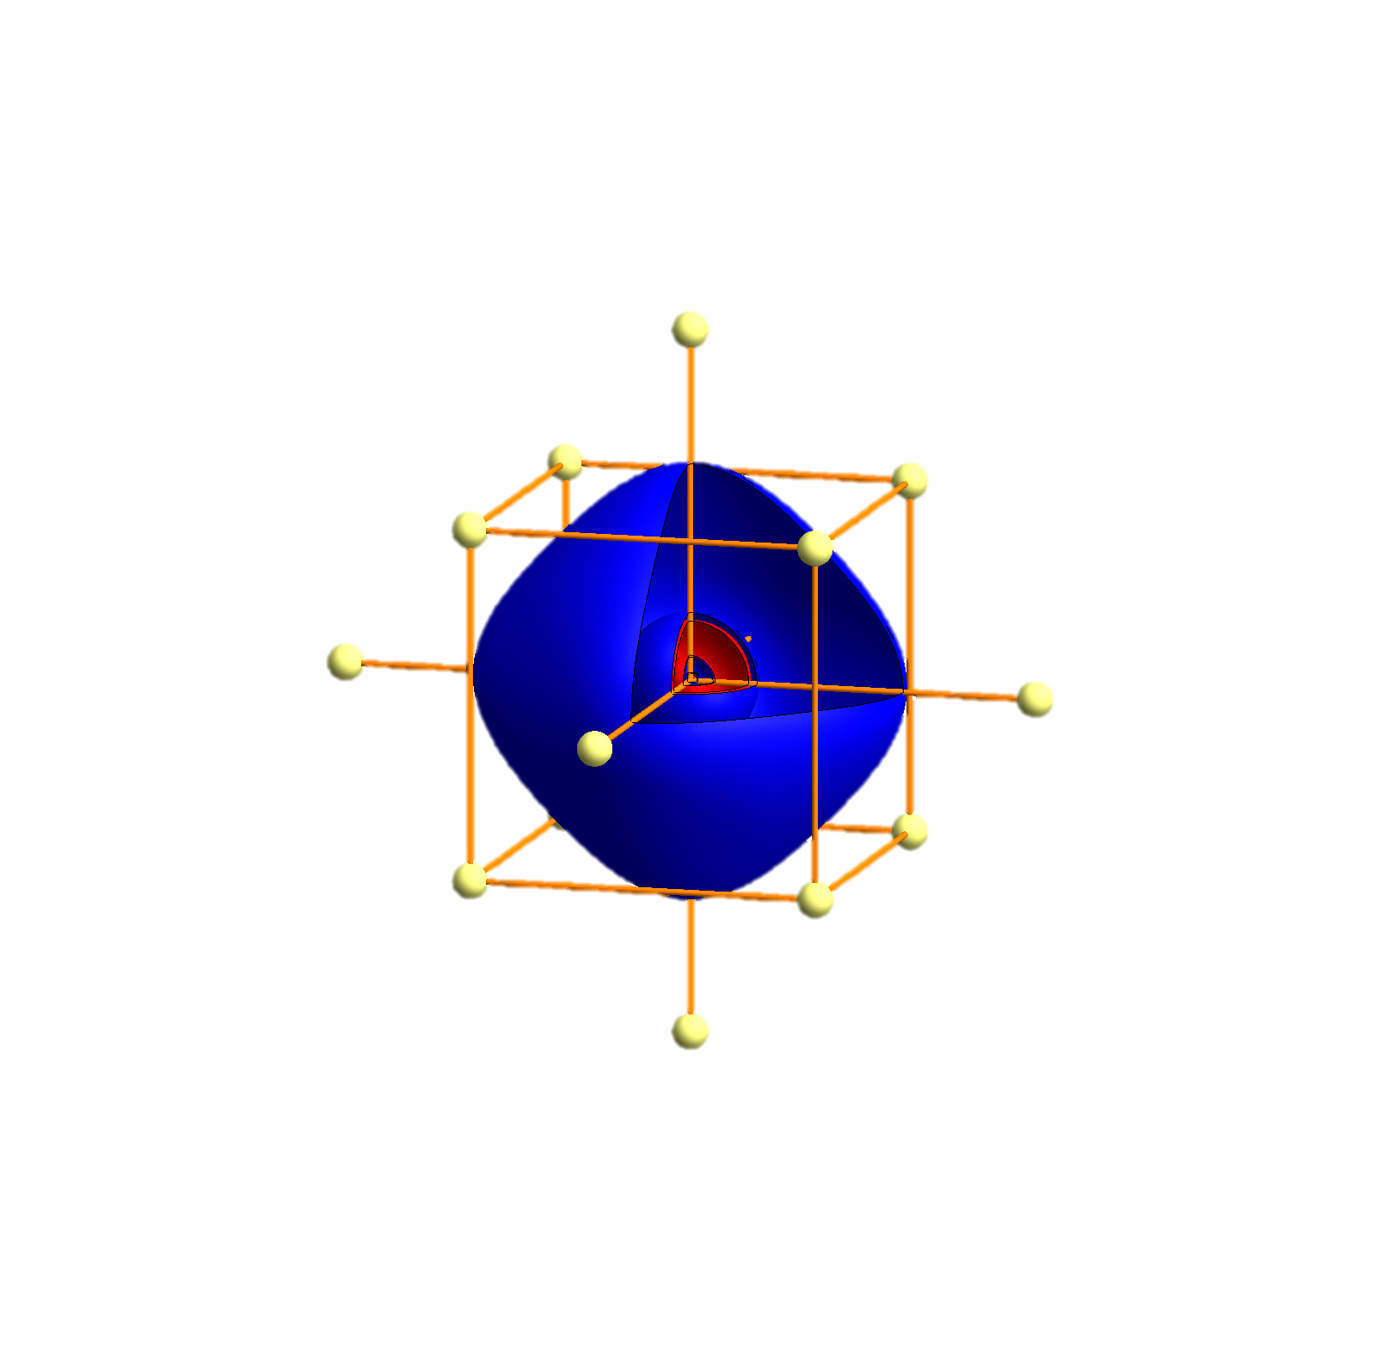
Cs - Tigth binding description – atomic orbitals
p_{x}
p_{y}
p_{z}
s
P
Γ
P
H
P
Γ
P
H
P
Γ
P

Slide 95


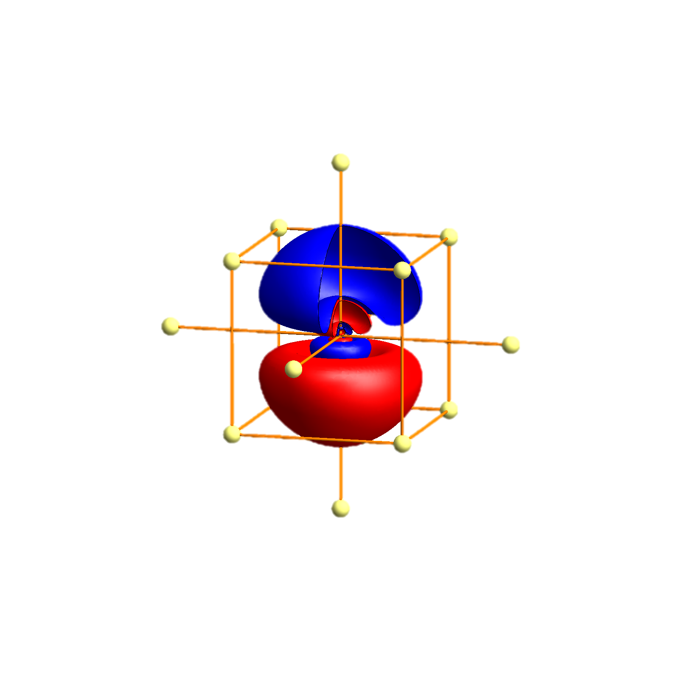
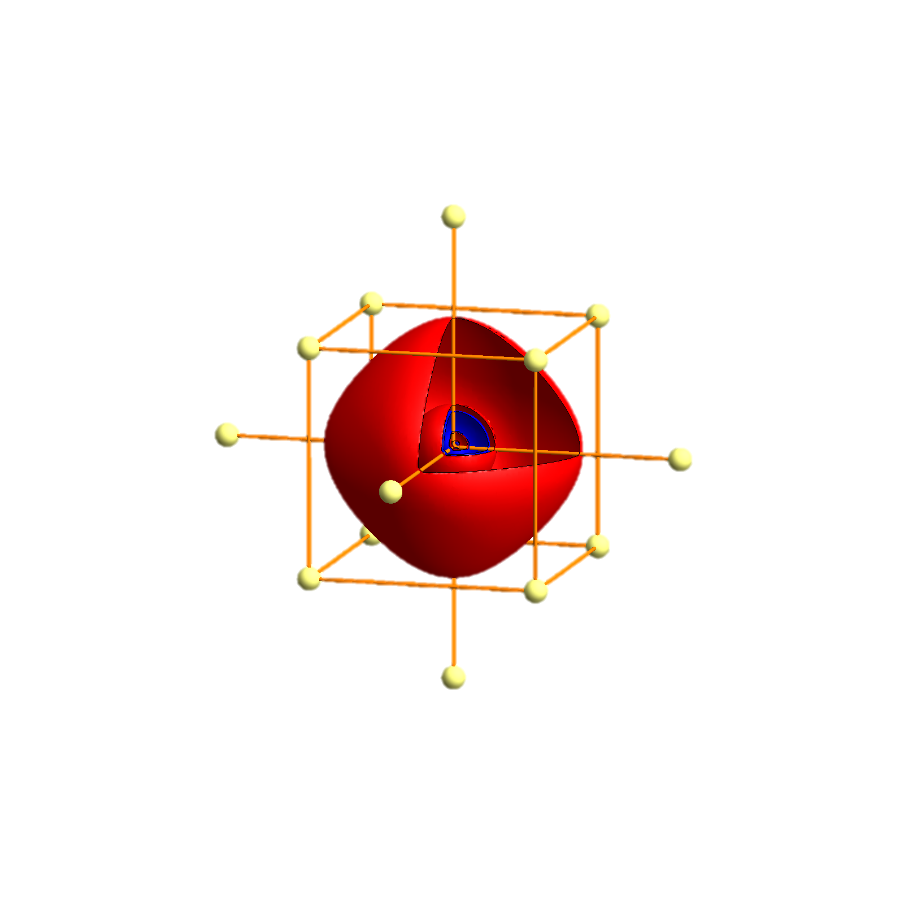
Fr - Tigth binding description – atomic orbitals
p_{x}
p_{y}
p_{z}
s
P
Γ
P
H
P
Γ
P
H
P
Γ
P

Slide 97



A possible realization of a Kitaev model?
In most materials the magnetic interaction is given as
Theoretically one can dream up models whereby the spin direction is related to the hopping direction. In a Kitaev model the x-component of the spin couples in the x direction, the y component in the y direction, the z component in the z direction.
Such exotic models can have all kind of exotic symmetry protected, topological excited state that are thus long lived and can be used for (quantum) spin-tronics.
But these are mathematical models, not descriptions of a material.

Slide 98
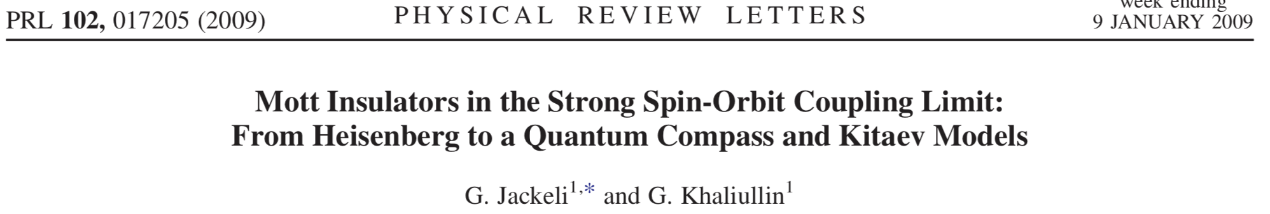
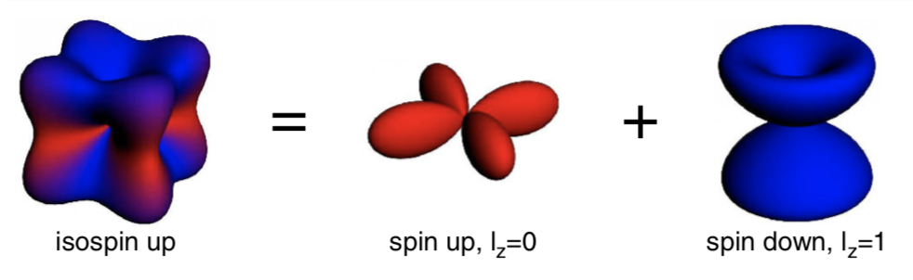
A possible realization of a Kitaev model?
Ir d⁵

Slide 99
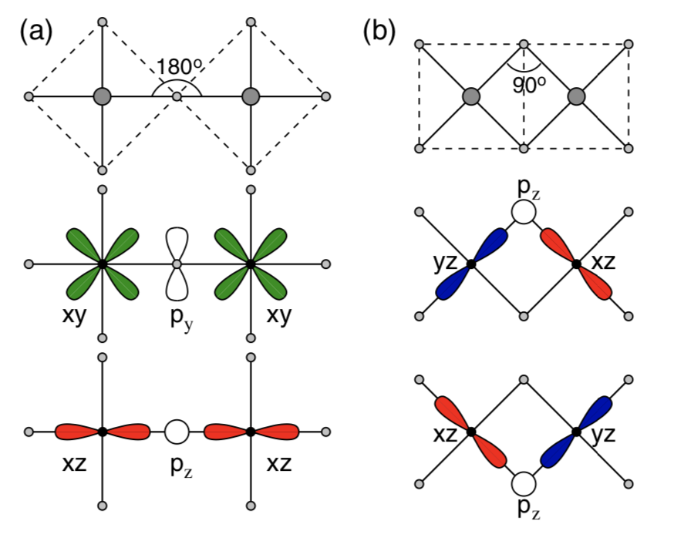
A possible realization of a Kitaev model?

Slide 100
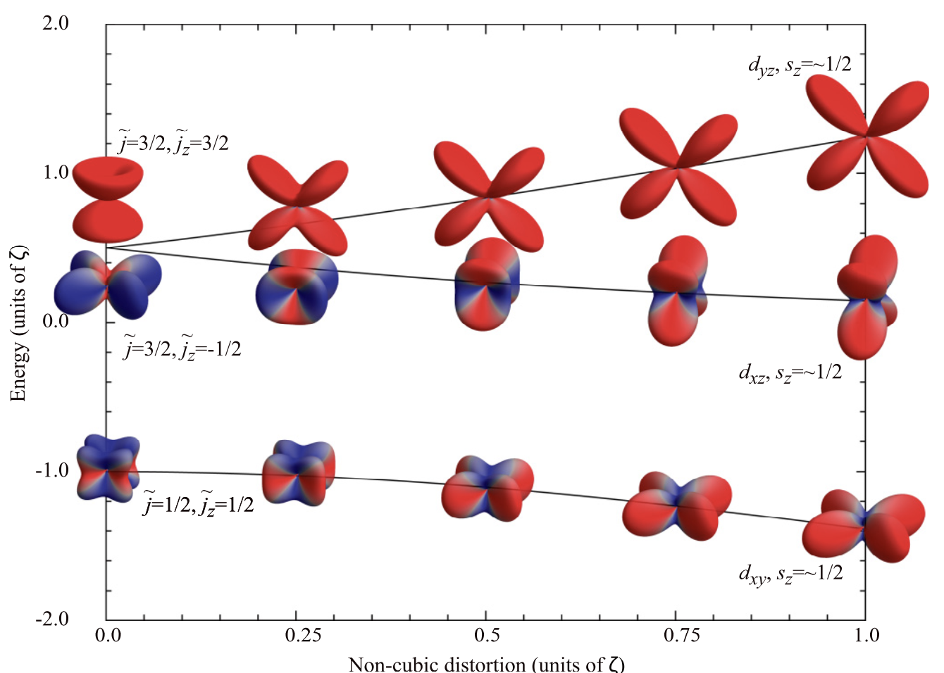
The system needs to be cubic

Slide 101
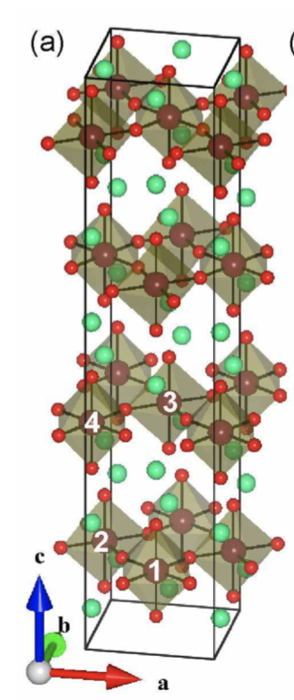
Test the size of the non-cubic distortions in Sr₂IrO₄

Slide 102
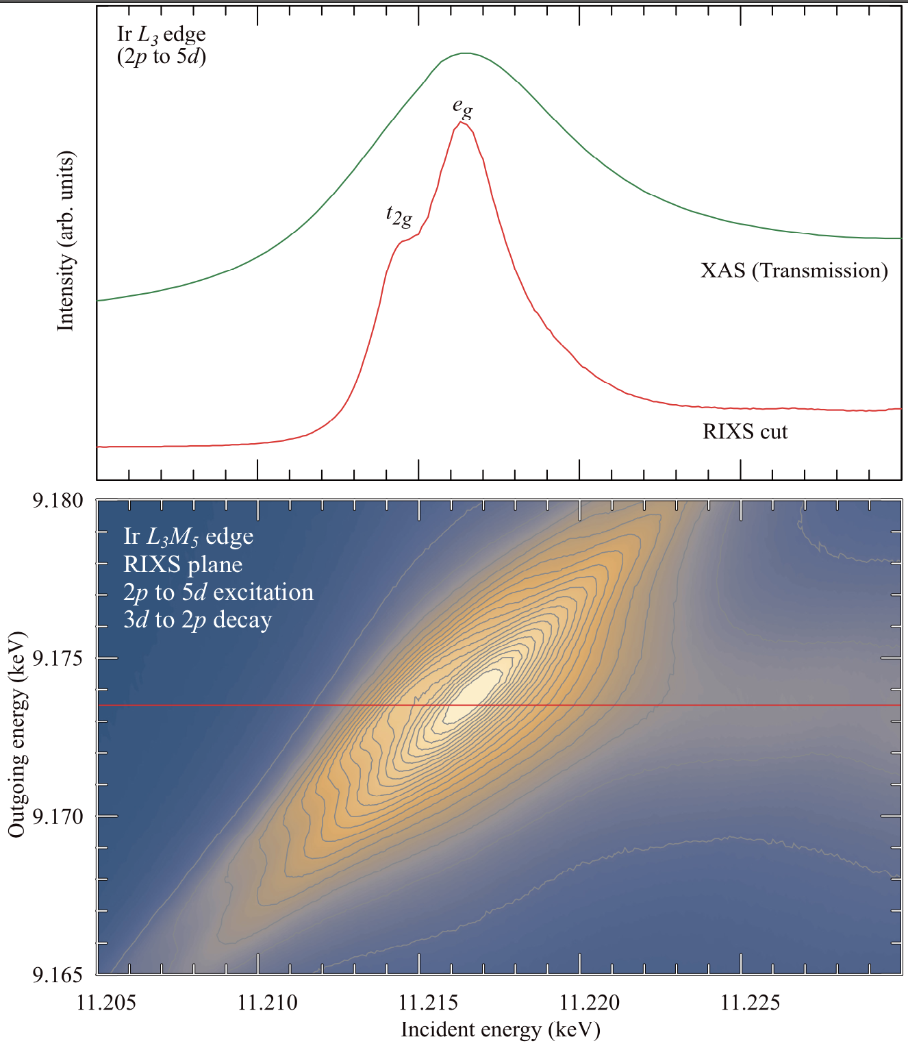
L₃M₄ edge (2p – 5d, 3d – 2p) in Sr₂IrO₄

Slide 103
L₃M₄ edge in Sr₂IrO₄ – resolution enhanced XAS ?

Slide 104
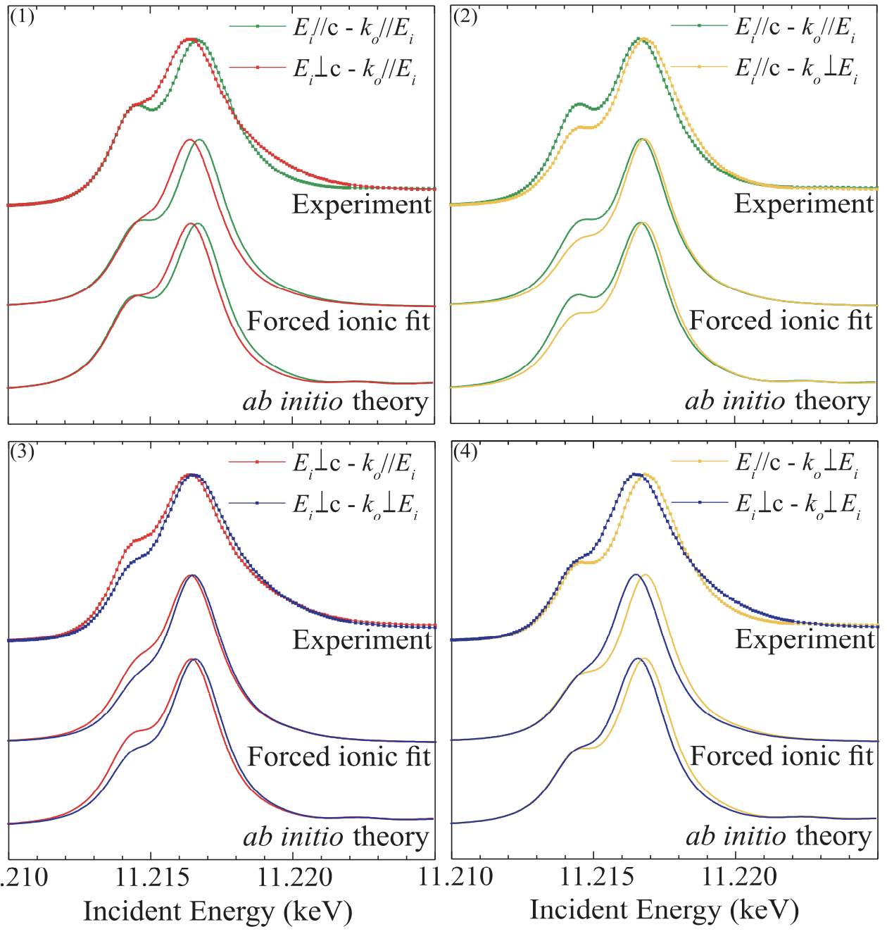
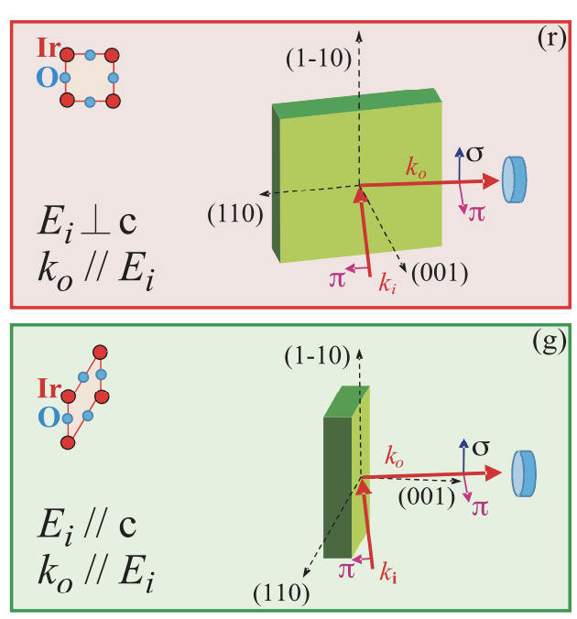

Different measurement geometries yield different spectra

Slide 105
Different measurement geometries yield different spectra

Slide 106
Different measurement geometries yield different spectra

Slide 107
Fit the experiment to a crystal-field theory calculation

Slide 108
Fit the experiment to a crystal-field theory calculation
Delta eg = ~ 0.5 eV
Delta t2g = ~ 150 meV
Spin-orbit atomic value ~ 0.5 eV
Slater integrals reduced to 20% of their atomic value

Slide 109

Electronic structure of Sr₂IrO₄

Slide 110
Electronic structure of Sr₂IrO₄

Slide 111
DFT based theory compared to experiment

Slide 112

Electronic structure of Sr₂IrO₄

Slide 113

Sr₂IrO₄ – long range anisotropic hopping on t_{2g} basis

Slide 115
Double counting

Slide 117

The non-spherical part – effective spurious crystal fields

Slide 119
Creating a cluster Hamiltonian

